Slide 1
Leading from our Gifts and Charisms

Slide 2
Pastoral
Encouragement
Helps
Hospitality
Mercy
Pastoring
Communication
Evangelism
Prophecy
Teaching
Organizational
Administration
Giving
Leadership
Service
Lifestyle or Healing
Celibacy
Faith
Missionary
Voluntary Poverty
Healing
Intercessory Prayer
Understanding
Discernment of Spirits
Knowledge
Wisdom
Creative
Craftsmanship
Music
Writing

Slide 3
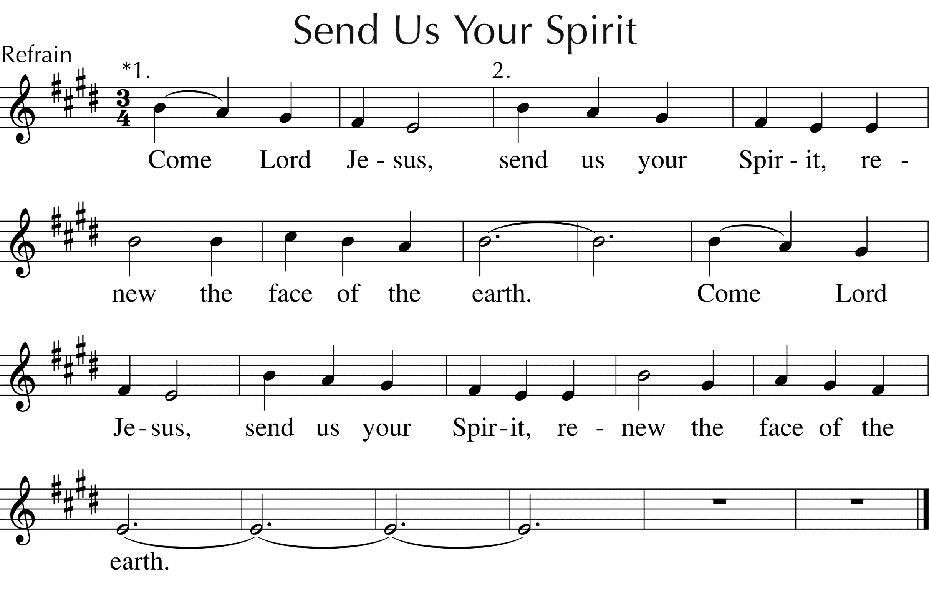
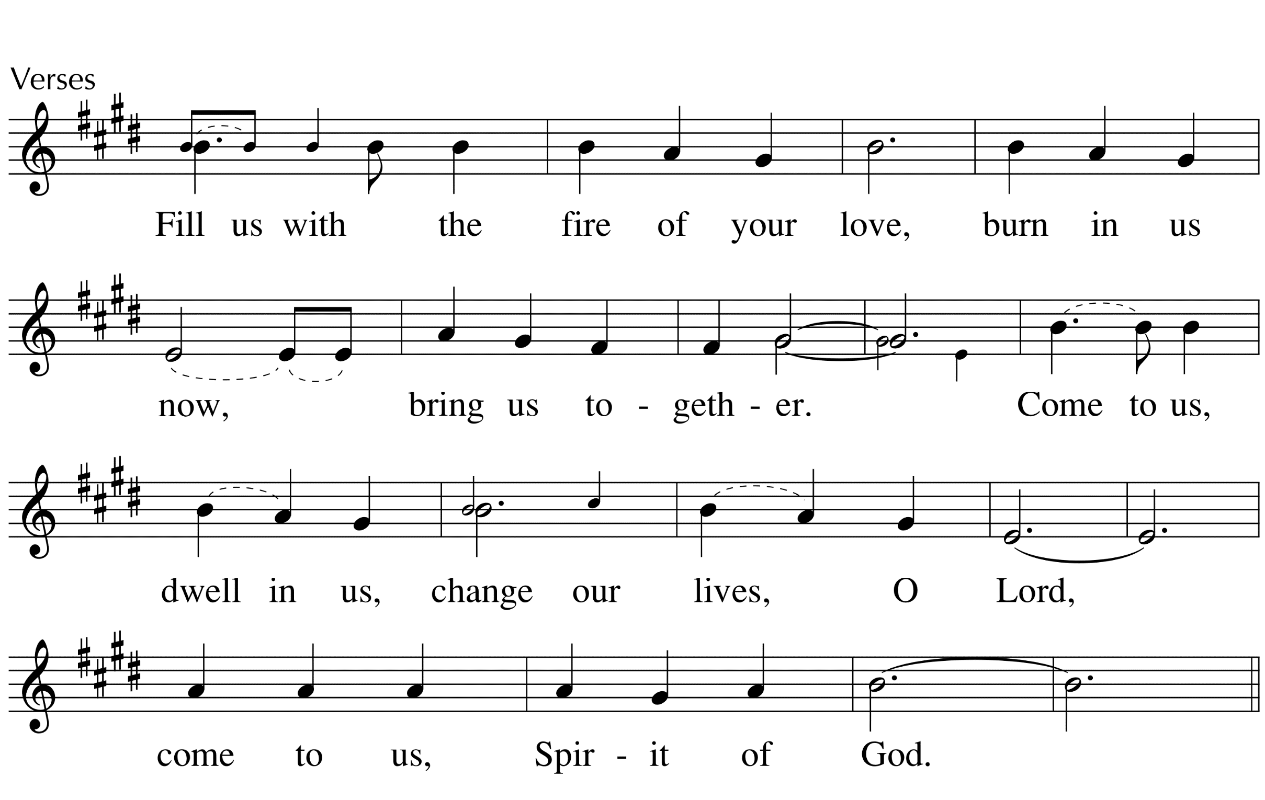

Slide 4


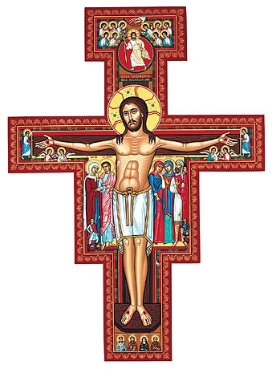

“… for God did not give us a spirit of cowardice …”
“Stir into flame the gift of God that you have…”

Slide 5
Leading from our Gifts and Charisms

Slide 6
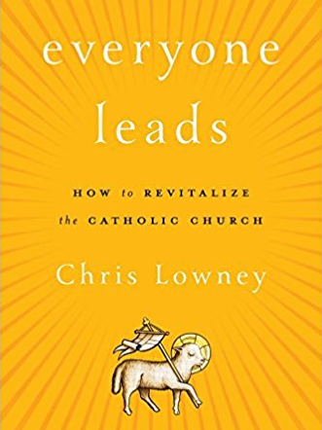

Leading from our Gifts means…
NOT Leading from Position or Power
The lay faithful are by baptism made one body with Christ and are constituted among the People of God;
they are in their own way made sharers in the priestly, prophetical, and kingly functions of Christ.
LG 31, CCC 871

Slide 7



Leading from our Gifts means…
NOT Leading from Position or Power
Leadership is
about influence,
not control.

Slide 8
Leading from our Gifts means…
Leading with influence, not position or power
Influence through clear direction and warm connection.
Take initiative and lead UP as you go.
Build an “oasis of excellence.”
What are you waiting for?

Slide 9


Leading from our Gifts means…
Using ALL our gifts
or skill at applying
MANY gifts to leadership?
THE gift of leadership?
Extroverted
Evangelization
Introverted
Evangelization

Slide 10
Leading from our Gifts means…
Using ALL our gifts
Extroverted
Leadership
Introverted
Leadership

Slide 11
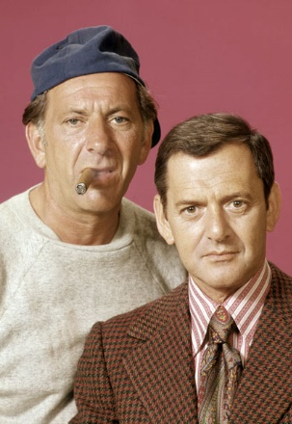

Leading from our Gifts means…
Using ALL our gifts
Pastoral
Communication
Organization
Healing
Understanding
Creative
New Cluster

Slide 12
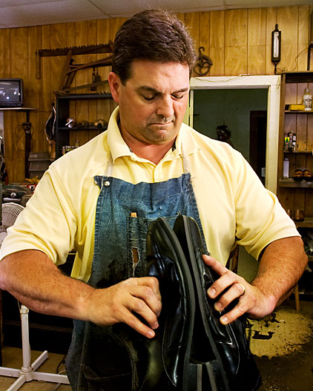
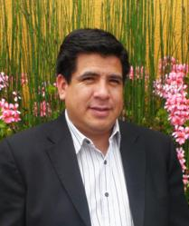
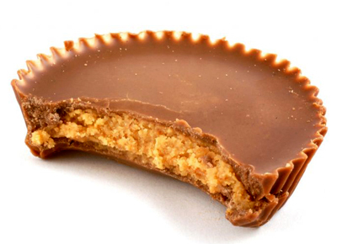
Leading from our Gifts means…
Leading collaboratively
My gifts and your gifts were meant for each other.

Slide 13
Leading from our Gifts means…
Growing our gifts
Fixed Mindset | Growth Mindset
Talent is set You either have it or you don’t | Talent is grown Talent can be increased over time
Challenges are threatening If I fail, it means I’m not talented | Challenges are welcome If I fail, I will learn something
Gives up I will switch to something I’m good at | Keeps trying If I work hard, I will get better

Slide 14

Leading from our Gifts means…
Growing our gifts
Talent
x investment
Strength
2
x 4
= 8
5
x 1
= 5
4
x 4
= 16

Slide 15
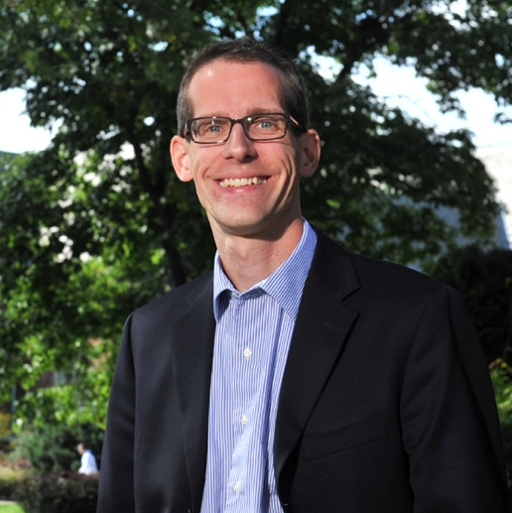
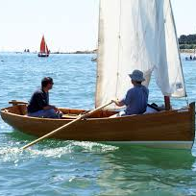
Leading from our Gifts means…
Growing our gifts
Talent
+ SPIRIT
cHARISM
+ INVESTMENT

Slide 16
Leading from our Gifts
What Growth Looks Like
“Everything can look like failure in the middle.”

Slide 17
Leading from our Gifts
What Growth Looks Like
Jesus calls his disciples
Jesus teaches his disciples
His disciples don’t get it
Jesus teaches some more
Jesus dies
Disciples are depressed & clueless
Pentecost – the Church rocks!

Slide 18
Leading from our Gifts means …
Leading with influence
Using ALL our gifts
Leading collaboratively
Growing our gifts

Slide 20

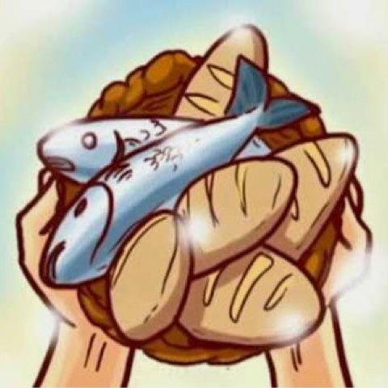
Leading from our Gifts

