Slide 1
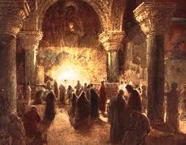
Session 2:
Early Christian Civil Wars
The problem of dissention and false teachings

Slide 2
Early Christian Civil Wars
Opening Remarks
The early civil wars in the Christian congregations were on two fronts:
Theological wars (Who is Christ?)
Leadership wars (Whose in charge?)
The civil wars appear to be largely personality-driven.
Most of the later NT letters deal with (reveal) the real growing pains of the early Church.

Slide 3
Early Christian Civil Wars
Questions for Theological Reflection
What are false teachings that you encounter in your ministry?
Are there civil wars occurring in your faith community? How do you choose sides?
What ‘civil wars’ are Catholics fighting today?

Slide 4
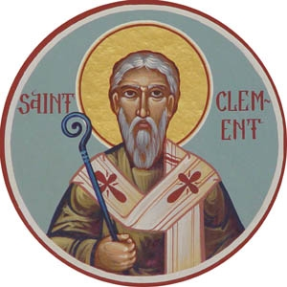
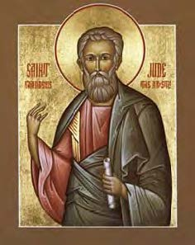
Early Christian Civil Wars
New Testament Sources:
The First Letter of John
The Second Letter of John
The Third Letter of John
The Letter of Jude
The Second Letter
of Peter
Apostolic Fathers Sources:
First Clement
Polycarp’s Epistle to the Philippians

Slide 5
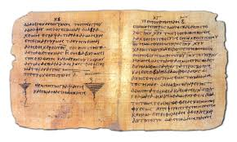
Early Christian Civil Wars
Setting the Context
1st & 2nd century Christian congregations
communicated almost exclusively
(in written form) by letters.
In fact, 21 of the 27 NT writings are “letters.”
NT and AF letters range in authorship from known authors (e.g., Paul’s 7 letters) to pseudonymous authors (e.g., Jude, 1 and 2 Peter) to anonymous authors (e.g., First John, Hebrews).
The nine later NT writings (8 of which are “letters”) share a common concern about dissenters and false teachers.
.

Slide 6
Early Christian Civil Wars
Historical Context of the Sources

Slide 7
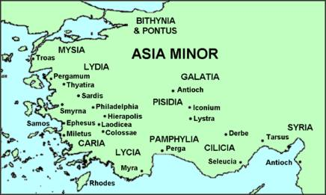
The historical context of 1 John
1,2, and 3 John were all addressed to the Johannine community, a church(es) likely located in Asia Minor, possibly Ephesus.
The author of First John is unknown. He never identified himself
in the letter.
It was composed
between 90-95 CE.

Slide 8
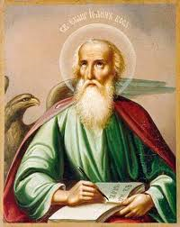
The historical context of 2 John
Second John was written by “the Elder” (presumably a leader among the Johannine churches) to “the chosen Lady and her children” (a specific Johannine congregation).
Likely composed between
90-95 CE somewhere in
Asia Minor.
Second John is only 13 verses.
The shortest NT writing.

Slide 9
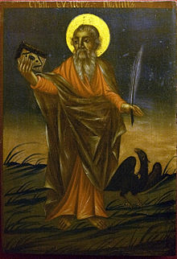
The historical context of 3 John
Third John is another written by “the elder” of the Johannine community and this time addressed to a specific person, Gaius (a likely leader of the one of the Johannine churches).
Composed between 90-95 CE in Asia Minor.
Third John is only 15 verses.
The exact order of composition
of 1, 2 and 3 John in unknown.

Slide 10
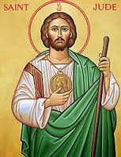
The historical context of Jude
Very little is known about the historical setting of the Letter of Jude.
We do not know the author, audience, or place of composition.
Scholars theorize it was written between 100-140 CE, given its internal evidence.
Its attribution to “Jude,” a “brother”
of Jesus is most interesting.
(see Mark 6:3; Matt 13:54).

Slide 11

The historical context of 2 Peter
Second Peter is equally perplexing as Jude
in terms of its historical setting.
We do not know the author, audience or place
of composition.
The author clearly intends to portray himself
as Peter the apostle who made a final statement prior to his death (2 Pet 1:1, 13-15).
It is clearly dependent upon the Letter of James – see the strong parallel of content and vocabulary between Jude 4-18 and 2 Pet 2:1-3:3. So, the date of composition is sometime after Jude.
Scholars consider Second Peter the last written document of the New Testament, written as late as 140 CE.

Slide 12
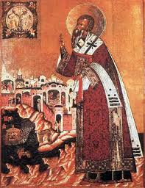
The historical context of 1 Clement
Clement was the third bishop of Rome but few scholars today believe he authored this letter.
It is a letter written by the (unidentified) leaders in the church of Rome to the leaders of
the church in Corinth.
It was written from Rome,
probably very near the end
of the 1st century CE.

Slide 13
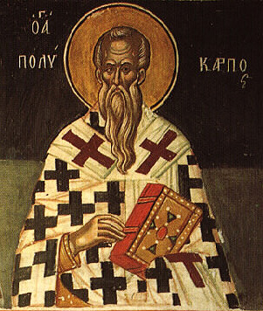
The historical context of Polycarp’s
Epistle to the Philippians
Polycarp, Bishop of Smyrna, wrote this letter
to the church in Philippi.
The letter is thought to have been written
from the city of Smyrna, around the year 120 CE.
One of the remarkable features of this letter Polycarp’s extensive knowledge of the early Christian tradition, which is evidenced by his use of most of the writings that would eventually make up the New Testament as well as texts now referred to as the Apostolic Fathers (the letters of Ignatius and 1 Clement).

Slide 14
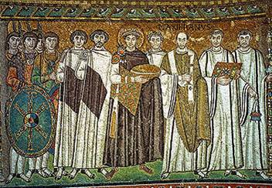
Early Christian Civil Wars
Who were these dissenters/false teachers?
And, what were they saying/doing?
.

Slide 15
Broad Sketch
First John is dealing with a dissenting faction.
Second John is warning against “deceivers.”
Third John is confronting an individual who challenges the authority of “the elder.”
Second Peter and Jude are dealing with “intruders” and “false teachers” and “scoffers” in their communities.
1 Clement and Polycarp’s Epistle to the Philippians are addressing some of the tensions in leadership of the early Christian communities.

Slide 16
The dissenting faction of 1 John
“Children, it is the last hour; and just as you heard the antichrist was coming, so now many antichrists have appeared. Thus we know this is the last hour. They went out from us, but they were not really of our number; if they had been, they would have remained with us. Their desertion shows that none of them was of our number.” - 2:18-19
“Who is the liar? Whoever denies that Jesus is the Christ. Whoever denies the Father and the Son, this is the antichrist.” -2:20
“Every spirit that acknowledges
that Jesus Christ come in the
flesh belongs to God.” -4:2

Slide 17
The “progressives” & “deceivers” of 2 John
“Many deceivers have gone out into the world, those who do not acknowledge Jesus as coming in the flesh; such is the deceitful one and the antichrist.” - v. 7
“Anyone who is so ‘progressive’ as not to
remain in the teaching of the Christ does
not have God; whoever remains in the
teaching has the Father and the Son.” – v. 9
“If anyone comes to you and does not bring
this doctrine, do not receive him in your
house or even greet him; for whoever greets
him shares in his evil works.” – v. 10

Slide 18
The problem of Diotrephes in 3 John
“I wrote the church, but Diotrephes, who loves to dominate, does not acknowledge us. Therefore, if I come, I will draw attention to what he is doing, spreading evil nonsense about us.” v. 9
“And not content with that, he will not receive the
brothers, hindering those who wish to
do so and expelling them from the
church.” v. 10.

Slide 19
The “intruders” of Jude
“For there have been some intruders, who long ago were destined for this condemnation, godless persons who pervert the grace of our God into licentiousness and who deny our only Master and Lord, Jesus Christ.” v. 4
“They are waterless clouds blown about
by the wind, fruitless trees in late
autumn, twice dead and uprooted.” v. 12
“On those who waver, have mercy; save
others by snatching them out of the fire;
on others have mercy with fear, abhorring
even the outer garment stained by the
flesh.” v. 23

Slide 20
The “false teachers” and “scoffers” in 2 Peter
“There were also false prophets among the
people, just as there will be false teachers
among you, who will introduce destructive
heresies and even deny the Master who
ransomed them.” 2:1
“They [false teachers] seduce unstable people,
and their hearts are trained in greed. Accursed children!” 2:14
“There are scoffers who will say, ‘Where is the promise of his coming?...But do not ignore this one fact, beloved, that with the Lord one day is like a thousand years and thousand years like one day.” 3:3-8

Slide 21
The “cliques” and “factions” of
First Clement
“We realize that we have been slow to turn our attention to the matters causing disputes among you, loved ones, involving that vile and profane faction that is alien and foreign to God’s chosen people.” -1:1
“[The] church of the Corinthians is reported to have created a faction against its presbyters, at the instigation of one
or two persons.” 47:6
“And this report has reached not only us but
even those who stand opposed to us.” 47:7
The letter urges the community in Corinth to “dispose
of this problem quickly,” appealing to Christian love,
encouraging wrongdoers to seek pardon, and calling on
the faithful to pray for the dissenters. 48:1-56:16

Slide 22
The “antichrists” and disgraced presbyter of Polycarp’s Epistle to the Philippians
Polycarp warns the church in Philippi to avoid
“false teachings” and those who deceive vulnerable
community members. He refers to such individuals
as “antichrist[s]” and the “first-born of Satan.” 7:1-2
He also takes up the matter of Valens (“once a presbyter among you”) and his wife, who apparently had stolen money from the congregation (11:1-12:3). He advises the community to forgive Valens and his wife if they truly repent: “Rather than judge such people as enemies, call them back as frail and wayward members, so as to heal your entire body.” 11:4

Slide 23
Diverse appeals among the early Christian communities
Jude and Second Peter launch dehumanizing attacks on their opponents:
“But these people revile what they do not understand and are destroyed by what they know by nature like irrational animals. Woe to them!” Jude 10-11
The Johannine epistles castigate the secessionists:
“They went out from us, but they were not really of our number; if they had been, they would have remained with us. Their desertion shows that none of them was of our number.” 1 John 2:19
1 Clement encourages dissenters to seek pardon:
“Thus you who laid the foundation of the faction should be subject to the presbyters and accept the discipline that leads to repentance.” 1 Clem. 57:1
Polycarp urges forgiveness for the former presbyter who embezzled community funds:
“Rather than judge such people as enemies, call them back as frail and wayward members, so as to heal your entire body.” Pol. Phil. 11:4
.

Slide 24
Early Christian Civil Wars
Opening Remarks
The early civil wars in the Christian congregations were on two fronts:
Theological wars (Who is Christ?)
Leadership wars (Whose in charge?)
The civil wars appear to be largely personality-driven.
Most of the later NT letters deal with (reveal) the real growing pains of the early Church.

Slide 25
Early Christian Civil Wars
Questions for Theological Reflection
What are false teachings that you encounter in your ministry?
Are there civil wars occurring in your faith community? How do you choose sides?
What ‘civil wars’ are Catholics fighting today?

