Slide 1
November 2016
Deacon Retreat
Lessons Learned from the Emerging Church: 100-160 AD
Dr. Dan Scholz
Dean, College of Arts and Sciences
Cardinal Stritch University
djscholz@strtch.edu

Slide 2
The Four Sessions
Fri night How the early Christians related to Outsiders
7:30 pm First Peter
Sat morning Early Christian Civil Wars
9:00 am Second Peter, Jude, 1, 2, and 3 John
Sat afternoon Early Christian Apocalypses
3:30 pm Revelation of John
Sun morning Early Christian Dynamic Homilies
9:00 am Hebrews

Slide 3
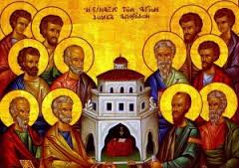
The Emerging Church :
Background and Sources

Slide 4
Sources: The Later NT Writings
Order in NT Date of Composition
Letter to the Hebrews 95-100 AD
Letter of James 100 AD
First Letter of Peter 90-110 AD
Second Letter of Peter 140 AD
First Letter of John 90-95 AD
Second Letter of John 90-95 AD
Third John of John 90-95 AD
Letter of Jude 100-140 AD
Revelation of John 90-110 AD

Slide 5
Sources: The Writings of the
Apostolic Fathers
AF Text Date of Composition
The Didache 100-110 AD
The 7 Letters of Ignatius 110-117 AD
The Martyrdom of Polycarp 155-156 AD
The Apology of Quadratus around 120 AD
The Epistle to Diognetus 150-200 AD
First Letter of Cement 100 AD
Second Letter of Clement around 150 AD
Polycarp’s Philippians around 120 AD
The Epistle of Barnabas around 130 AD
The Shepherd of Hermas 110-140 AD

Slide 6
From the “Age of the Apostles” to the
“Age of the Apostolic Fathers”
The “apostolic age” covers seventy years, from the resurrection of Christ (around 30 CE) to the death of the last apostle, John
(around 100 CE).
The next generation of Christian leaders, 100-160 CE, are called the “apostolic fathers.”
The “apostolic fathers” were Church bishops (e.g., Ignatius of Antioch and Polycarp of Smyrna) and unknown authors of significant writings from this time period (e.g., the Didache, the Shepherd of Hermas, the Epistle of Barnabas, First and Second Clement).
The authors of the later NT writings and the authors of the writings of the Apostolic Fathers are second and third generation believers.

Slide 7
Defining characteristics of
Christians (100-160 AD)
The experience of being a “Christian” is localized
Where you meet (voluntary [illegal] association)
What writings guide your gatherings (no NT canon yet)
Which level of persecution: tolerance-harassment-prison/death
Emerging practices
Initiation rites: catechesis and adult baptism
Common practices at gatherings (ekklesia / “church”):
readings, reflections, celebrating the Lord’s Supper
Male hierarchy taking shape: bishops, presbyters, deacons
Diversity (divergence) of voices present in the congregations

Slide 8
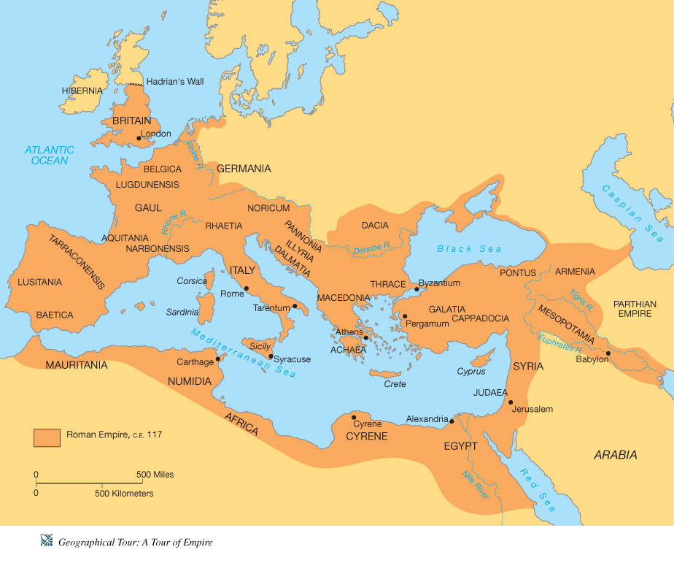
Roman Empire around 100 AD

Slide 9

Roman Empire and the continental U.S.
http://wps.ablongman.com/wps/media/objects/262/268312/art/figures/KISH106.jpg

Slide 10
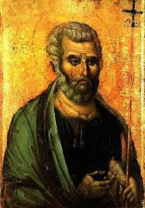
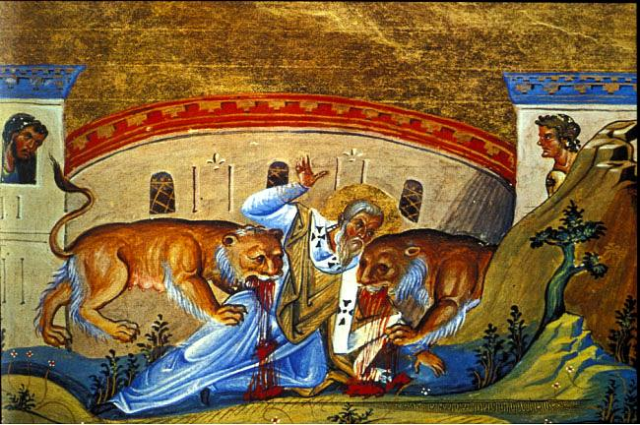
Session 1:
How the Early Christians Related to Outsiders
New Testament Sources:
The First Letter of Peter
Apostolic Fathers Sources:
The 7 Letters of Ignatius
The Martyrdom of Polycarp
The Apology of Quadratus
The Epistle to Diognetus

Slide 11
How the Early Christians
Related to Outsiders
Questions for Theological Reflection
Who do you consider “outsiders” associated with your faith community?
What strategies do you employ in dealing with current outsiders to the faith?
How can the Church effectively evangelize outsiders?

Slide 12
How the Early Christians Related to Outsiders
Historical Context of the Sources

Slide 13
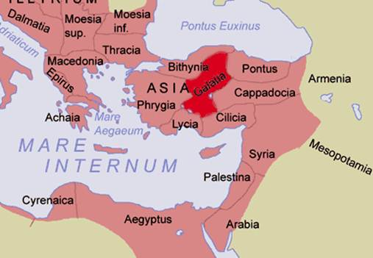
The First Letter of Peter
Written between 80-100 CE to the Gentile Christian communities living in the five Roman provinces of Pontus, Galatia, Cappadocia, Asia, and Bithynia.
The author is unknown,
but writes in the name
and authority of Peter.
Possibly composed in
the city of Rome.

Slide 14
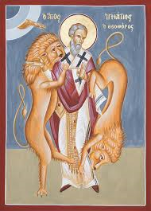
The 7 Letters of Bishop Ignatius
All 7 letters were written by Ignatius, Bishop of Syria, on his way to martyrdom.
The letters were composed sometime
between 110-117 CE.
Five of the 7 letters were targeted for five
different church in Asia Minor, one for the
church in Rome, and one for a fellow bishop,
Polycarp.
Four of the church letters were written from Smyrna, and the other three were written from Troas (both in Asia Minor).

Slide 15
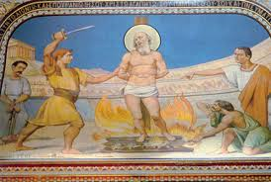
The Martyrdom of Polycarp
Polycarp, Bishop of Smyrna, was martyred in 154-55 CE. He was 86 years old.
The Martyrdom of Polycarp is actually a letter sent from the members of the church of Smyrna in Asia to the church members in the city of Philomelium in Phrygia, about 100 miles east of Smyrna.
The letter was composed in 156 CE.

Slide 16
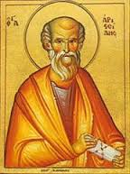
The Apology of Quadratus
Quadratus, Bishop of Athens, wrote an apology (a defense of the faith) to Hadrian, who was the Roman emperor from 117-138 CE.
The full text of the apology is missing. All that remains is a single fragment.
The Apology of Quadratus is thought to have been composed around 120 CE.

Slide 17
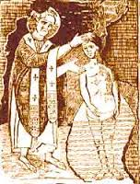
The Epistle of Diognetus
The author of the Epistle to Diognetus is unknown.
The intended recipient of this letter, “most excellent Diognetus” is otherwise unknown.
The date of composition is uncertain, although most scholars date it to the second half of 2nd century, 150-200 CE.
Place of composition is possibly
Asia Minor.

Slide 18
Circumstances of these Writings
These early- to mid-second century CE authors were reacting to outsiders under various circumstances:
1 Peter, the letters of Ignatius, and the Martyrdom of Polycarp were written during a time of varying levels of duress and mostly deal with persecution.
The Apology of Quadratus and the Epistle to Diognetus present arguments for the legitimacy of Christian beliefs.
The Apology of Quadratus is a fragment of an apology reacting to the Roman state.
The Epistle to Diognetus is a letter written in response to ancient philosophy.

Slide 19
How the Early Christians Related to Outsiders
Strategies Identified in these Sources

Slide 20
Quotes and Strategies dealing with “Outsiders”
First Peter
Offer advice on how to cope with suffering.
“Always be ready to give an explanation to anyone who asks you for a reason for your hope…so that when you are maligned those who defame your good conduct in Christ may themselves be put to shame. For it is better to suffer for being good, if that be the will of God, than for doing evil.” – 1 Pet 3:15-16
Bring relief to those “insiders” suffering
“Beloved, do not be surprised that a trial by fire is occurring among you. But rejoice to the extent that you share in the sufferings of Christ, so that when his glory is revealed, you may also rejoice exultantly…But whoever is made to suffer as a Christian should not be ashamed but glorify God because of his name.” – 1 Pet 4:12-16

Slide 21
Dealing with “Outsiders”
First Peter
Defend the faith through self-discipline
“Beloved, I urge you as aliens and sojourners to keep away from worldly desires that wage war against the soul. Maintain good conduct among the Gentiles, so that if they speak of you as evildoers, they may observe your good works and glorify God on the day of visitation.”
– 1 Pet 2:11-12

Slide 22
Dealing with “Outsiders”
The 7 Letters of Ignatius
Show no fear of torture and death
I am God’s wheat and I am being ground by the teeth of wild beasts to make a pure loaf for Christ. – Rom. 4:2
What a thrill I shall have from the wild beasts that are ready for me! I hope they make short work of me. – Rom. 5:2
Pass on the authentic faith to those who hate us
There is only one physician – of flesh yet spiritual, born yet unbegotten, God incarnate, genuine life in the midst of death, sprung from Mary as well as God, first subject to suffering then beyond it – Jesus Christ our Lord. – Eph. 7:2

Slide 23
Dealing with “Outsiders”
The Martyrdom of Polycarp
Think of martyrdom in the context of Jesus’ passion
The adventurous story of Polycarp’s martyrdom bears remarkable similarities to the New Testament Gospel accounts of Jesus’ arrest and seizure.
Polycarp’s entry into the city of Smyrna to face martyrdom “mounted…on an ass” ready to face “Herod, and his father, Nicetas” (Mart. Pol. 8:2); and even “a voice from heaven” strengthening Polycarp as he faced death (Mart. Pol. 9:1).

Slide 24
Dealing with “Outsiders”
The Martyrdom of Polycarp
Accept martyrdom as “God’s will”
The Christians in Smyrna viewed “all the martyrdoms” and the death of Polycarp in particular, as “God’s will,” since God “has power over all things” (Mart. Pol. 2:1).

Slide 25
Dealing with “Outsiders”
The Apology of Quadratus
Defend the faith by showing Jesus’ miracles were legitimate (lasting and real)
“But the works of our Saviour were always present, for they were true – those who were healed, those who were raised from the dead, who were not only seen when healed and raised, but were always present – and not just while the Saviour was here, but even when he had gone they remained for a long time, so that some of them survived even to our own time.”
– entire fragment

Slide 26
Dealing with “Outsiders”
The Epistle to Diognetus
Defend the faith through education (catechesis)
I understand, sir, that you are really interested in learning about the religion of the Christians, and that you are making an accurate and careful investigation of the subject. – Diogn. 1:1
Highlight the “stupidity” of other religions
Christians “are not the slaves of [false] gods like these [pagans]” - Diogn. 2:10
Jews are “superstitious…offering gifts to God just as if he needed them.” - Diogn. 3:3

Slide 27
10 Strategies for Christians relating to “Outsiders”
Offer advice on how to cope with suffering. (1 Pet)
Bring relief to the “insiders” suffering. (1 Pet)
Defend the faith through self-discipline. (1 Pet)
Show no fear of torture and death. (Ignat.)
Pass on the authentic faith to those who hate us. (Ignat.)
Think of martyrdom in the context of Jesus’ passion. (Mart. Pol)
Accept martyrdom as “God’s will.” (Mart. Pol)
Defend the faith by showing Jesus’ miracles were legitimate (lasting & real). (Apol Q)
Defend the faith through education (catechesis). (Diogn.)
Highlight the “stupidity” of other religions. (Diogn.)

Slide 28
How the Early Christians
Related to Outsiders
Questions for Theological Reflection
Who do you consider “outsiders” associated with your faith community?
What strategies do you employ in dealing with current outsiders to the faith?
How can the Church effectively evangelize outsiders?

