Slide 1
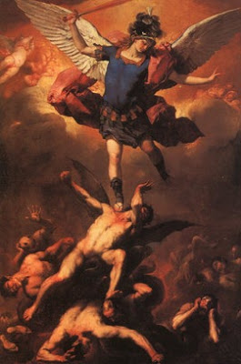
Session 3:
Early Christian Apocalypses
Christian Visions of the Unseen Order

Slide 2
Early Christian Apocalyptic Visions
Questions for Theological Reflection
How do you balance your “American” identity with your “Catholic” identity?
In this “Year of Mercy,” what does the reality of heaven and hell say about God?
How does the season of Advent say about divine judgment?

Slide 3
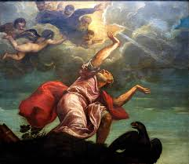
Early Christian Apocalyptic Visions
Setting the Context
.

Slide 4
What is an “apocalypse” and “apocalyptic” literature?
The term “apocalypse” comes from the Greek term apokalypsis meaning “unveiling.”
“Apocalyptic” literature refers to writings that claim to unveil or reveal something hidden, often involving heavenly or otherworldly mysteries.
These writings were popular among ancient Jews and Christians. And they remain popular today.

Slide 5

Apocalyptic literature is alive and well in 21st century American Christianity
Proof of Heaven: A Neurosurgeon’s
Journey into the Afterlife”
(Eben Alexander, 2012)
Heaven is for Real:
A Little Boy's Astounding Story
of His Trip to Heaven and Back
(Todd Burpo, 2010)
Heaven and Hell Unveiled: Updates from the World of Spirit (Stafford Betty, 2014)

Slide 6
Types of Apocalypses
There are two different types of apocalypses: vision apocalypses and journey apocalypse.
Some apocalypses were mediated through a vision, while others were mediated through a journey.
The Revelation of John is a vision apocalypse.
The Shepherd of Hermas and the Apocalypse of Peter are journey apocalypses.

Slide 7
Jewish and Christian apocalypses
Jewish apocalypses were produced during a period of about three hundred years, around 200 BCE to 100 CE.
Many Christian apocalypses were written between 100 – 300 CE, with some dating to as late as the Middle Ages (for example, the 12th century Apocalypse of Golias).
.

Slide 8
Jewish apocalypses
Five major Jewish apocalypses either predate or are roughly contemporary to the Revelation of John:
1 Enoch
Daniel (chapters 7-12)
4 Ezra
2 Baruch
The Apocalypse of Abraham
.

Slide 9
Christian apocalypses
The Revelation of John is the New Testament’s only apocalypse. Although the Gospels and Letters of Paul contain apocalyptic motifs (see, for example, Mathew 24; Mark 13; 1 Thessalonians 4; 2 Thessalonians 2).
No other New Testament text belongs to this genre.
.

Slide 10
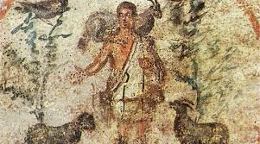
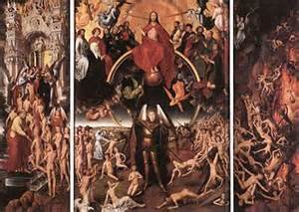
Early Christian Apocalyptic Visions
New Testament Sources:
The Revelation of John
Apostolic Fathers Sources:
Shepherd of Hermas
Apocalypse of Peter

Slide 11
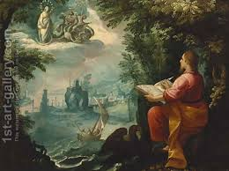
Early Christian Apocalyptic Visions
The Historical Context
of these Three Sources
.

Slide 12
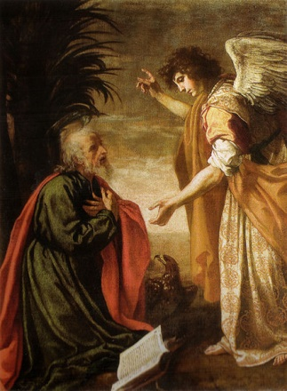
The Historical setting of Revelation
The author of the Revelation of John identified himself as “John” – a Christian leader and prophet exiled for his beliefs.
John claims to be exiled on the island of Patmos, a Roman penal colony (Rev 1:9).
The target audience is seven churches
in Asia Minor (see Rev 2-3).
Scholars date this apocalypse 90-110 CE.

Slide 13
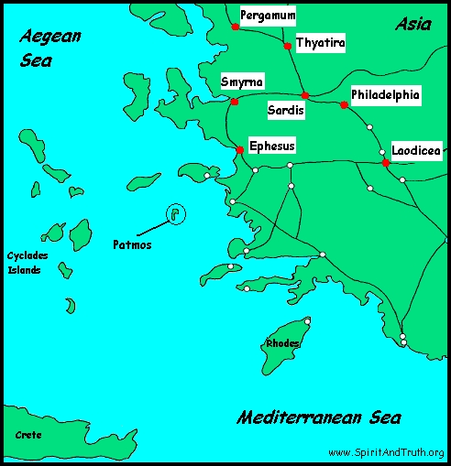
Early Christian Apocalyptic Visions
Narrative Setting of the Revelation of John
“I, John, your brother, who share with you the distress, the kingdom, and the endurance we have in Jesus, found myself on the island called Patmos because I proclaimed God’s word and gave testimony to Jesus.” – Rev 1:9
The Island of Patmos

Slide 14
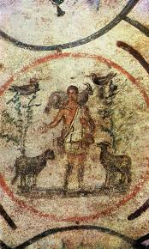
The historical setting of the Shepherd of Hermas
The author of the Shepherd of Hermas is a former slave, named Hermas.
Since the setting of the apocalypse is in and around the city of Rome, scholars think this may be the audience and place of composition.
The ecclesiology of this apocalypse dates to a time of composition around 110-140 CE.

Slide 15
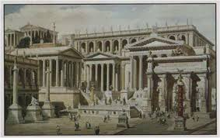
Early Christian Apocalyptic Visions
Narrative Setting of the Shepherd of Hermas
“The one who raised me sold me to a certain woman named Rhoda, in Rome. After many years, I regained her acquaintance and began to love her as a sister…While I was praying the sky opened up and I saw the woman I had desired, addressing me from heaven: ‘Hermas, greetings!’” - Shep Herm 1:1-4
The ancient city of Rome
The city of Rome

Slide 16
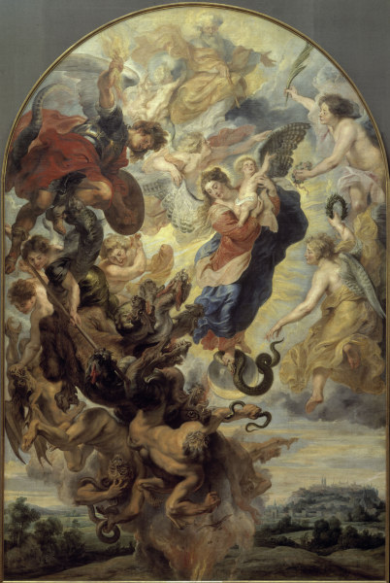
The historical context of the Apocalypse of Peter
The author of the Apocalypse of Peter is
unknown, but writes in the name and
authority of the apostle, Peter.
The audience is unknown, as is the
place of composition, but scholars
speculate either Palestine or Egypt.
Given its theology and focus, scholars
date this writing to mid-second century CE,
around 130-150 CE.

Slide 17
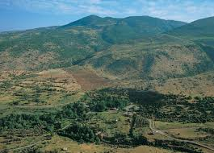
Early Christian Apocalyptic Visions
Narrative Setting of the Apocalypse of Peter
“And when the Lord was seated upon the Mount of Olives, his disciples came to him.”
-Apoc Pet 1:3
Mount of Olives
Mount of Olives

Slide 18
Early Christian Apocalyptic Visions
What was “revealed” about the unseen order in these apocalypses?
.

Slide 19
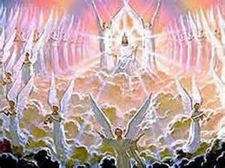
The Revelation of John
John does not present a linear series of predictions in his apocalypse, but rather a circular series of overlapping predictions.
John 4-11;
12-18;
19-21

Slide 20
The Storyline of the Revelation of John
1:1-3 The Prologue
1:4-8 The Greeting
1:9-20 Opening Vision
2:1-3:22 Prophetic Oracles to the 7 Churches
4:1-5:14 The Vision of Heaven
6:1-8:1 The Vision of the 7 Seals
8:2-11:19 The Vision of the 7 Trumpets
12:1-13:18 The Enemies of God
14:1-20 The Lamb and the Saved
15:1-16:21 The Vision of the 7 Plagues and 7 Bowls
17:1-19:10 Babylon and the Pagan Nations
19:11-22:5 Closing Visions
22:6-21 Epilogue

Slide 21
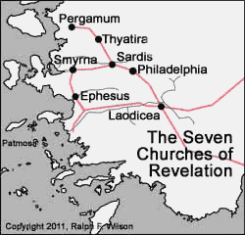
Rev 2-3 as interpretative key
It seems clear that the Christians in these 7 churches have been exposed to competing theologies from rival leaders and responded in a variety of ways to those challenges.
John identifies three opponents (heretics):
the Nicolaitans
those who subscribe to the teachings
of “Balaam”
3. the followers of “Jezebel”
The latter two are derogatory terms
applied by John.
John does not provide enough
detail for modern scholars to differentiate the beliefs or
practices of these rival leaders.

Slide 22
Revelation 2-3
John maintains that he and the churches to which he writes, live in a time of crisis and anticipation; they face significant challenges ranging from persecution by outsiders to the presence of false Christian teachers (rival leaders) and disillusioned believers within their communities.
Most significantly, they face an impending future where believers can anticipate an unprecedented level of widespread persecution by the forces of evil operative in and throughout the Roman Empire – all revealed in a series of visions to John.
John weaves a message of encouragement and a stern warning for beleaguered believers and rival teachers (“heretics”) who may be tempted to compromise their faith – or who may be unaware that, according to John, they have compromised their faith.

Slide 23
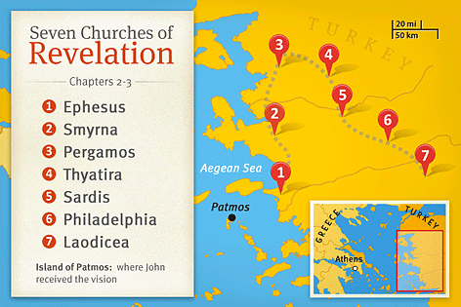
The 7 Churches of the Rev of John
The community members seem to be unduly influenced, as John sees it, by the larger imperial cult, which was devoted to honoring the Roman emperor as a god and as humanity’s protector and benefactor. Concerns over Christians adopting polytheistic practices, such as eating meat offered to idols (Rev 2:20), suggests that there was an ongoing debate as to what extent it was appropriate for Christians to assimilate into the wider pagan society.
What John deemed compromise with pagan Rome and over-assimilation led some (perhaps many) church members to become “lukewarm” (3:16), “fallen” from their original zeal for the faith (2:5) and even “dead” in their faith (3:1).
.

Slide 24
Revelation of John
Rival leaders spreading “false teachings” and disillusioned believers compromising their faith led to the writing of the Revelation of John

Slide 25
The Shepherd of Hermas

Slide 26
The Shepherd of Hermas
The Shepherd of Hermas was a VERY popular apocalypse in early Christianity.
The text itself is VERY long…5 times the length of the Revelation of John.
The Shepherd of Hermas is grouped together by three different types of revelations – namely visions, commandments (“mandates”), and parables (“similitudes”).
.

Slide 27
Who was Hermas?
The text reveals that Hermas was a former slave (now free) from the city of Rome (Vis. 1:1), married with children (Vis. 1.3.1-2), possibly a farmer (Vis. 3.1.2), who professes he is considered by others as a pious, cheerful and simple man (Vis. 1.2.1-4).
Although he never claims the status of prophet, it is reasonable to assume he enjoyed – or at least felt entitled to – some type of privileged status as the recipient of divine revelations.
The writing does not specify
that he held any formally
recognized leadership role
within his community, however.
.

Slide 28
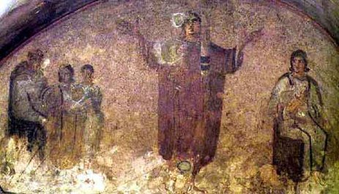
The Shepherd of Hermas
The revelations are grouped into three categories: five “Visions,” twelve “Commandments” and ten “Parables.”
The “Lady” reveals the first four visions.
The fifth vision and all the commandments
and parables are then conveyed to Hermas
by the Shepherd, who is “the angel of
repentance” (Sim. 9.1).
The dialogues and revelations, both those that occur initially between Hermas and the Lady and later exchanges between Hermas and the Shepherd, clearly show that these divine messengers offer not only revelations but also instruction.
The work’s title stems from the figure who gave most of the revelations to Hermas.
.

Slide 29
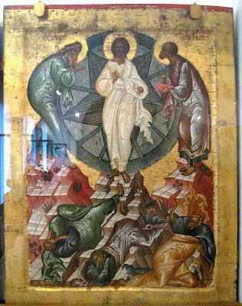
The Shepherd of Hermas
Vision 3 and Parable 9 exemplify the theology and ethics embedded in the writing – in particular, Hermas’s ideas about the church (ecclesiology), the end times (eschatology), and the importance of repentance for salvation (soteriology).
In Vision 3, for instance, Hermas recounts what the “Lady” revealed to and interpreted for him. He initially sees an “ivory couch,” “six young men,” a “great tower built upon the water” and “stones” (Vis. 3.1-2).
Each of these heavenly objects, the Lady informs Hermas, represents another reality: the ivory couch stands for divine judgment, the six young men for the holy angels of God, the tower and the water for the
church comprised of the baptized faithful, and the
stones for all Christ-believers (both those who will be
saved and those who will ultimately be rejected).
.

Slide 30
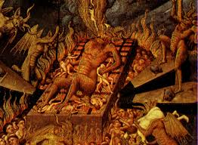
The Apocalypse of Peter

Slide 31
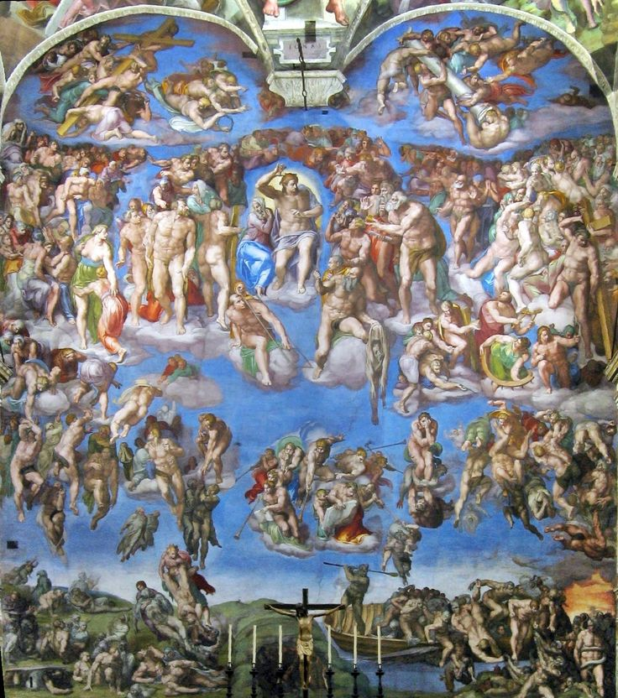
The Apocalypse of Peter
Unlike the Revelation of John and the Shepherd of Hermas, both of which have complex storylines and dramatic images and symbols, the Apocalypse of Peter is considerably shorter and has a relatively easy to follow narrative: on the Mount of Olives, Jesus explains to Peter and the disciples about the judgment to come at the end times.
The world will be consumed by fire,
followed by the final judgment of all
people. There are only two possible
ultimate destinations for all humanity:
heaven or hell. Most of the story
describes the horrors awaiting those
condemned to hell.
.

Slide 32
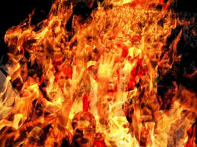
Hell in the Apocalypse of Peter
“Men and women whose works were done in deceitfulness shall have their lips cut off; and fire enters into their mouth and their entrails (bowels). These are they who caused the martyrs to die by their lying.” – Apoc. Pet. 9
“Beside them shall be girls clad in darkness for a garment, and they shall be seriously punished and their flesh shall be torn in pieces. These are they how did not preserve their virginity until they were given in marriage and with these torments shall they be punished.” – Apoc. Pet. 11
“Children shall be chastised with pain, with hanging up and with a multitude of wounds which flesh-flesh-devouring birds shall inflict upon them. These are the ones who did not obey their parents.”
– Apoc. Pet. 11
.

Slide 33
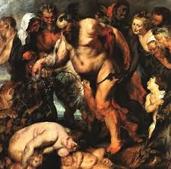
The Angels of the Apocalypse of Peter
The Apocalypse of Peter mentions the many angels
present in both heaven and hell, for example, those
who “weep” at the site of the condemned (Apoc. Pet. 3).
Four angels singled out by name for particular mention
are Uriel (Apoc. Pet. 4, 6, 12); Ezrael (Apoc. Pet. 7, 9-12);
Temlakos (Apoc. Pet. 8); and Tatirokos (Apoc. Pet. 13).
None of those names is mentioned in the Old or New Testaments.
The “great” Uriel, described as “the angel of God,” is in charge of “the resurrection of the dead at the day of judgment” (Apoc. Pet. ref.). The Jewish apocalypse First Enoch 9 mentions that the archangel Uriel protected humanity from the “Watchers” (a group of fallen angels). Ezrael is the “angel of wrath” who summons the sinners in hell to face their torment. In Apocalypse of Peter 8, the angel Temlakos, whose name means “care-giver,” protects the children aborted by their parents. Tatirokos, the “keeper of hell,” offers no mercy to the unrighteous in hell who suffer without end.
.

Slide 34
Heaven in the Apocalypse of Peter
The Apocalypse of Peter offers comparatively few details about what happens to those destined for their reward in heaven, beyond that they live in eternal bliss:
“I [Jesus] will cause the people to enter into my
everlasting kingdom, and show them eternal good
things to which I have made them set their hope, I
and my Father in heaven.” – Apoc. Pet. 14
.

Slide 35
Early Christian Apocalyptic Visions
Questions for Theological Reflection
How do you balance your “American” identity with your “Catholic” identity?
In this “Year of Mercy,” what does the reality of heaven and hell say about God?
How does the season of Advent say about divine judgment?

