Slide 1
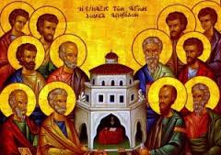
November 2016 Deacon Retreat
Lessons Learned from the Emerging Church: 100-160 AD

Slide 2
5 Retreat “Take-aways” from the Later NT Writings
In every age of Church history, the Church is “emerging” anew (for us, its the first time).
Our age has both its unique and its universal set of challenges.
We can burn-out – and even destroy ourselves – trying to move the needle.
The key is to allow the Holy Spirit do the work – through us.
In this emerging Church, we are called to dance well with the Holy Spirit.

