Slide 1


New Business Administrator Institute
Session III
May 11, 2022

Slide 2


Header here
Opening Prayer
Almighty God,
You fill all things with Your presence.
In Your great love, keep us near You this day.
Grant that in all our ways and doings we may remember that You see us.
May we always have grace to know and perceive what things You would have us do,
And give us strength to do the same;
Through Jesus Christ our Lord.
Amen.

Slide 3

HR: Employees sometimes make bad decisions
Jenny Moyer
Parish & School Human Resources
Archdiocese of Milwaukee

Slide 4
WHY ARE WE HERE?
We can work where our faith is!
Notes:
All of you make herculean efforts daily – juggle multiple plates, where multiple hats.
We get overwhelmed.
Remember your staff feels the same way
We need to take a moment and reflect
Be grateful to serve the church in our roles
Spread positivity – WE CAN DO THIS TOGETHER
Thank you!!!
So your day is going great. You are getting through your “to do list”….
You have set your employees up for success
Job description
Handbook
Policy manual
And then…..

Slide 5


Slide 6
You have an employee who Is rude to co-workers, parents or parishioners Is continually missing deadlines. Inappropriately uses email or social media. Is continually late or absent. Was accused of sexual harassment.

Slide 7
What do you do? Evaluate the situation Paid Administrative Leave is always an option… Then investigate, document, and determine next steps according to their type of employment & the egregious action. Restrict their access to the workplace while you investigate. Make sure the right people are involved & informed
Notes:
If there is a potential danger – you can always call the police
If tempers are flying you can send an employee home with pay.
Let him/her know you will contact them about when to return.

Slide 8
AT-WILL VS CONTRACT EMPLOYMENT At-Will: Another way of saying, “At the will of either party.” Employee(s) must be treated fairly. Able to defend
Notes:
Several work factors fall under the umbrella of culture, including, but not limited to, work performance, personality, work style, work ethic or ability to work as a team member. Once a performance or behavioral fit issue arises, employers should candidly address them with the employee. Regardless of tenure or status, employers have the option of allowing time for improvement or terminating immediately, provided they follow protocol.
Ideally, you've been having conversations about their performance all along the way and they are aware of your concerns. Reflect on these conversations. You want to believe that this employee truly "owns the problem" and that they have the "initiative and drive" to solve it. If so, the employee may have a future. If you haven't been transparent, now is the time to be.
opening the conversation with a straightforward question. "Say, 'You are not hitting the targets we set. What do you think is the root cause?’
Start by having an "informal conversation" with HR in which you discuss "the person's development" and objectives. Depending on where you are in your decision-making process, "HR may require you to do a performance improvement plan (PIP)," so you have "evidence" of their inability to improve in case they sue, says Conger.

Slide 9
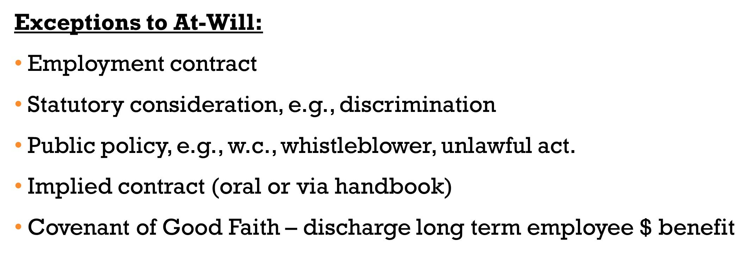
AT-WILL VS CONTRACT EMPLOYMENT
Notes:
CONTRACT: FOR EXAMPLE4119 Termination of a Contracted Employee.
STATUTORY CONSIDERATIONS: the basis of race, religion, age, citizenship, sex, sexual orientation, national origin, marital status, disability and certain other factors.
Employers should also consider whether a termination or series of prior terminations has a disparate impact on a particular group.
RETALIATION: Even where the underlying claim of discrimination or other employment violation lacks merit, the employee may indeed have a bona-fide retaliation claim if terminated or subjected to other negative employment action soon after lodging a complaint. While such employees are not necessarily insulated from termination, employers should be aware that they may assume an additional burden to justify their decisions against a possible retaliation claim, especially if taken within approximately six months of an employee’s complaint.
COVENANT OF GOOD FAITH -Terminating a long-term employee because their salary is too high
Terminating all older employees
Promise of job security
For example, if you tell an employee during an interview that they can always keep working as long as they perform well, you could unintentionally create an implied contract. Despite the lack of specific terms about the employee’s job security, this could make them reasonably trust that they have a permanent place of employment with your company
Employee handbook policies
Your employee handbook has the potential to create implied contracts if it includes information about when employees can expect raises and promotions, what actions can result in termination or other employment conditions and terms. One way to avoid creating an implied contract with your employee handbook is to include a waiver explicitly stating that all employment is at-will.
For example, if your employee handbook states that all employees can get a raise once a year, an employee could file a complaint if they did not have a discussion about a possible raise at their yearly performance review. They could argue that not being considered for a raise violates the implied agreement of the handbook.
.

Slide 10
MISCONCEPTIONS Any employee can be terminated at any time during the probationary period without warning. An At Will employee can be terminated at any time without warning.
Notes:
It is important to foster ongoing communication between yourself and your new employee. You can do this by:
Giving immediate constructive criticism or positive feedback
Creating a plan for improvement
Scheduling meetings 1-3 times per week to help train the employee
Assigning a mentor to assist the new employee on a daily basis
Don’t be afraid to tell the employee they are not meeting expectations and it may not work out long term if changes are not made

Slide 11
I care enough about you to tell you the truth! It is caring to give feedback. If you see someone doing something that is getting in their own way, the thing to do is to speak up.
Notes:
Therese Huston –
Giving Feedback is hard
It feels personal – you know their challenges and don’t want to demotivate them
Taught, if you don’t have anything nice to say don’t say anything. Now it is your job to say it.
Three types of feedback Supervisors give:
Appreciation – what you like positive impact. Do more of it
Coaching – how could do differently, ways to adapt and make it better.
Evaluation – Let them know where they stand. Will they be renewed?
Givers of feedback tends to feel more stress than those receiving it. (Book thanks for the feedback viking 2014)
Unclear is unkind
Example of priest who didn’t want to tell ee that job was on the line. When he did their communication improved. Sometimes ee resigns, not always perfect.

Slide 12
Employee(s) must be treated fairly. Know expectations Dialog on performance Evidence of poor performance Reasonable discipline The consequences must be clear Consistent and following policy Document
Notes:
If it is a performance problem: hand out Ricks 7 questions
Look at the job description with the employee
Review the handbook, policy or work rule, the training materials.
Start with a conversation.
Many times, this will be enough to revisit the expectations
State what is going on with performance
Give examples. What needs to change.
Ask them to explain to you what they think they should be doing.
Determine the next step
Was a conversation enough? Document you had one and the date, what you covered. In shadow file
Let the employee know this is important for this job. Needs to change or could affect employment.
Follow up
Treat employees the same – would you treat another employee the same way?

Slide 13
Documented Performance Improvement Plan (PIP) – Policy #4118 List the performance concerns with examples (specifics are helpful, i.e.. Past conversations, outside complaints…) Define expectations Develop a plan of action to improve performance Schedule follow up meetings to monitor progress State the consequences if performance does not improve
Notes:
Mandatory for a non-renew of teacher or principal. Lawyer. CMG ask
Identification of performance concerns, supported by examples.
Identification of performance expectation and resources available to change behaviors. Classes, books, mentor… Teacher Effectiveness Framework, Job description, Code of Ethics…
Development for plan of action, including timelines and goals.
Could be weekly meeting with goals
Giving lesson plans weeks in advance
Reviewing accuracy of journal entries
Any complaints?
EE taking notes so that s/he doesn’t have to ask same ?s
A procedure to monitor progress of goal achievement through scheduled feedback sessions.
Signatures of both the employee and the employer.
3rd person in the room
Listen to the employee – give them input and use this as a proactive tool
The ee has a right to be heard.
Continue with form on next page

Slide 14
The Performance Improvement Plan must have this language: “The above goals and areas for improvement will be in effect for the _________ school year.” “Failure to comply with these goals may lead to termination and/or the non-renewal for the _________________school year.” Template for the PIP – Policy 4118

Slide 15
Paid Depending upon the circumstances, discipline may be: verbal warning, written warning, suspension without pay, OR termination. Progressive discipline may not be followed in all cases.
Notes:
Pass out the corrective action form Can be a letter .
Refer to your:
Job description
Handbook
Policy Manual
Code of Ethics.
Contract

Slide 16
Notes:
Avoid impressions
Use facts
You do not want slander…
Refer to prior warnings/conversations.
This is where shadow file comes in

Slide 17
Memories inevitably fade over time, but documentation is the best way to preserve a record of the steps you have taken and the reasons for your actions, and decisions, preparing you to defend them should the need arise.
Notes:
Ten commandments of documentation from Education Law Association #90 by Todd A DeMitchell and Mark A Paige
Hand out the 10 commandments

Slide 18
An employee is poorly doing 40% of their job duties. An employee is poorly doing 40% of their job duties. What does Documentation need to include? Who What When Where Why Facts

Slide 19
An employee is poorly doing 40% of their job duties. Legal Considerations An employer may say the termination was for nonperformance, but the employee can say it’s really because of_____________. Gender, Age, Retaliation, etc. Documentation is key for a good defense.

Slide 20
Reduction in Force (Policy 4112.1) Eliminate or reduce employment status due to employer not employee. Employment procedure with legal implications. Criteria for determining job reduction or job elimination. Employee(s) may have the right to recall. 30-day notice prior to effective date.
Notes:
Consider this when restructuring a job
For example, making a phy ed part time/dean of students
Look at all your positions.
Policy says 14 day notice
WARN – Worker Adjustment and Retraining Notification Act also Wisconsin Business Closing and Mass Layoff Law mini-WARN Wisconsin is 50 ees
Who is covered under the Wisconsin law?
Covered employers include businesses employing 50 or more “persons” in the state of Wisconsin. “Persons” do not include “new or low-hour employees” (i.e., workers employed for fewer than six of the 12 months preceding the date on which a notice is required or employees averaging fewer than 20 hours per workweek). The definition of “employer” excludes federal and state governmental entities as well as any political subdivisions. Also excluded are charitable and tax-exempt institutions and organizations.

Slide 21
An employee is poorly doing 40% of their job duties.
Notes:
The following criteria for teachers and teaching aides will be considered and evaluated by administration in determining staff reductions or eliminations:
Certification/Experience/Qualifications
• Practicing Catholic
• Appropriate degree and certification by the Wisconsin Department of Public Instruction or a formal plan of study to attain appropriate degree and/or certification agreed to by the employee and approved by the Principal
• Maintaining qualifications as identified in the applicable job description
• Appropriate certification level for religious education as established by the Archdiocese of Milwaukee
Evaluation of Effective Teaching
The performance and contributions of faculty and staff will be reviewed in alignment with the evaluation of effective teaching in the following domains:
• Classroom Community
• Professional Life of a Catholic Educator
• Planning and Instructional Effectiveness
• Assessment
• Other evaluative artifacts
Information and artifacts the administrator gains from written evaluations, performance improvement plans, letters of reprimand, and other credible sources, in accordance with all established personnel policies and procedures of the Archdiocese of Milwaukee, will be used in the evaluation of these domains.
Transferability
The judgment on transferability shall be based on the following:
• Relevant experience, both locally and in other professional positions
• Ability to accept alternate assignments
Needs of the Parish/School
• Unique local staffing needs reflecting cultural, environmental, or geographic reasons
• Staffing of student service areas, resource areas, etc.
• Supervision of co-curricular activities
• Teacher/pupil ratio
Seniority
Seniority is defined as the first day the person was scheduled to start employment. Seniority will be the determining factor only when application of other criteria fails to distinguish sufficiently to lead to a result.
The Director of Parish and School Human Resources and the Office for Schools are available for assistance with RIF procedures.

Slide 22
Criteria for Employees, other than Teachers doing 40% of their job duties. Practicing Catholic, if a ministerial position Maintaining qualifications as identified in applicable job description Performance evaluation documents Seniority

Slide 23
An employee is Remember prior to taking an action that will result in a dismissal or termination (including a RIF and non-renewal of contract), the employer must have sought and followed the advice of a qualified employment attorney OR other professional person that Catholic Mutual has approved. doing 40% of their job duties. An employee is poorly doing 40% of their job duties.

Slide 24
An empl40% The Decision to Terminate has been Confirmed. What now? Of You have talked with your pastor and Parish and Schools HR or an employment attorney Termination letter is prepared This will include pay and benefits info and arrangements to pick up personal items Temporary work plan is in place Social Media, email and facilities access is disengaged In some instances, there is a plan/email to notify staff, parents, parish members. A third person will be in the room as a witness The meeting time has been arranged The meeting will be short – less than 10 minutes. Walk the employee out their job duties.
Notes:
Side note, in some instances you can give the employee the opportunity to resign. Contact HR or your attorney prior to offering this.

Slide 25
n Sample letter Here at ___________ School, we expect all employees to conduct themselves in a manner that reflects the highest standards of ethical conduct. This is part of our mission as a Catholic School. _______ on __________ you _________________________________. Page ___ in the _______ Employee handbook states that certain offenses may result in disciplinary action up to and including termination. “Immoral or unethical conduct on the work premises or off the premises if conduct has an adverse impact on the school” is on that list. Due to, but not limited to the above-mentioned misconduct, your employment with __________ School is terminated effective ____________________________. We can arrange for you to pick up your personal items the weekend of ___________, and we would retrieve any school property you may have. Your final paycheck will be on __________________. This will include payment through ____________ and any unpaid sick pay (if applicable). Please keep our office updated on your address for your yearend tax forms. Your coverage for benefits will cease at the end of February. Your portion of your February premiums will be deducted from your final paycheck. You will then be afforded the opportunity to elect continuation of coverage for your health insurance for a period of up to 18 months, provided you pay the full premium. The information is attached. If you have any questions, please contact me. Sincerely,

Slide 26
An employee is poorly doing 40% of their job duties. Sample message to Staff and/or parents: Today will be Jane Doe’s last day at the Cathedral School. We wish her the best in her future endeavors. Please be assured that the faculty and staff at the Cathedral School will continue its legacy of excellence in educating your children. There will be no change in the daily operations of the school, or in its mission as a Christ-centered school, designed to educate the whole child. You can also be assured that the parish fully supports the teachers, staff, students and parents. That being said, any matters that involve personnel are confidential . While we understand you would like more information, please understand the limitations that always exist when it comes to employee involvement matters. I will continue to keep you updated on our progress in filling this position. Thank you for your understanding. Any questions should be directed to me.

Slide 27
Grievance What is a Grievance? Formal dissatisfaction of what an employee expects from the workplace. Why? Improperly or inequitable application of policy; Harassment… Process – Defined steps. Written documentation. Confidential, to the extent it is practical.
Notes:
Parish Grievance Procedures
We are committed to fostering a process to solve a problem or a resolve dispute that is timely and fosters refined communication in all steps. We are also committed to a process in which there is no reprisal against anyone who brings forward a complaint, concern or problem. These steps are designed to ensure that decisions are being made on an informed and consistent basis. A fair and just process upholds the dignity of all individuals involved and has the greatest potential to resolve differences.
Personnel policies are intended to promote equitable treatment of all employees. On occasion, however, claims that an employment condition is unjust, inequitable, or that a provision of the personnel policies has been improperly, unjustly or inequitably applied may arise. In the event that these situations cannot be resolved to the mutual satisfaction of employee and employer, a procedure for resolution of the situation may be initiated as follows:
Direct discussion between the party aggrieved and the aggrieving party
Immediate supervisor, if applicable
Next person in order of supervision, if applicable
Pastor, Administrator, or Parish Director
Note: it may be helpful to the Pastor, Parish Director or Administrator to consult with the Pastoral Council, trustees, or personnel committee. Pastor, Administrator, or Parish Director may:
Convene the parties and attempt to resolve the grievance.
Request assistance from the Regional Vicar, if applicable and/or the appropriate diocesan director.
Gather a Grievance Committee. The committee will meet promptly with all parties regarding the dispute/issue. The Pastor, Administrator, or Parish Director will issue a decision to both parties.
Regional Vicar, if applicable.
Appropriate diocesan director.
Steps including and beyond the Step 4 must be in written communication form by the employee and must contain a request for the meeting along with the notification of the problem and the desired result. If terminated, the employee must pursue the process in writing within 10 working days of termination.
The Pastor/Parish Director/School President may contact the Archdiocesan Parish and School Personnel Office for assistance in resolving the grievance.
Assistance during the parish proceedings and possible appeal procedures through the Archdiocese are available to either parish or employee. Contact the Director of Parish and School Human Resource for further information. Documents of the grievance along with a letter explaining why an appeal is requested should be submitted to the Director of Parish and School Human Resource within ten days of the Pastor/Parish Director/School President’s decision.
Following the examination of the documents on the Archdiocesan level, either the grievance will be accepted for further appeal, or it will be remanded back to the Pastor/Parish Director/Administrator. If so warranted, further mediation, grievance panel review, binding arbitration, or subject to review by the Archbishop will be done to assure it does not violate civil or canon law, Church teaching, or parish/school policy.
When then the Pastor/ Parish Director/Administrator is perceived to be part of the concern, the following sequence is to be followed:
Direct discussion between the party aggrieved and the aggrieving party
Regional Vicar, if applicable
Appropriate diocesan director
Assistance during the parish proceedings and possible appeal procedures through the Archdiocese are available to either parish or employee. Contact the Director of Parish and School Human Resource for further information. Documents of the grievance along with a letter explaining why an appeal is requested should be submitted to the Director of Parish and School Human Resource within ten days of the Pastor/Parish Director/School President’s decision.
In addition, an employee who reports an activity that he/she reasonably believes to be illegal or dishonest or reports unethical behavior is protected in the area of confidentiality and retaliation. If an employee has knowledge of or a concern of illegal, dishonest, or fraudulent activity or of unethical behavior, the employee is to contact:
Immediate supervisor
Director of Parish and Schools Human Resources
An employee who intentially files a false report of wrongdoing will be subject to discipline up to and including termination.
To the extent practical, confidentially of the reporting individual will be maintained. However, identity may have to be disclosed to conduct a thorough investigation, to comply with the law or archdiocesan policy and to provide accused individuals their legal rights of defense. The Archdiocese of Milwaukee and associated entities will not retaliate against the reporting employee. The right of the reporting individual does not include immunity from personal complicity in wrongdoing or any other misconduct.

Slide 28
Church Unemployment Pay Program (CUPP) GOVERNED BY Wisconsin Catholic Conference (WCC) Program has an Administrator contracted by WCC Covered employee – at least 20 weeks of work with the employer during the prior 52 weeks. CUPPWI.ORG

Slide 29
Church Unemployment Pay Program (CUPP) Listed inside brochure: Benefit Eligibility Disqualifications Benefit Determinations Claims Process Appeal Process Program Board Hearing CUPPWI.ORG

Slide 30
QUESTIONS?
Jenny Moyer
414-769-3370
Moyerj@archmil.org
Up Next: Priest & Deacon Compensation
Notes:
How far do you want to cast out your net?
Communication avenues:
Paper – bulletins, newspapers, etc.
Job boards – parish, archdiocese, NCEA, Indeed, etc.
Social network – LinkedIn, Facebook, etc.
Networking
Catch people’s attention:
Can you take a Catholic school & make it the best in the world?
Are you a leader with tremendous energy who makes things happen?
Are you a highly responsible leader who always follows through?

Slide 31
Priest & Deacon Compensation
Denise Montpas
Parish & School Financial Consulting
Archdiocese of Milwaukee

Slide 32
Overview
Priest Compensation
  Group Exercise
Deacon Compensation
  Example
Mass Stipends & Stole Fees Overview / Help Out Priests
Priest Professional Expenses
  Group Quiz

Slide 33
Priest Compensation Background
There have been changes to the priest compensation plan since the program was initiated in 1982
The program currently used was effective July 1, 1997
  This program intends to pay priests the same, regardless of assignment
  Components vary based on years since ordination
Recommendations on priest compensation come out of the Archdiocesan Council of Priests
Priests have dual tax status under federal law
  They are employees of the church for federal income tax purposes (and receive a W-2)
  They are considered self-employed for Social Security and Medicare purposes (FICA) (they DO fill out a Schedule SE)

Slide 34

Components of the Archdiocesan Priest Compensation Plan
Priest Compensation Workbook
  Gross Compensation (line 1a)
  Pension Deduction (line 1b)
    Priest pays half, parish pays half – note: this deduction is the priest portion
    This is a pre-tax deduction
    Priest pension plan is a 401(a) plan
  Supplemental Payment (line 1c)
    This is taxable income and should be included on each paycheck
  Housing (line 2a or 2b)
    Parish provides or on own
  403(b) contribution (line 2c)
  Stipend/stole fee reduction (line 2d)
  Additional Professional Expense (line 2e)
  Other Pretax Deductions (line 2f)
Priest compensation workbook must be signed by priest and employer annually to document payroll elections. Copy must be kept in priest employment file.
Notes:
A 401(a) defined contribution plan is an employer-sponsored retirement savings plan that allows dollars to accumulate on a tax-advantaged basis for retirement. Contributions may be made by the employer, the participant, or both.

Slide 35
Priest Compensation Matrix (2022-23)

Slide 36
Priest Compensation: Housing Allowance
Housing allowance is exempt from income tax
Allowance is limited to salary paid directly by the Church
  Church defined as Catholic Parish, School or Agency
Provides opportunity to reduce overall tax liability
  Reduction in federal income tax owed
May a priest include a second home in his housing allowance request?
  IRS Code Sec. 107 provides for a ‘home’ not ‘homes’.
  An Appeals Court ruling in 2012 limited the application of a minister’s housing allowance to expenses incurred in only one home (the principal residence). Driscoll v. Commissioner

Slide 37
Priest Compensation: Housing Allowance

Slide 38
Priest Compensation Record (2022-23)

Slide 39
Priest Compensation Paycheck
Don’t forget this worksheet…

Slide 40
Priest Compensation: Religious Order Priests
From the Archdiocese of Milwaukee Clergy Manual:
The amount paid to a religious order priest should be the same salary scale level as a diocesan priest in the same ministry
They should receive the same professional expense reimbursement, reimbursement for continuing education, the annual retreat allowance, and health and dental premium payments.
The Archdiocesan Priest Pension Plan is for Archdiocesan priests only. However, a similar “retirement contribution” for religious order priests shall be offered to the religious order.
TIPS
Most parishes pay the priest salary directly to the religious order (religious order FEIN) and not to the individual priest.
Work with the provincial office of the religious order on payment options.
Parish remains whole

Slide 41
Priest Compensation – Group Exercise
Please break into small groups. Each group will receive the same narrative and will be asked to fill out a workbook for the priest.
Instructions
  Read narrative
  Fill out all pages of priest comp workbook
  Allotted time: 5-10 minutes

Slide 42
Priest Compensation – Group Exercise
Now let’s review. What is the first piece of information we know?

Slide 43
Priest Compensation – Group Exercise
What about housing? How should that look?

Slide 44
Priest Compensation – Group Exercise
And on the workbook…

Slide 45
Priest Compensation – Group Exercise
What about that 403b contribution?

Slide 46
Priest Compensation – Group Exercise
What about stipends and professional expenses?

Slide 47
Priest Compensation – Group Exercise
What does his paycheck show?
Net Pay
Taxes Withheld

Slide 48
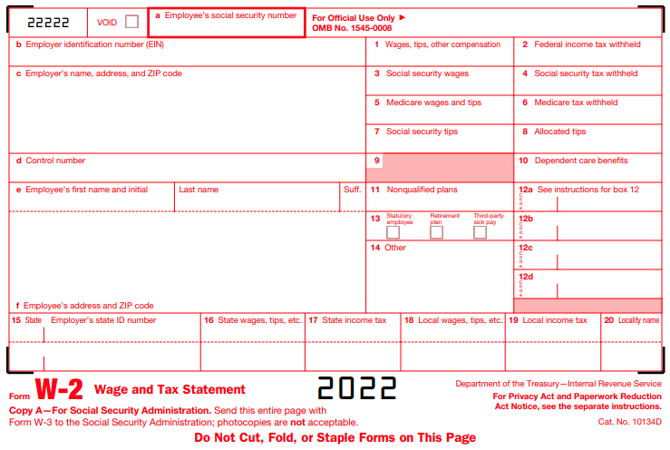
Priest Compensation – Group Exercise
Fr. Andrew’s 2022 W-2
987-65-4321
12-3456789
28425.50
3000.00
St. Mary Parish
123 Easy Street
Anywhere WI 55555 United States
Andrew J Smith
8675309 Main Street
Nowhere WI 56555 United States
X
7440.00 Housing
WI
112233445566
28425.50
600.00

Slide 49
Deacon Compensation: Who is Eligible?
Deacons may be eligible for housing allowance (similar to priests)
  Must be ordained by the Catholic Church
  Must have the authority to conduct and actually conduct religious worship, perform sacerdotal functions, and administer sacraments
  Must have authority to “direct, manage or promote the organization’s activities.”
    Examples:
      Director of Faith Formation
      Pastoral Director
      Director of Administrative Services
    Excluded:
      Custodian

Slide 50
Deacon Compensation: Housing Allowance
Housing allowance is exempt from income tax
Allowance is limited to salary paid directly by the Church
  Church defined as Catholic Parish, School or Agency
Provides opportunity to reduce overall tax liability
  Reduction in federal income tax owed
  Will change tax status to self-employed as it relates to compensation earned from the Church
    Creates self employment tax obligation (employer AND employee portion of FICA)
    Church may supplement self employment tax owed by increasing salary – deacon comp workbook template includes this
May a deacon include a second home in his housing allowance request?
  IRS Code Sec. 107 provides for a ‘home’ not ‘homes’.
  An Appeals Court ruling in 2012 limited the application of a minister’s housing allowance to expenses incurred in only one home (the principal residence). Driscoll v. Commissioner

Slide 51
Deacon Compensation: Example
Deacon James Smith
Position: Director of Faith Formation
Salary from the Church, $50,000
Stipends received from parishioners for performing sacerdotal functions, $1,000
Supplement received from the Church for self-employment taxes, $3,473
Total Income: $54,473
Housing Allowance Received from the Church:
Mortgage principal and interest, $8,000
Real estate taxes, $5,000
Utilities, $1,850
Homeowner’s Insurance, $750
Home repairs/maintenance, $2,000
Total Housing costs: $17,600
Pre-Tax Deductions:
Tax Sheltered Annuity, $1,000
Medical premiums, $2,100
FSA, HSA, and dependent care, $1,500

Slide 52
Deacon Compensation: Example
Is Deacon Smith eligible for housing allowance?
He must be able to answer “YES” to each of these questions.
  Does he have a position with authority to “direct, manage or promote the organization’s activities”?
  Is at least a portion of his salary paid directly by the Church?
  Does he incur housing costs?
YES

Slide 53

Deacon Compensation: Example
Tax Savings to Deacon Smith:

Slide 54
Deacon Compensation: Next Steps
Contact Parish Finance Office if you have a deacon who may qualify.
Other Considerations:
  Calendar year election
  Lay pension calculation
  Housing allowance limitations¹
¹ Housing allowance is limited to the lowest of: (1) Amount designated in advance by the employing unit, (2) Fair rental value of the residence, or (3) Actual expenses incurred in providing the residence.
Notes:
If election is not made on a calendar year basis, may be challenging to file taxes for part of the year as regular employee and part of the year as dual tax status.
The supplemental payment is excluded from the lay pension calculation.
Housing allowance is limited to the lowest of: (1) Amount designated in advance by the employing unit, (2) The fair rental value of the residence, or (3) The actual expenses incurred in providing the residence.

Slide 55
Mass Stipends and Stole Fees: Help Out Priests
Remuneration for each weekday Mass:
  $40.00 plus Mass stipend of $10.00 – plus mileage
Remuneration for each weekend and Holy Day Mass:
  $60.00 plus Mass stipend of $10.00 – plus mileage
Remuneration for all other services
  Sacrament of reconciliation
    $30.00 – plus mileage
  Funeral vigil, etc.
    $30.00 – plus mileage
  Funeral
    Maximum stole fee is $50 – plus mileage
  Wedding
    Maximum stole fee is $75 – plus mileage
  Baptism
    Maximum stole fee is $10 whether within Mass or outside of Mass – plus mileage
A help-out priest presiding at a pro-populo Mass is to be paid $10.00 in addition to the assigned help-out fee and mileage expense.
A proposal to change the help-out fee schedule is underway, as the fees have not been updated in nine years.

Slide 56
Mass Stipends and Stole Fees
Stipends and Stole fees
The maximum amount for stipends and stole fees is established by the bishops of the Province of Wisconsin (c 1264, 2°). The wedding offering is set at a maximum of $75.00 and funeral offering at a maximum of $50.00.
When some parishes indicated a desire to implement an additional fee for the use of parish facilities for weddings and funerals, particular law set the maximum amount at $100.00.
The Chancery Office has received an increased number of calls in the last year regarding the amount being requested for sacramental celebrations especially for weddings and funerals. Usually the fees are not broken out by category so it is difficult to explain to inquirers why the fees are so high. Please review your fee schedules to ensure that you are not exceeding the maximum amounts permitted.

Slide 57
Mass Stipends and Stole Fees
From the Archdiocese of Milwaukee Clergy Manual:
Offerings should not be requested for copies of church records (baptisms, death, etc.); if given voluntarily, they are contributions to the parish
All bination/trination stipends and stipends from multiple Mass intentions beyond the initial stipend are to be sent to the Chancery for the Continuing Education Fund for Priests; it is unjust to use them for any other purpose.
It is the personal responsibility of the priest celebrant to send the 2nd and 3rd stipends to the Chancery. N.B. Even when a priest receives the “stipend offset” compensation all of his bination/trination stipends are to be sent to the Chancery.
The pro-populo Mass (no stipends permitted) on Sundays and Holy Days is required as a personal responsibility of pastors, team administrators and temporary administrators. If a priest is assigned as pastor and/or administrator to more than one parish only one pro-populo Mass is required.

Slide 58
Mass Stipends and Stole Fees
From the Archdiocese of Milwaukee Clergy Manual:
For priests who choose stipend offset compensation ($6,000):
  These priests must willingly sign over stipends, stole fees and help-out income received on the occasion of Masses, baptisms, weddings and funerals to the parish or other paying institution
  Separate stipend accounts must continue to be kept in parishes: a check made payable to the general account is drawn on the stipend account after Masses are celebrated.

Slide 59
Mass Stipends and Stole Fees: FAQ’s
1. Are stipends taxable income to priests?
  Yes.
  Parish priests receive W-2’s and therefore stipends (or stipend offset) would be included on the W-2.
  Help-out priests receive 1099’s from the parish if the parish paid the priest $600 or more in a calendar year. The 1099 should exclude mileage.
2. My pastor doesn’t want to maintain a separate checkbook for Mass Stipends. Can we include our stipend bank account in QuickBooks?
  Let’s discuss
3. May I accept more than $10 for a Mass Stipend? Less?
  The Mass offering is $10.00. If someone makes an offering for Masses without designating the number of Masses being requested (as can happen in an estate gift), the number of Masses to be applied for the stated intention is determined by dividing the total amount given by 10.
  It has long been a custom in the Church that a priest may accept an offering from the faithful to celebrate a Mass for a specified intention. Likewise, the members of the faithful may request that a Mass be offered for a specified intention even if they cannot provide an offering.
4. Is there any limit on the number of Mass intentions and offerings that may be accepted?
  No priest may accept more offerings for Masses to be celebrated by than he can fulfill within a year. (c. 953) Likewise, a parish may not accept more mass intentions that can be fulfilled there in a year. Pastors are to transfer to the Chancery Office Mass obligations that have not been fulfilled within a year. (c. 956)

Slide 60
Priest Professional Expense Reimbursement Fund
The purpose of the fund is to reimburse priests for professional ministerial expenses incurred
This is not taxable income if itemized receipts are provided and the expense is professional in nature
Priest professional expenses are subject to sales tax
Allowable Professional Expense form (included in handouts)
  On Archdiocesan website
  Follows IRS guidelines
Additional professional expense deduction
  Noted in the priest comp workbook
  “Use it or lose it”
Cash advance of professional expense reimbursement is not allowed
Proper documentation of business expenses is required to satisfy IRS requirements. This includes notation of who was involved, when and where the expense occurred, what the expense was and how it relates to the mission of the parish.
For 2022-23 Priests are allowed up to $6,927 per year for professional expenses

Slide 61
QUESTIONS?
Up Next: Safe Environment
Notes:
How far do you want to cast out your net?
Communication avenues:
Paper – bulletins, newspapers, etc.
Job boards – parish, archdiocese, NCEA, Indeed, etc.
Social network – LinkedIn, Facebook, etc.
Networking
Catch people’s attention:
Can you take a Catholic school & make it the best in the world?
Are you a leader with tremendous energy who makes things happen?
Are you a highly responsible leader who always follows through?

Slide 62
The Safe Environment Program for the Business Manager
Suzanne Nickolai
Safe Environment Program Manager
Archdiocese of Milwaukee

Slide 63

Safe Environment Office
Safe Environment Program Manager
Suzanne Nickolai
Office - 414-769-3449 Cell – 262-210-6697
Email: NickolaiS@archmil.org
Safe Environment Program Training Coordinator
Cynthia Rivera-Garcia (Bilingual in English & Spanish)
Office - 414-769-3447
Email: RiveraGarciaC@archmil.org
Victim Assistance Coordinator
& Employee Support Coordinator for Parishes and Schools
Stephanie Delmore, MA, LPC
Office – 414-769-3332 Cell – 262-352-2163
To Report Abuse – 414-758-2232
Email: DelmoreS@archmil.org

Slide 64
Scenario 1
Fr. Juan was just ordained as a priest and assigned as an associate pastor at a parish with an active high school youth group. He enjoys helping with the group and is always planning small group outings. Each month Fr. Juan schedules an optional outing for just the boys from the youth group. Last month Fr. Juan took four 15 year old boys from the youth group on a camping trip to a local state park. One of the boy’s fathers had offered to go along as well, but he was told by Fr. Juan that additional chaperones were not needed. After the camping trip, the boys that went on the trip joked that “What happens on camping trips stays at the camping trip.” Next month Fr. Juan has scheduled an outing to go to the movie theater to watch a movie and out for ice cream afterwards.
What are some examples of concerning behavior?
What do you do next?

Slide 65
Scenario 2
The DRE at your parish comes in and mentions that for the last two weeks of classes, she has noticed that one of her students seems to not be her usual bubbly self. She arrives at class at the last minute and leaves as soon as class ends. A small group of the students have been talking a lot about Snapchat lately, and a group of them seem to interact with each other in a way that makes her suspicious.
This week after class one of the student’s mother approaches you and asks you if you have heard anything regarding a picture being sent around by the middle school students. The mother tells you that her daughter Jenny had talked to her about a nude picture of another girl that was shared in Snapchat. She says that her daughter told her that one of the male students in the class has a secret file on his phone with pictures that are of his “wins.”
What are some concerning behaviors?
What do you do next?

Slide 66

Scenario 3
You receive an anonymous email with this screenshot. You recognize the Facebook account as being Bob, one of the middle school catechist for your parish. Bob does not have any children, and you don’t recognize the individuals in the picture as known relatives of Bob.
Email To Staff: Your teacher Bob is a pervert. Shame on the church for having him around children.
What do you do next?

Slide 67
USSCB Charter for the Protection of Children & Young People – 2002, Revised 2018
ARTICLE 12. Dioceses/eparchies are to maintain “safe environment” programs which the diocesan/eparchial bishop deems to be in accord with Catholic moral principles.
They are to be conducted cooperatively with parents, civil authorities, educators, and community organizations to provide education and training for minors, parents, ministers, employees, volunteers, and others about ways to sustain and foster a safe environment for minors.
Dioceses/eparchies are to make clear to clergy and all members of the community the standards of conduct for clergy and other persons with regard to their contact with minors.

Slide 68
What are the Responsibilities of my Safe Environment Coordinator?
Serve as the archdiocesan contact person for all tasks associated with the Safe Environment Program
Assist new volunteers, employees and new employee applicants with completing their Initial Safe Environment Certification in the CMG Connect System.
Notify and assist volunteers and employees with completing the Renewal Safe Environment Certification Renew Background Check/Code of Conduct (See Criminal Background Check Procedures)
Review the Criminal Background Check Reports for your parish’s and/or school’s volunteers and employees (See Criminal Background Check Procedures)
Complete the annual Safe Environment Compliance Report.
Maintain Safe Environment records and documentation in CMG Connect and on-site as needed.
Coordinate any Safe Environment Education Session that your parish/school hosts.
Distribute Safe Environment Program newsletters, updates, and information to your parish/school.
Implement and enforce Safe Environment Policies and Procedures in the parish/school.
Be the point of contact for ministries, departments, directors and employees regarding Safe Environment Certification status inquiries.

Slide 69
What are the Responsibilities of my Safe Environment Coordinator?
A designated On-Site Safe Environment Coordinator (SEC) should be on-site (or shared between collaborating parishes) for every parish/school.
These responsibilities can be shared or designated to a single person.
An On-Site Safe Environment Coordinator Designation Form should be completed for each person you are designating to assist you as a coordinator.
If your designated SEC leaves your parish/school, please notify the Safe Environment Office so we can remove any confidential access to employee or volunteer records.
New SEC’s are scheduled for training from the Safe Environment Office in using CMG Connect and important policies and procedures. Training typically lasts 3 hours and is conducted in whatever way is most convenient for your parish/school staff.
Your SEC should be identified or made known to your parish/school staff and volunteers. (Identified on website, Listed in bulletin, Identified on internal phone directories, etc.)

Slide 70
What Does the Safe Environment Program Look Like in a Parish/School?
Designated On-Site Safe Environment Coordinator
Every Employee Safe Environment Certified
Every Volunteer with Contact with Minors Safe Environment Certified
Complete Annual Safe Environment Documentation by July 1st.
Annual Compliance Report with attached Children Data Report
Every Student in Grades K4-12th Annual Circle of Grace Lessons
Posted Policies, Flyers, Newsletters, Information on Safe Environments
Abuse Reporting Information
Safe Environment Documentation & Records
(CMG Connect)
Safe Environment Week Information and Activities Raise Awareness of Abuse Prevention Efforts

Slide 71
Important Policies
Code of Ethical Standards (Updated revision pending 2022)
Background Check Guidelines (Updated in 2019)
Social Media & Digital Communication Policy (2020)
Overnight Trip with Minors Policy
Sex Offender Protocol for Parishes & Schools
Mandatory Reporting Responsibilities & Requirements
Safe Environment Certification Policy (2019)
Safe Environment Week Resource Guide (Emailed in February/March each year)

Slide 72
How does the archdiocesan Safe Environment Office support the parish/school?
Education & Training
Compliance & Enforcement
Response & Intervention

Slide 73
How can we help you?
On-site training for new on-site safe environment coordinators.
Additional training for parish/school staff in any safe environment policy, abuse prevention, mandatory reporting, etc.
Create or provide resources for parish/school to provide to staff, volunteers, ministries, or families.
Request a review of the Parish/School Safe Environment Program.
Assistance and guidance with completing any safe environment compliance documentation.
Assistance in responding to or addressing sensitive issues involving children.
Assistance and support for responding to any abuse allegations involving staff or volunteers.
Guidance for navigating through any difficult situations that involve abuse or sexual misconduct.
Counsel for any mandatory reporting situations.

Slide 74
QUESTIONS?
Up Next: Archives/Records Management
Notes:
How far do you want to cast out your net?
Communication avenues:
Paper – bulletins, newspapers, etc.
Job boards – parish, archdiocese, NCEA, Indeed, etc.
Social network – LinkedIn, Facebook, etc.
Networking
Catch people’s attention:
Can you take a Catholic school & make it the best in the world?
Are you a leader with tremendous energy who makes things happen?
Are you a highly responsible leader who always follows through?

Slide 75
Office for Archives & Records Management
Parish Archives & Records Management
Amy Lisinski, MLIS, DAS
Associate Director
Office for Archives & Records Management

Slide 76
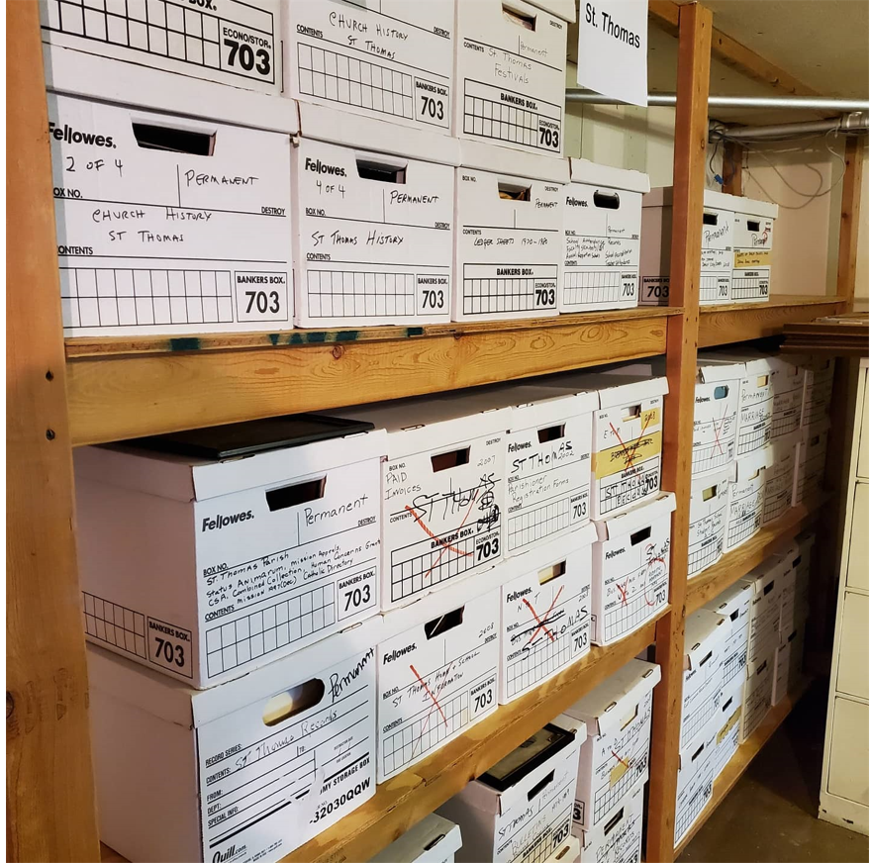
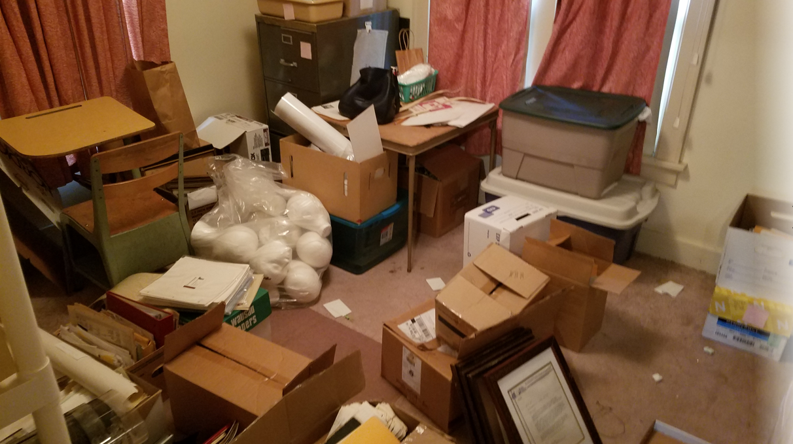
The Parish Archive
“In each parish there is to be a storage area, or archive, in which the parochial registers are protected along with letters of bishops and other documents which are to be preserved for reason of necessity or advantage.” Canon 535 §4
The mission of the archives is to collect, preserve, organize and make available for research the permanently valuable records and artifacts of this archdiocese that reflect the work of the Church, its people and institutions.
The purpose of records management is to ensure that records are retained for as long as legally, historically, or operationally necessary.

Slide 77

Records Retention for Parishes & Schools
Annual Review of Guidelines
Parish & School Human Resources
Parish & School Financial Consulting
Office of Catechesis
Office for Schools
Feedback & questions from parish staff
Determining Record Value
Identify what records are being created
Each records type evaluated for administrative, financial, legal, canonical, & historical value
Notes:
The 2nd step is to determine what needs to be saved, and what can be shredded or discarded. This is the easiest step! The archives, in conjunction with the Office for School and Parish Personnel, the Office for Parish Finance, the Schools Office, and the Office for Catechesis have worked together to issue the Parish Records Retention Guidelines. This is a list of most of the records that a parish or school may have, and how long they need to be saved for. You may remember that the Schools Office and the Catechesis Office had their own Retention Schedule for a number of years. In an effort to make things easier on parishes and schools, we thought it would be best to combine everything into one document. And we do review this document annually to determine if any changes need to be made.

Slide 78
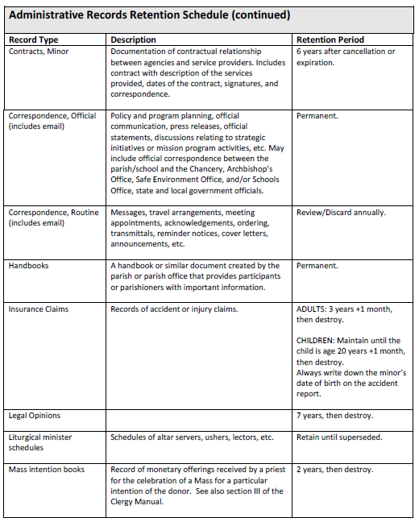
Records Retention for Parishes & Schools
Records Retention Schedule
Divided into 9 categories:
  Administrative
  Catechetical
  Cemetery
  Financial & Accounting
  Historical Records & Publications
  Personnel
  Property
  Sacramental
  School
COVID-19 addendum
Student Cumulative record examples
Storage recommendations
Notes:
The 2nd step is to determine what needs to be saved, and what can be shredded or discarded. This is the easiest step! The archives, in conjunction with the Office for School and Parish Personnel, the Office for Parish Finance, the Schools Office, and the Office for Catechesis have worked together to issue the Parish Records Retention Guidelines. This is a list of most of the records that a parish or school may have, and how long they need to be saved for. You may remember that the Schools Office and the Catechesis Office had their own Retention Schedule for a number of years. In an effort to make things easier on parishes and schools, we thought it would be best to combine everything into one document. And we do review this document annually to determine if any changes need to be made.

Slide 79
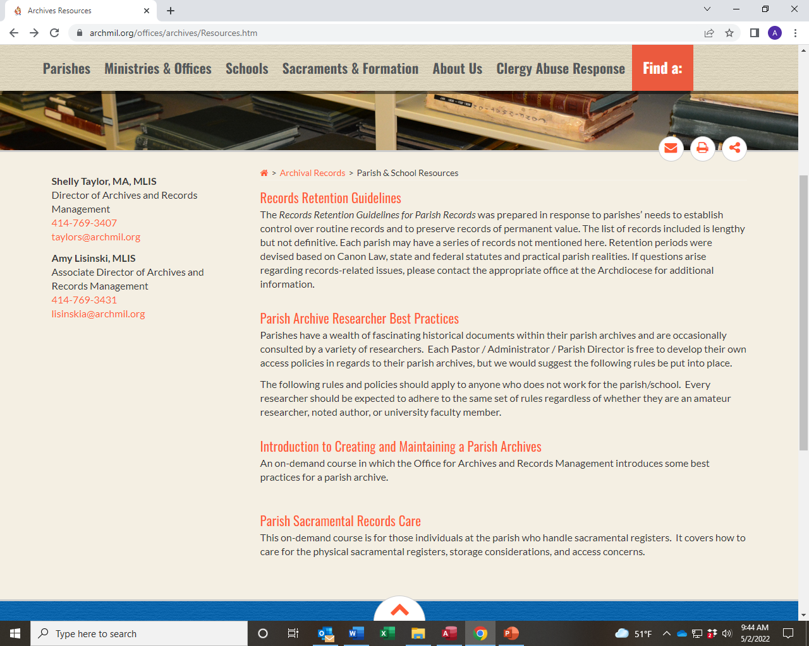
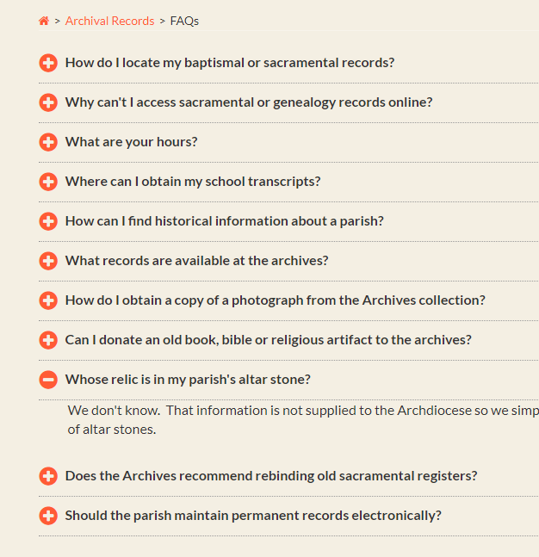
Online Resources for Parishes
https://www.archmil.org/archives

Slide 80
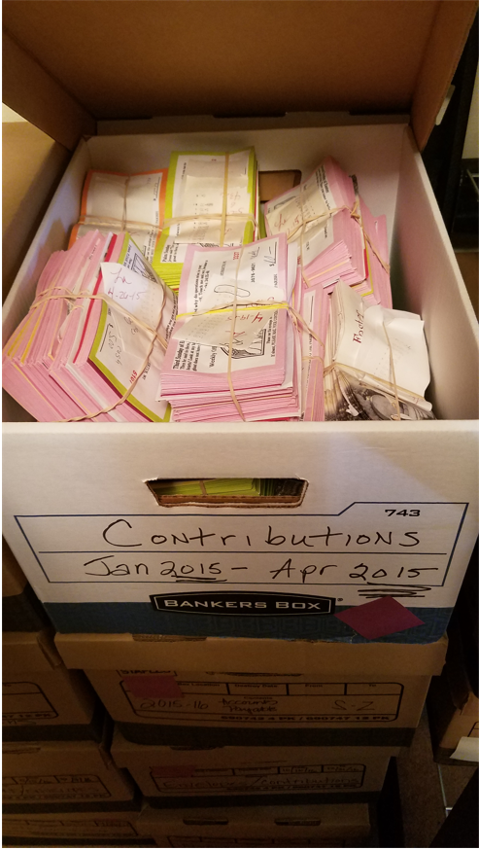
Consultations & Staff Trainings
Records Management Consultations
Onsite parish/school records survey
Big bucket sorting
Storage/site review
Roadmap a plan for future
Phone & Email
Reach out any time with questions about parish and sacramental records

Slide 81
Contact Us!
Shelly Taylor
taylors@archmil.org
414-769-3407
Amy Lisinski
lisinskia@archmil.org
414-769-3431
Notes:
Finally, if you have a big mess, please don’t hesitate to reach out to either Amy or I. The mission of our offices is to assist parishes. Many times we hear from parishes that they are embarrassed to show us their mess.
A few years ago Amy was asked to help clean out an old school. The school had closed years prior, and the doors were locked and everything was left where it was. The parish then made the decision to sell the building, so they needed to get the records out. When she and the pastor entered the building there was no shortage of dead animals. The pastor didn’t have the key to the room where the records were kept, so he broke down the door. Then he told her “well, no one should be here, so if you hear a noise, LEAVE!”. Then he left here there. So – your situation hopefully can’t be worse than that!
So please, if you have questions or need help, don’t be afraid to ask.

Slide 82
The Corporate Book
Barbara Anne Cusack
Chancellor
Archdiocese of Milwaukee

Slide 83

The Corporate Book
What is a Corporate Book?
Why do parishes/schools need a Corporate Book?
Who is responsible for maintaining a Corporate Book?
Does the Corporate Book need to be an actual tangible book?
Notes:
Finally, if you have a big mess, please don’t hesitate to reach out to either Amy or I. The mission of our offices is to assist parishes. Many times we hear from parishes that they are embarrassed to show us their mess.
A few years ago Amy was asked to help clean out an old school. The school had closed years prior, and the doors were locked and everything was left where it was. The parish then made the decision to sell the building, so they needed to get the records out. When she and the pastor entered the building there was no shortage of dead animals. The pastor didn’t have the key to the room where the records were kept, so he broke down the door. Then he told her “well, no one should be here, so if you hear a noise, LEAVE!”. Then he left here there. So – your situation hopefully can’t be worse than that!
So please, if you have questions or need help, don’t be afraid to ask.

Slide 84
The Corporate Book
What goes in the Corporate Book?
  Permanent Records Book
    Articles of Incorporation
    By-Laws
    Proxies
    Endowment Documents
    Etc.
  Annual Corporate Book
    Annual Report
    Trustee Confirmation Form
    Leases
    CFS
    Etc.
  Policy Book
    Employee Handbook
    Cemetery Policies
    School Policies
    Etc.
Notes:
Finally, if you have a big mess, please don’t hesitate to reach out to either Amy or I. The mission of our offices is to assist parishes. Many times we hear from parishes that they are embarrassed to show us their mess.
A few years ago Amy was asked to help clean out an old school. The school had closed years prior, and the doors were locked and everything was left where it was. The parish then made the decision to sell the building, so they needed to get the records out. When she and the pastor entered the building there was no shortage of dead animals. The pastor didn’t have the key to the room where the records were kept, so he broke down the door. Then he told her “well, no one should be here, so if you hear a noise, LEAVE!”. Then he left here there. So – your situation hopefully can’t be worse than that!
So please, if you have questions or need help, don’t be afraid to ask.

Slide 85
QUESTIONS?
Contact:
Barbara Anne Cusack
cusackb@archmil.org
414-769-3341
Notes:
How far do you want to cast out your net?
Communication avenues:
Paper – bulletins, newspapers, etc.
Job boards – parish, archdiocese, NCEA, Indeed, etc.
Social network – LinkedIn, Facebook, etc.
Networking
Catch people’s attention:
Can you take a Catholic school & make it the best in the world?
Are you a leader with tremendous energy who makes things happen?
Are you a highly responsible leader who always follows through?

Slide 86

We have a gift for you!

Slide 87

On Your Flash Drive
Specific to Parish:
Articles of Incorporation
Bylaws
2022 Property Tax Exemption Report (PC220) if a copy was sent to us
  File name is code parish city 2022
Past due agreements, if any
Endowments
Leases
Current Parish Trustees (that we have on file)
Non-Parish Specific:
Resource listing with links
Corporate Book items
Priest Compensation workbook 2022-23
Parish By Laws document
  All parishes moved to these bylaws in 1994

Slide 88

Lunch!
Up Next: Buildings & Grounds

Slide 89
Buildings & Grounds
Panel Discussion

Slide 90
Panel Discussion: Participants
Name(s) | Title/Role | Parish | City | # Yrs | # Buildings | # Parishioners | B&G Committee
Celia Meyers | DAS | St. Gabriel | Hubertus |  | ~7 plus cemeteries |  | Yes – 10 people
Heather Goeden | Office & Facilities Administrator | St. Therese | Milwaukee | 5 | 1 (recently sold 1) |  | Yes – 3 people
Tim O’Neil | B&G Volunteer Extraordinaire | St. Andrew | Delavan
Parish Introductions
Name, Parish, Role (Title), how long you have been in your role
# of Buildings that you maintain, # of parishioners, B&G staff count (For example, “Our parish has 1 full-time Maintenance Manager and 2 part time (20 hour) general maintenance staff”
Does your parish have a B&G committee? If so, how do they work with and communicate with the parish staff?

Slide 91
Catholic Mutual & PIPIT
Molly Hatfield
Claims/Risk Manager
Catholic Mutual Group
Kim Kasten
Treasury Analyst
Archdiocese of Milwaukee

Slide 92
PIPIT
Participants’ Indemnity Plan Irrevocable Trust
Billing of premiums
  New software
Annual Workers Comp data request
  Due May 27, 2022
Kim Kasten
  kastenk@archmil.org
  (414) 769-3326

Slide 93
CATHOLIC MUTUAL GROUP
Catholic Mutual Group is a Catholic not-for-profit that is the administrator of a self-insured property and liability program for the Catholic Church in North America. Catholic Mutual has partnered with the Archdiocese of Milwaukee since 1987.
Notes:
Overview
Catholic Mutual Group is a Catholic not-for-profit that is the administrator of a self-insured property and liability program for the Catholic Church in North America. Catholic Mutual has partnered with the Archdiocese of Milwaukee since 1987.
3-person service office located in Menomonee Falls
Claims handling
Litigation Management
Yearly on-site risk inspections at parishes and schools
Risk management program coordination and consultation
Safety and loss prevention services
Keep current property and auto inventories
Review contracts for insurance and indemnification language compliance
Provide certificates of insurance and surety bonds as requested
Administer pre-employment physical program for maintenance, custodial and cemetery hires

Slide 94
CATHOLIC MUTUAL GROUP
3-person service office located in Menomonee Falls – Ph. 262-255-6906
  Molly Hatfield – 414-405-2603 mhatfield@catholicmutual.org
  Jen Brokmeier – 414-405-2604 jbrokmeier@catholicmutual.org
  Patrick Peyton – ppeyton@catholicmutual.org
Catholic Mutual Website – catholicmutual.org
      Member Login: Username – 0065mil
Password – service

Slide 95
CATHOLIC MUTUAL GROUP
Claims handling
Litigation Management

Slide 96
CATHOLIC MUTUAL GROUP
Yearly on-site risk inspections at parishes and schools
Risk management program coordination and consultation
Safety and loss prevention services

Slide 97
CATHOLIC MUTUAL GROUP
Keep current property and auto inventories
Review contracts for insurance and indemnification language compliance

Slide 98
CATHOLIC MUTUAL GROUP
Provide certificates of insurance and surety bonds
Administer pre-employment physical program for maintenance, custodial and cemetery hires
Administer Third-Party Special Events program
Driver Record Checks

Slide 99
CATHOLIC MUTUAL GROUP
Thank You!

Slide 100
Internal Controls & Parish Reviews
Katie Esterle
Parish & School Financial Consulting
Archdiocese of Milwaukee

Slide 101

Internal Controls & Parish Reviews
.

Slide 102

Internal Controls & Parish Reviews
What is an Internal Control?
  Internal controls include all actions taken by an organization to safeguard its assets, verify the accuracy and reliability of its accounting data, foster efficiency and adhere to good management practices.
Why are Internal Controls Important?
  Because the Arch says they are.
  Because our Trustee said we need to protect our offertory collection.
  Is this day over yet???????????????
  Because they help to safeguard the funds that our donors entrust to us.

Slide 103
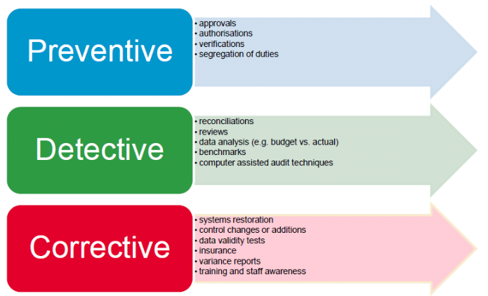
Internal Controls & Parish Reviews
What are some types of Internal Controls?
Preventative:
  What is your parish’s disbursement approval process?
  Does the same person do the bank recs who enters all accounting entries?
  Do job descriptions accurate identify roles and responsibilities?
Detective
  Who reviews the bank reconciliations?
  Does the Finance Council review financials? Compared to the budget?
Corrective
  If an incident occurs, are staff properly trained on new controls?
  If your computer crashes, are there proper backups so that everything can be restored in a reasonable time?

Slide 104

Internal Controls & Parish Reviews
But we are a church (or school)….. No one would take any money from us. Right? RIGHT?
Well let’s see what some recent (ish) news articles have to say….

Slide 105
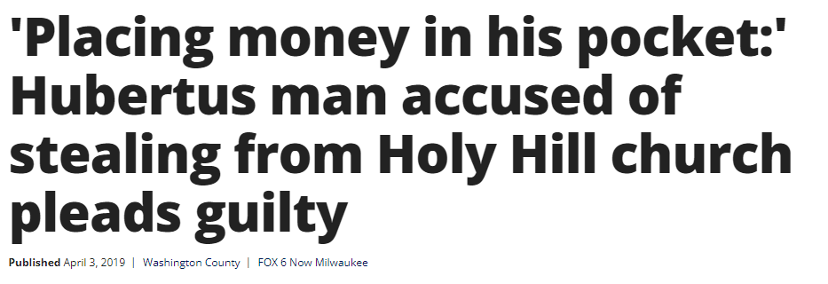
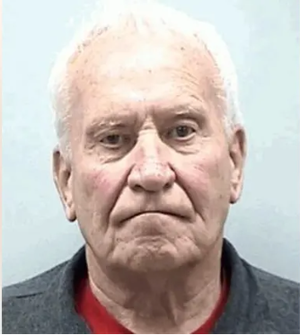
Internal Controls & Parish Reviews
Highlights:
Parish noticed some discrepancies from past donation totals
Parish worked with law enforcement to conduct a Sting Operation
Man had $1,400 in his pockets from that particular day
Admitted to $50,000, but law enforcement believe it was between $85,000-$135,000
The man did not appear remorseful and never explained why he really took it

Slide 106
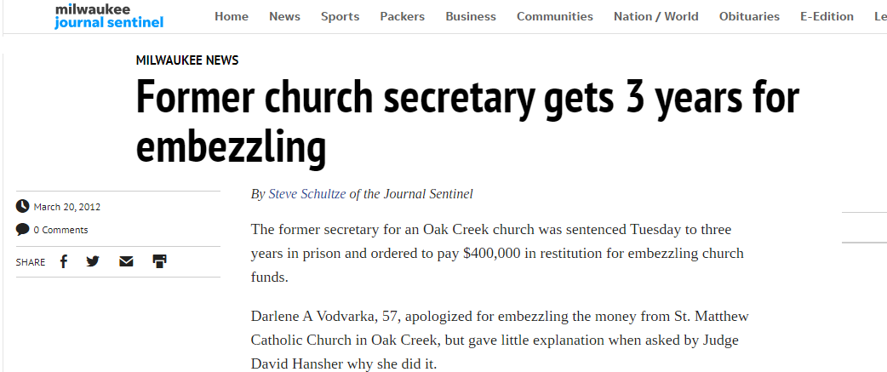
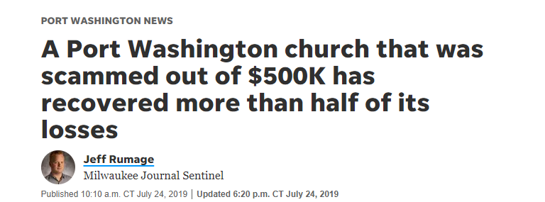
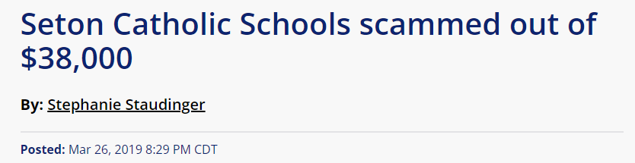
Internal Controls & Parish Reviews

Slide 107
Internal Controls & Parish Reviews
Chapter 5 of the Parish Financial Management Manual provides many financial management guidelines that parishes and schools in the Archdiocese are expected to follow. These guidelines are not meant to be a burden, but instead, help the parish implement solid internal controls to minimize risk.
Common Weaknesses:
Parish Staff Should NOT be involved in money counting – ever
Affiliated Organizations (Athletics, Christian Women, etc.) do not follow the rules
  Two signatures on every check
  Bank reconciliations performed on a monthly basis
  Timely financial statements
Electronic payments do not have proper approval/documentation/authorization
Financial statements are not accurate
  Standard accounting methods not correctly applied
Financial Statements are not prepared on a timely basis and comparative reports are not given to department heads
Separation of Duties
Policies for handling cash at fundraising events

Slide 108

Internal Controls & Parish Reviews
Are we convinced that Internal Controls are important?
So, what are some other ways that we can minimize risk at our parishes and schools?

Slide 109
Internal Controls & Parish Reviews
Audits
Increased awareness among staff and key leaders
  Training through Catholic Mutual
  KnowBe4
Make staff/volunteers aware of a reporting system in case they suspect misconduct
  Convercent
Ensure a good culture among staff
Monitor vacation balances
Internal reviews of policies, processes, etc.
Have a PARISH REVIEW ☺

Slide 110
Internal Controls & Parish Reviews
A Parish Review is a required formal review of parish financial operations by Archdiocesan staff on a periodic basis. The primary purpose of this financial review is to assist parishes in managing their financial resources effectively.
The review will consist of:
A pre-visit questionnaire and document request
An on-site visit stage
A report stage

Slide 111

Internal Controls & Parish Reviews
Stage 1: Pre-visit Questionnaire and Document Request
Someone from the Archdiocese will contact you to discuss the review process and determine a date for the on-site visit
You will receive an Internal Control Questionnaire that should be completed and sent back to the reviewer prior to the on-site visit
You will receive a list of documents that the reviewer will like to take a peek at before the review (i.e, internal financials, staff list, etc.)

Slide 112
Internal Controls & Parish Reviews
Stage 2: On-Site Visit
On a pre-determined date, the reviewer will come to the parish in the morning
It will begin with a review of the Internal Control Questionnaire and discussion on any other items that came up in their pre-visit review
  There are often several questions on the ICQ, CFS to internal financial reconciliation, etc.
From there, the on-site review is broken into 6 areas:
Balance Sheet Reconciliation
Review of Cash Receipts
Disbursements
Payroll & Priest Compensation
Sacramental Records
Read-Through & Discussion

Slide 113
Internal Controls & Parish Reviews
Stage 3: Reporting
The reviewer will write a report that notes all of the “findings” that were discovered during the review
  We are working on updating our report template so that it is easier for parishes to identify serious concerns vs. smaller concerns.
A paper copy of the final report is mailed to the Pastor/Administrator with copies to the Trustees
Parishes are expected to respond to all of the findings within a defined amount of time. This is done via a written response to the report.
  Note: Not every finding needs to be corrected immediately. We completely understand and support parishes prioritizing.
The review report and parish response are reviewed and filed. Copies of both reports are sent to the Archbishop for his review.

Slide 114
QUESTIONS?
Up Next: Fiscal Year End Reminders
Notes:
How far do you want to cast out your net?
Communication avenues:
Paper – bulletins, newspapers, etc.
Job boards – parish, archdiocese, NCEA, Indeed, etc.
Social network – LinkedIn, Facebook, etc.
Networking
Catch people’s attention:
Can you take a Catholic school & make it the best in the world?
Are you a leader with tremendous energy who makes things happen?
Are you a highly responsible leader who always follows through?

Slide 115
Fiscal Year End Reminders
Katie Esterle & Denise Montpas
Parish & School Financial Consulting
Archdiocese of Milwaukee

Slide 116

Fiscal Year End Reminders
Proper financial cut off…remember:
  Revenue may not be recorded unless funds have been received
  Expenses may not be accrued if the purchase has not been made
    Likewise expenses may not be deferred if the expense has already been incurred
Review your balance sheet:
  Have all accruals been updated appropriately?
  Has prepaid expense been reported correctly?
  Has SCRIP inventory been updated?
Budgets due:
  May 15 for deficits
  June 15 for balanced
June 30 - Final payments due for Assessment, PIPIT and priest pension

Slide 117

Fiscal Year End Reminders
New trustees
  Provide copy of Trustee Manual
  Credit reports must be obtained/reviewed from trustees
New pastor/administrator
  Form 8822-B for Change of Address or Responsible Party
Priest compensation workbook
Update employee benefit rates and salaries for first July payroll
Also…
Employee Retention Tax Credit
PPP loan forgiveness
LOA campaign

Slide 118
Closing Remarks
NBAI Dates:
  Session IV: Wednesday, August 10, 2022
BAAM Meetings:
  Wednesday, May 18, 2022
Please remember to fill out an evaluation form.
We appreciate your feedback!

Slide 119
Closing Prayer
Most loving God, you have placed an important task before us.
There will be challenges, which we will meet bolstered by Your strength.
There will be decisions to make, which we will discern with Your guidance.
There will be work to do, which we will accomplish fed by Your grace.
We ask You to be with us as we continue this adventure in faith.
Help us to see the great good that will be accomplished when we answer Your call to build the kingdom.
We ask this through the intercession of Jesus, our Lord.
Amen.

