Slide 1


New Business Administrator Institute
Session I
November 10, 2021

Slide 2

Welcome to the New Business Administrator Institute
Session I

Slide 3
Introduction to the Archdiocese
Chris Brown
CFO & Treasurer
Archdiocese of Milwaukee

Slide 4



Header here
Welcome!

Slide 5
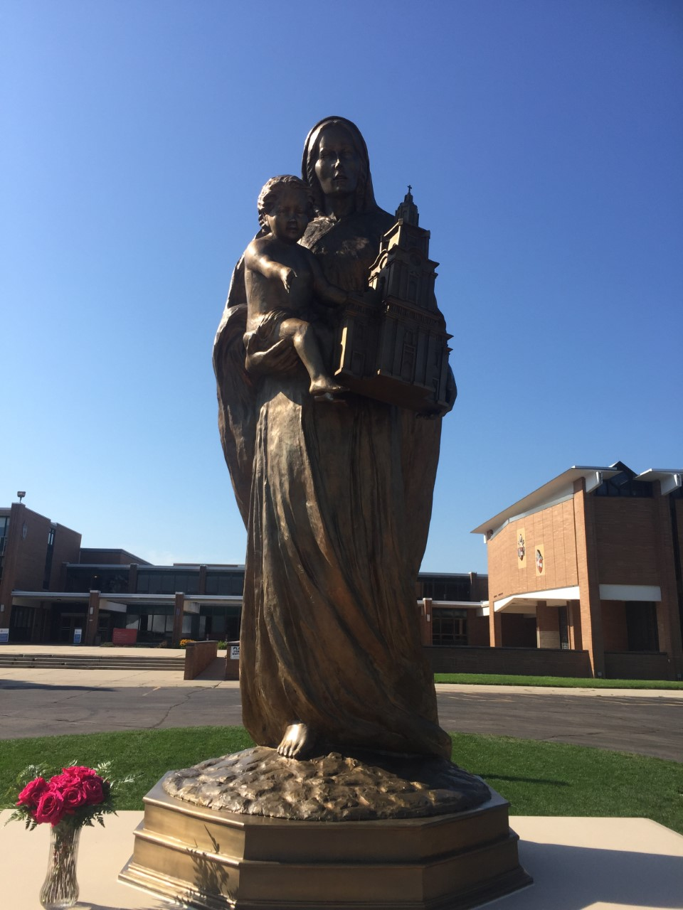
Header here
MMCPC
Mary Mother of the Church Pastoral Center
125 Employees

Slide 6
MMCPC Mission Statement
Header here
Do Everything We Can to Help Parishes/Schools Live out the Archdiocesan Mission

Slide 7
Archdiocese Leadership Team

Slide 8
Archdiocese Leadership Team

Slide 9
Archdiocese Leadership Team

Slide 10
Archdiocese Leadership Team

Slide 11
Archdiocese Leadership Team

Slide 12
Archbishop Listecki Three Priorities
Header here
Catholic Identity
  Who we are
  Rooted in Prayer and Sacraments
  Deepen Faith
Evangelization
  What we do
  Making Disciples
  Spreading the Faith
Stewardship
  How we do it
  Commitment to a Healthy Organization
  Sharing God’s Gifts

Slide 13
Priorities for the Future of the Archdiocese
Header here
    Missionary Planning and Leadership
      Planning: Diocese, Parish, School, Pastor, Facilities
      Leadership: Pastors and Lay
    Evangelization and the Sunday Mass
      The Gift of Sunday – VIA Jesus
    Catholic Social Responsibility
      Provide a strong, coordinated Catholic response in the relation to social issues in the Archdiocese
    Enlarge Our Parish HR and Finance Presence
      More Intentional Parish Outreach and Support

Slide 14

Questions
Up Next: HR – Your Employees’ Onboarding Experience

Slide 15
HR: Your Employees’ Onboarding Experience
Jenny Moyer
Parish & School Human Resources
Archdiocese of Milwaukee

Slide 16
Your Employees’ Onboarding Experience
From the welcome someone receives on their first day, through to their development plan for the first few months, onboarding is the foundation of employee experience.
Notes:
The time taken to achieve this will vary from one organization to another.
Setting up the position correctly and planning the process for them to feel a welcomed part of your organization takes planning.
According to peakon, A workday company 30% of job seekers have left a job within the first 90 days.
Planning!!!
New employee onboarding is the process of integrating a new employee with a company and its culture, as well as getting a new hire the tools and information needed to become a productive member of the team.
Different than orientation. Can take up to 12 months.

Slide 17
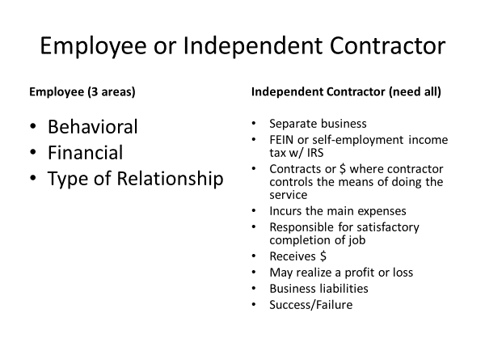
Your Employees’ Onboarding Experience
Notes:
Behavioral - Directs and Controls the Work
What work will be done and how
Instruct them how to do it
Financial – ER controls financial and business direction of the work
Independent – will give you a W-9 and you will give a 1099

Slide 18
Your Employees’ Onboarding Experience
In an employee-employer relationship, employment is for an extended period of time, additional projects can be given w/o added compensation, employer determines work schedule, and employee paid by time period
Notes:
Why is this important?
Must pay:
Medicare
UC taxes
Income taxes
If misclassified….
Talk about IT student coming in through the end of the year.

Slide 19
Your Employees’ Onboarding Experience
Exempt
Vs
Non-Exempt
Hourly vs Salary
Notes:
Completion of this questionnaire helps determine the exemption status of a position. Check the appropriate exemption (Executive, Administrative, Professional, Computer-Related, Outside Sales and Highly Compensated). Then check all boxes under the selected exemption that are applicable. To qualify for an exemption, all boxes must be checked for that exemption. To access the Department of Labor (DOL) online resources for FairPay (CFR 29, Part 541), click here.
EXECUTIVE (examples: chief executive officer, controller, vice president, director)
❑Regularly receives a predetermined amount constituting all or part of the employee's salary, which is not subject to reduction because of variations in the quality or quantity of work performed. To link to the DOL salary basis information, click here❑Is paid at least $455 weekly.❑Primary duty consists of managing the enterprise or a customarily recognized department or subdivision of the enterprise.❑Customarily and regularly directs the work of two or more full-time employees or their equivalents (for example, one full-time employee and two half-time employees).❑Has the authority to hire or fire other employees OR makes recommendations that carry particular weight as to the hiring, firing, advancement, promotion or any other change in status of other employees.To link to the DOL Executive Exemption information, click here.
ADMINISTRATIVE (examples: manager, supervisor, administrator)
❑Regularly receives a predetermined amount constituting all or part of the employee's salary, which is not subject to reduction because of variations in the quality or quantity of work performed. To link to the DOL salary basis information, click here.❑Is paid at least $455 weekly.❑Primary duty consists of performing office or nonmanual work directly related to the management or general business operations of the employer or the employer's customers.❑Work includes the exercise of discretion and independent judgment with respect to matters of significance.To link to the DOL Administrative Exemption information, click here.
PROFESSIONAL: LEARNED AND CREATIVE (examples: accountant, nurse, engineer, composer, singer, graphic designer)
❑Regularly receives a predetermined amount constituting all or part of the employee's salary, which is not subject to reduction because of variations in the quality or quantity of work performed. To link to the DOL salary basis information, click here.❑Is paid at least $455 weekly. Note: For teachers, licensed or certified practitioners of law and medicine, medical interns and residents covered under this exemption, the salary basis and salary requirements do NOT apply.Learned Professional
❑Primary duty consists of the performance of work that requires advanced knowledge (beyond high school) and that is predominantly intellectual in character and consistently includes the exercise of discretion and independent judgment.❑The advanced knowledge is in a field of science or learning.❑The advanced knowledge was acquired by a prolonged course of specialized intellectual instruction (position possesses the appropriate academic degree or has substantially the same knowledge level and performs substantially the same work as degreed employees but possesses advanced knowledge only through a combination of work experience and intellectual instruction)
Creative Professional
❑Primary duty consists of the performance of work requiring invention, imagination, originality or talent in a recognized field of artistic or creative endeavor as opposed to routine mental, manual, mechanical or physical work.To link to the DOL Professional Exemption information, click here.
COMPUTER-RELATED (examples: network or database analyst, developer, programmer, software engineer)
❑Is paid at least $455 weekly OR $27.63 per hour. That is, this exemption does NOT have to meet the salary basis requirement to regularly receive a predetermined amount constituting all or part of the employee's salary, which is not subject to reduction because of variations in the quality or quantity of work performed IF paid at least $27.63 on an hourly basis.❑Primary duty consists of:The application of system-analyst techniques and procedures, including consulting with users to determine hardware, software or systems functional specifications, OR
The design, development, documentation, analysis, creation, testing or modification of computer systems or programs, OR
The design, documentation, testing, creation or modification of computer programs related to machine-operating systems, OR
A combination of these duties which requires the same level of skills.
To link to the DOL Computer-Related Exemption information, click here.
OUTSIDE SALES (examples: salespersons, contract negotiators)
The salary basis and salary requirements do NOT apply for this exemption. That is, this exemption does NOT have the salary basis requirement to regularly receive a predetermined amount constituting all or part of the employee's salary, which is not subject to reduction because of variations in the quality or quantity of work performed, AND this exemption does NOT have to be paid a minimum salary.
❑Primary duty consists of making sales or obtaining orders for contracts for services or for the use of facilities for which consideration will be paid by the client or customer.❑Customarily and regularly is engaged away from the employers place or places of business.To link to the DOL Outside Sales Exemption information, click here.
HIGHLY COMPENSATED EMPLOYEES PERFORMING EXECUTIVE,
PROFESSIONAL OR ADMINISTRATIVE DUTIES
❑Is paid an annual total compensation of $100,000 or more, which includes at least $455 per week paid on a salary basis. The required total annual compensation of $100,000 or more may consist of commissions, nondiscretionary bonuses and other nondiscretionary compensation earned during a 52-week period, but does not include credit for board or lodging, payments for medical or life insurance, or contributions to retirement plans or other fringe benefits.❑Primary duty consists of performing office, nonmanual work. Note: No matter how highly paid, manual workers or other blue-collar workers, including nonmanagement construction workers, who perform work involving repetitive operations with their hands, physical skill and energy are not eligible for this exemption.❑Customarily and regularly performs at least one of the exempt duties or responsibilities of the Executive, Professional or Administrative Exemption.

Slide 20
Your Employees’ Onboarding Experience
QUESTION:
Susan is an exempt employee, therefore she
IS or IS NOT entitled to overtime pay?
Notes:
Susan is NOT entitled to overtime pay.
Exempt Employees
Certain types of employees, often classified as exempt employees, are not entitled to overtime pay as guaranteed by the Fair Labor Standards Act (FLSA). To add to that, most states have their own wage and hourly rate laws that have even more requirements in addition to the FLSA. It is imperative that companies follow both the state and federal employment laws in order to remain legally compliant.
The FLSA requires that employers must pay at least minimum wage for up to 40 hours in a work week and overtime pay for any additional time unless the employee falls into an exception category. In addition to the Federal Act, many states have their own set of wage requirements and laws and it is imperative that employers abide by both federal and state law to stay compliant.
If an employee is considered exempt (vs. non-exempt), their employer is not required to pay them overtime pay.
It is at the employer’s discretion whether or not to pay for hours worked overtime. Some employers might create an employee benefits package with extra perks in lieu of overtime pay. In general, to be considered an “exempt” employee, you must be paid a salary (not hourly) and must perform executive, administrative or professional duties.
To complicate matters further for employers, there are additional federal, state, and FLSA laws related to other classifications of workers, such as interns, independent contractors, temporary employees, volunteers, workers in training, and foreign workers, that employers are required to abide by.

Slide 21
Your Employees’ Onboarding Experience
TRUE OR FALSE?
John is a non-exempt employee, so he works as many overtime hours as he can because he earns one and a half times his hourly wage.
Notes:
True
Non-Exempt Employees
A non-exempt employee is entitled to overtime pay through the Fair Labor Standards Act (FLSA). Employers are required to pay time and a half the employee’s regular rate of pay when they work more than 40 hours in a given pay week. Most employees must be paid the federal minimum wage ($7.25 in 2021) for regular time and at least time and a half for any hours worked over the standard 40.
We recommend not using comp Time. Must be in same pay period
Know what the job takes and be fair to the employee
Supervisor should address workload if there is a lot of overtime.

Slide 22
Your Employees’ Onboarding Experience
NEW EMPLOYEE
Parish & school employee handbook
Code of Ethical Standards
Payroll Paperwork
Benefit Paperwork
I-9
Workspace Prepared

Slide 23
Your Employees’ Onboarding Experience
Parish & School Employee Handbook
Contact Human Resources to receive the word document of the handbook template
Acknowledgement receipt of handbook in the personnel file
Review highlights during orientation

Slide 24
Your Employees’ Onboarding Experience
CODE OF ETHICAL STANDARDS
Three Purposes:
Guidelines on which to model lives & ministries
Stimulate discussion to broaden consensus on ethical standards, aid in training and supervision
Instrument for accountability & basis for disciplinary action

Slide 25
Your Employees’ Onboarding Experience
I-9
-Law – Confirms identity & work authorization
- Form expiration date 10/31/22
- Employee has one day to fill out page 1
- Employer has three days to fill out page 2
Don’t suggest what ID to bring
Recommend NOT photocopying ID
Keep all in a separate binder

Slide 26
Your Employees’ Onboarding Experience
TELL YOUR EMPLOYEE ABOUT YOUR ORGANIZATION – WHO YOU ARE AND WHAT YOU BELIEVE
- Mission statement
- Vision
- Values
- Organizational Chart

Slide 27
Your Employees’ Onboarding Experience
DON’T FORGET THE SOFT SIDE OF ONBOARDING
Call or email the employee the day before their start to tell them where to park, what time to show up….
Ensure the workspace is ready and stocked
Ensure the equipment is ready: phone, computer, etc.
Compile emails, websites, organizations
Who will he/she eat lunch with? How to include.
Set up a list of meetings with others in your organization
Make it interactive

Slide 28
Your Employees’ Onboarding Experience
Tools that help an employee
Job Description
Performance Evaluation
  Share document within 90 days of start date
  Performance evaluation 90 days & yearly
    Self-Evaluation
    Written with face-to-face conversation
    Give and receive feedback with Grace

Slide 29
Your Employees’ Onboarding Experience
TEACHER EXAMPLE
Domaine 2: Professional Life
-Component 2A: Understands School Mission & Role
-Focus on Role model & professional demeanor/attitude
PIP could look like:
-Model professional behavior, through his words and actions, that is appropriate for his audience.
-Refrain from sarcastic comments toward students.
-Refrain from conduct and language that may inhibit a student’s comfort level and ability to learn.
-Understand and maintain a highly professional relationship with students, parents, and staff.

Slide 30
Your Employees’ Onboarding Experience
JUST A FEW REMINDERS:
Contract Offer Dates: April 1 for Principals; April 15 for Teachers
According to Policy, if non-renewal is due to performance concerns:
  Should not come as a surprise
  Concerns put into a written PIP
  “Reasonable” time e.g., minimum of 60 days
First two years of a contract are probationary

Slide 31
Your Employees’ Onboarding Experience
JUST A FEW REMINDERS (CONT.)…
Prior to taking an action that will result in a dismissal or termination (including a RIF and non-renewal of contract), the employer must have sought and followed the advice of a qualitied attorney OR other professional person that Catholic Mutual has approved.

Slide 32
Parishioner Statements
Questions??
Up Next: Year-end Financial Information

Slide 33
Year-End Financial Information: Parishioner Statements and Other Reminders
Katie Esterle
Parish & School Finance Office
Archdiocese of Milwaukee

Slide 34
Parishioner Statements
More than a year end report ……
Every communication is an OPPORTUNITY
What do they WANT to know?
What do they NEED to know?
What do WE WANT them to know?

Slide 35
Parishioner Statements
What do they WANT to know?
What did I give to my parish this year?

Slide 36
Parishioner Statements
What do they NEED to know?
IRS Publication 1711: Charitable contributions overview – Substantiation and Disclosure Requirements for any single contribution over $250.00
  Name of the Parish (Parish Letter head)
  Amount of cash contribution or description (but not value) of non-cash contribution
  “No goods or services were provided by the parish” (if that is the case)
  Description and good faith estimate of the value of goods or services, if any, that the parish provided in return for the contribution
    Ex: Dinner Auction Ticket
  *Important Note: These are the minimum IRS requirements and not the recommendation of best practices in the Archdiocese

Slide 37
Parishioner Statements
What do WE WANT to know?
This is an opportunity!!!! No communication to our parishioners should be wasted …..
  All contributions are important
  All contributions are accounted for
  All contributions are used as they were intended
  All contributions are APPRECIATED
ALL PARISHIONERS ARE IMPORTANT AND APPRECIATED

Slide 38
Parishioner Statements
So how do we get them to know what WE WANT them to know?
Timely Reports … by January 31 … preferably mailed
Accurate Reports … Reconcile your parishioner data system to your accounting system
  Reconcile by deposit & monthly year to date
Complete Reports … Include all contributions
  Contributions, Mass Stipends, Parish-Related Collections, Other …

Slide 39
Parishioner Statements
So how do we get them to know what WE WANT them to know?
What about? Collections for others, Third Party Matching, Memorials, Special Collections, Non-cash donations, etc.
It depends. ☺

Slide 40
Parishioner Statements
Our communities have a RIGHT to EXPECT that we have ACCURATELY accounted for EVERY donation
Accuracy Builds Credibility
Credibility Builds Trust
Trust Builds Community

Slide 41
Parishioner Statements
Questions??

Slide 42
Year-End Financial Reminders
1099’s
W-2’s
First…. A Quiz!

Slide 43
Year-End Financial Reminders – 1099’s
Form 1099-NEC should be issued for all non-employees who the parish paid $600 or more in a calendar year for services they performed
Not all vendors receive a 1099.
  You should have a W-9 on file for any vendor that you pay (this includes individuals) for services. No new vendors should be paid without this document filled out by the vendor.
  A W-9 tells you (the parish) the federal tax classification of the vendor.
    The vendor should fill it out, including their tax classification and EIN or Social Security Number
  You should use the data provided on the W-9 to determine if they are eligible for a 1099 and that information should be entered in your accounting software.

Slide 44
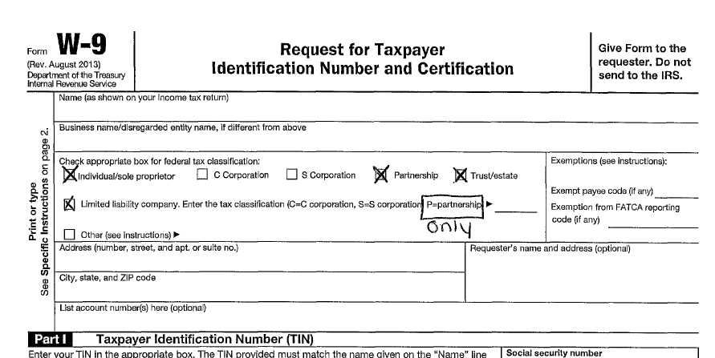
Year-End Financial Reminders – 1099’s

Slide 45
Year-End Financial Reminders – 1099’s
Vendors who are
  Individuals/Sole Proprietors
  Partnerships
  Trusts/Estates
  LLC’s (Partnerships Only)
  …… Are all 1099 eligible
So let’s review your Quiz

Slide 46
Year-End Financial Reminders – W-2s
Let’s move on to W-2s
W-2’s should be prepared for all employees
  Generally speaking, an individual should NOT receive both a 1099 and a W-2 from your parish
    UNLESS – their designation or position changed during the calendar year

Slide 47
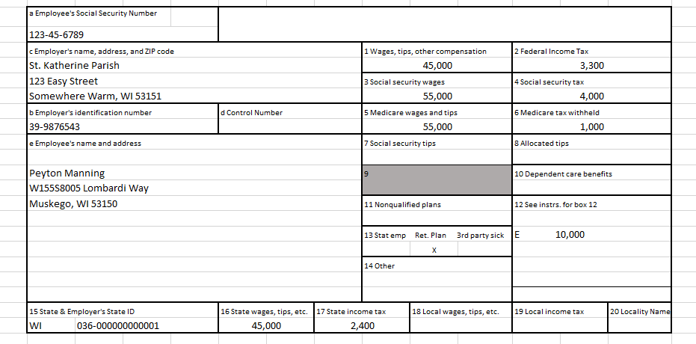
Year-End Financial Reminders – W-2s
This W-2 is for a regular (non-ordained) employee
-If an employee is part of the lay pension program and/or contributes to a 403(b) or 401(k), box 13 on their W-2 should be checked

Slide 48
Year-End Financial Reminders – W-2s
In most cases, your priest’s W-2 will look significantly different that that of all other employees. This is due to their dual tax status: employees for income tax purposes but self-employed for Social Security and Medicare purposes
  Typically, only Box 1 and Box 1 are filled out. Boxes 3-12 are blank.
  Box 13 “Retirement Box” should be checked, as they participate in the Priest Pension Plan.
  Housing may be included in Box 14

Slide 49
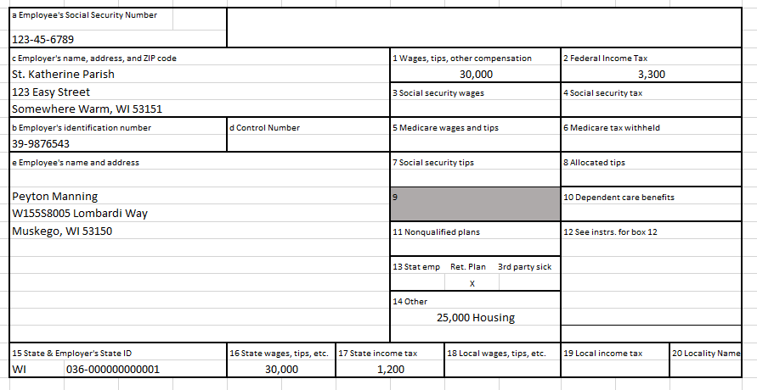
Year-End Financial Reminders – W-2s
This W-2 is for a priest

Slide 50
Year-End Financial Reminders – W-2s
Other Year-End Reminders about W-2s
  The face value of gift cards given to employees are considered taxable income and must be included on a W-2
  Gifts that are not de minimus or gift cards that are given to employees by Home & School, Christian Women, etc. are considered taxable income and must be included on a W-2

Slide 51
Parishioner Statements
Questions??
Up Next: Love One Another Capital Campaign

Slide 52
Love One Another Capital Campaign
Andy Gaertner - Director
Development Department
Archdiocese of Milwaukee

Slide 53

Development Office
Love One Another Capital Campaign
What is a capital campaign?
What is the Love One Another campaign?
Why now?

Slide 54

Development Office
Love One Another Capital Campaign
What is the purpose of the Love One Another campaign?
Launched in 2020 following a planning study.
$150 million goal
  Strengthening 188 Parishes: $90 million
  Serving and Helping those in Need: $13.5 million
  Supporting Our Priests, Deacons, Seminarians, and Lay Ministers: $13 million
  Supporting Catholic Schools: $17 million
  Strengthening Centers of Prayer and Ministry: $16.5 million

Slide 55
Parishioner Statements
Questions??
Up Next: Lunch ☺

Slide 56
Lunch!

Slide 57
Development Office: How We Serve You

Slide 58

Development Office - Stewardship
God Loves You
Comprehensive & Custom Solutions
Prayer
Time
Talent
Treasure
  Increased Offertory Program
    Based on industry best practices
      Data analysis & reporting
      Project Management
    Cost = print & postage

Slide 59

Development Office
Catholic Stewardship Appeal (CSA)
What is the Catholic Stewardship Appeal?

Slide 60
Development Office
Catholic Stewardship Appeal (CSA)
CSA Kickoff 2022 – February 5-6
Parish Advocates
Video
Mailings
In-Pew Solicitation

Slide 61

Development Office
Catholic Stewardship Appeal (CSA)
We are here to help

Slide 62
Development Office
Combined Collections
June - Combined Collections: Catholic Ministries in the United States
Black and Indian Missions
Catholic Campaign for Human Development
Catholic Communications Campaign
Retirement Fund for Religious
Catholic University of America
October - Combined Collections: Catholic Global Ministries
World Mission Sunday
Catholic Home Missions
Catholic Relief Services
Church in Central and Eastern Europe
Collection for the Works of the Holy Father: Peter's Pence

Slide 63
Development Office
Systems & Operations
Data and Donation Processing
Keeping track of your parish database
Changes/Adds/Deletes can be sent to parishupdates@archmil.org
Questions: email nymank@archmil.org or 414-769-3570
Recording all donations to the archdiocese and other collections
Questions regarding donations: email brangerd@archmil.org or 414-769-3321
Regular reporting of results for CSA, Combined Collections, Love One Another campaign, other special gifts
Questions regarding reports: email nabihm@archmil.org or 414-769-3323
Processing stock gifts, IRA donations, bequests, planned gifts, or other large general donations to the archdiocese
Questions regarding processing: email nabihm@archmil.org or 414-769-3323
Providing year end tax letters to donors for all archdiocesan related gifts.
Questions regarding tax letters: email brangerd@archmil.org or 414-769-3321

Slide 64

Development Office
Planned Giving
Did You Know…

Slide 65

Development Office
Planned Giving
This can be really confusing
Securities
Life Insurance
Bequests
Charitable trusts
Retirement plans
Cash
Personal Property

Slide 66

Development Office
Planned Giving
I can plan my giving
Will Seminars
Estate Planning
Remember the Church

Slide 67

Development Office
Planned Giving
One good idea helped me
Make a difference at your parish
Schedule an appointment with the
Development Office to discuss any of the topics we shared with you today.
Thanks for what you are doing and will do at your parish.

Slide 68

Development Office
Contact Us!
Andy Gaertner – Director
414-769-3322
gaertnera@archmil.org
Cindy Lukowitz
Stewardship
414-769-3572
lukowitzc@archmil.org
Michele Nabih
Systems & Operations
414-769-3323
nabihm@archmil.org
Jenny Mendenhall
Catholic Stewardship Appeal (CSA)
414-769-3320
mendenhallj@archmil.org
Bob Pfundstein
Planned Giving
414-769-3583
pfundsteinb@archmil.org

Slide 69
Parishioner Statements
Questions??
Up Next: Budgeting

Slide 70
Parish & School Budgeting
Denise Montpas
Parish & School Finance Office
Archdiocese of Milwaukee

Slide 71

Budget Timeline
December 15 – Budget forms and instructions are to be distributed to all persons responsible for any program or function in the parish. They should be given previous fiscal year, current fiscal year and budgeted current fiscal year financial data.
January 31 – All completed budget forms should be returned to the Budget Committee (or Business Administrator) and assembled to create a consolidated budget.
February 28 – The Budget Committee should complete the initial review of the proposed budget and make suggestions for adjustments.
March 1-15 – The Budget Committee discusses the proposed adjustments with the persons responsible for the program. They then consult with the Finance Council and pastor/administrator.
April 1 – Budget Committee finalizes the proposed budget and a summary of it goes to the Finance Council in advance of the April Council meeting.
April/May – The proposed budget is presented to the Finance Council for discussion. Approval by the pastor/administrator.
Submit to the Archdiocese.

Slide 72
Submitting a balanced (surplus) budget
Your budget and a signed coversheet must be submitted to the Parish & School Financial Consulting Office by June 15th.
  It should be submitted in whatever format the budget was given to your Finance Council.
Parishes are required to send a current year-to-date actual P&L compared to the current year budget with their budget submission.
  YTD through February 28th or more current.
You can email or mail your budget and coversheet.
  Email is preferred.
The Parish & School Financial Consulting Office reviews the submission.
  If there are any questions, we contact you.
  Upon completion of our review, we confirm the submission has been accepted.

Slide 73
Submitting a deficit budget
It is recognized that a deficit budget may be required from time to time. It is the routine and repeated use of a deficit budget that requires a change in direction.
Your budget and a signed coversheet must be submitted to the Parish & School Financial Consulting Office by May 15th.
The parish must provide the same documentation required for a balanced budget submission. In addition, the parish must provide the following for a deficit:
  Narrative explaining:
    Why the parish has a deficit;
    How the deficit will be funded; and
    A plan indicating how the parish will resolve the budget in the future and identifying the steps needed to maintain positive cash flow.
  Balance Sheet as of February 28th or more current.
Then what?
The Parish & School Financial Consulting Office will review the material and discuss the situation with the parish. The proposed deficit will be presented to the Archbishop. The Archbishop will approve the deficit as proposed, approve it with modifications, or return it to the parish for further work. You will be notified of his decision.

Slide 74
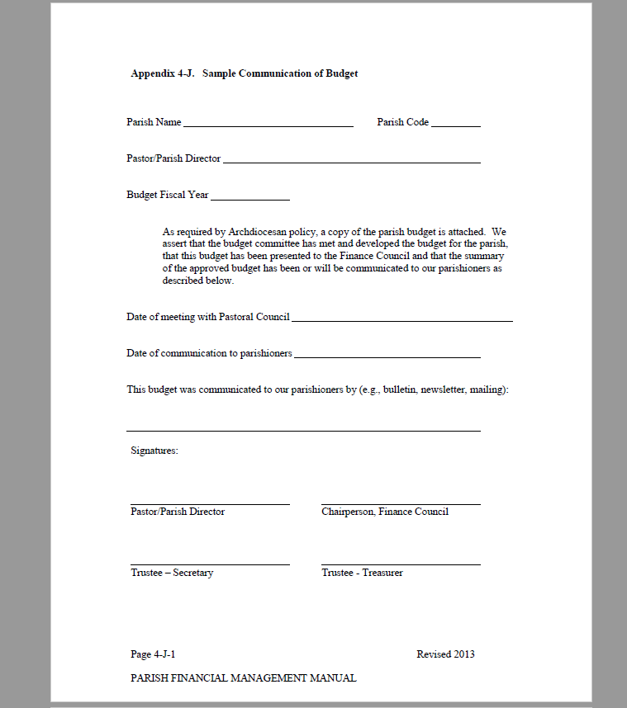
Sample Coversheet

Slide 75

How can we help?
At any point during your budgeting process, we are happy to review a draft budget and make recommendations. We can also meet with you to discuss any concerns you have.
We are here to help.

Slide 76
Panel Discussion: Participants
Barb Gawlik
  St. Patrick, Whitewater
Dan Hansen
  St. Mary, Hales Corners
Lisa Schoneman
  St. John the Baptist, Plymouth

Slide 77
Panel Discussion: Overview of Parish Processes
How does it actually work in parishes?
  Timing: When does the budgeting process start, how long does it take, and when does it finish?
  Who is part of the process? Departmental involvement, Finance Council involvement, any others
  Any tools that are used in the process?

Slide 78
What does the Archdiocese review?
Revenue
Review total revenue for reasonableness
Investment income
Is “other revenue” reasonable?
Any negative, or contra-revenue, items?
Any restricted revenue included?
Any use of reserves?

Slide 79
What does the Archdiocese review?
Expense
Review total expense for reasonableness
School subsidy information
Are any capital expenditures included?
  What are they for?
  Will they be paid using restricted funds?
Verify Archdiocesan Assessment included
Is “other expense” reasonable?

Slide 80
What does the Archdiocese review?
Schools
What is the school enrollment for next year?
Is it higher or lower than the current year?
Has tuition rate changed?
Is school Choice revenue consistent with any known changes?
Are expenses in line with change in enrollment?

Slide 81
Small Group Exercise
Two example budgets have been provided.
Work together to identify at least two things the parish did well and at least two things the parish did not do well in preparing these budgets.
  Do this for both of the example budgets.

Slide 82
Budgeting Session Wrap Up
Any best practices to share?
Other questions?
Feedback?

Slide 83
Thank you for attending the New Business Administrator Institute.

