Slide 1
Welcome to the New Business Administrator Institute Session I

Slide 2
Coffee with Catherine
Today’s Chat is on:
Setting Employees Up for Success
Making an impact on the workplace community requires clarity, focus, & expanding knowledge.

Slide 3
Employee or Independent Contractor?
Independent Contractor (need all)
Employee (3 areas)
Separate business
FEIN or self-employment income tax w/ IRS
Contracts or $ where contractor controls the means of doing the service
Incurs the main expenses
Responsible for satisfactory completion of job
Receives $
May realize a profit or loss
Business liabilities
Success/Failure
Behavioral
Financial
Type of Relationship
Notes:
The IRS has identified eleven main tests to determine if an individual is an employee or an independent contractor. The eleven main tests have been organized into three main groups: behavioral control, financial control, and the type of relationship of the parties.
Employee - 3 areas that are looked at:
Behavioral Control:
Instructions - when to do the job, tools to use, workers to help, where to buy supplies, work performed by specified individual, & what order to follow.
Training
Financial Control – reimbursed expenses, worker’s investment, “jobs” for others, regular pay, no profit or loss.
Type of Relationship – nature of relationship, benefits, permanency of relationship, & right to direct & control activities.
Independent Contractor (need all):
Separate business
FEIN or files self-employment income tax w/ IRS
Contracts or $ where contractor controls the means of doing the service
Incurs the main expenses
Responsible for satisfactory completion of job
Receives $
May realize a profit or loss
Has business liabilities
Success/Failure of business depends on $ in and $ out.
In determining if an individual is covered under workers compensation is defined according to Wisconsin State Statute 102.07(8):
Except as provided in pars. (b) and (bm), every independent contractor is, for the purpose of this chapter, an employee of any employer under this chapter for whom he or she is performing service in the course of the trade, business, profession or occupation of such employer at the time of the injury.

Slide 4
In an employee-employer relationship, employment is for an extended period of time, additional projects can be given w/o added compensation, employer determines work schedule, and employee paid by time period.
Notes:
An employer that fails to id an individual as an ee (when they actually are) will owe back taxes and penalties….maybe cost of benefit coverage, accrued health claims that the individual paid out of pocket. Note: stop loss might refuse to pay.

Slide 5
Exempt vs Non-Exempt
Hourly vs Salary
Notes:
Completion of this questionnaire helps determine the exemption status of a position. Check the appropriate exemption (Executive, Administrative, Professional, Computer-Related, Outside Sales and Highly Compensated). Then check all boxes under the selected exemption that are applicable. To qualify for an exemption, all boxes must be checked for that exemption. To access the Department of Labor (DOL) online resources for FairPay (CFR 29, Part 541), click here.
EXECUTIVE (examples: chief executive officer, controller, vice president, director)
❑Regularly receives a predetermined amount constituting all or part of the employee's salary, which is not subject to reduction because of variations in the quality or quantity of work performed. To link to the DOL salary basis information, click here❑Is paid at least $455 weekly.❑Primary duty consists of managing the enterprise or a customarily recognized department or subdivision of the enterprise.❑Customarily and regularly directs the work of two or more full-time employees or their equivalents (for example, one full-time employee and two half-time employees).❑Has the authority to hire or fire other employees OR makes recommendations that carry particular weight as to the hiring, firing, advancement, promotion or any other change in status of other employees.To link to the DOL Executive Exemption information, click here.
ADMINISTRATIVE (examples: manager, supervisor, administrator)
❑Regularly receives a predetermined amount constituting all or part of the employee's salary, which is not subject to reduction because of variations in the quality or quantity of work performed. To link to the DOL salary basis information, click here.❑Is paid at least $455 weekly.❑Primary duty consists of performing office or nonmanual work directly related to the management or general business operations of the employer or the employer's customers.❑Work includes the exercise of discretion and independent judgment with respect to matters of significance.To link to the DOL Administrative Exemption information, click here.
PROFESSIONAL: LEARNED AND CREATIVE (examples: accountant, nurse, engineer, composer, singer, graphic designer)
❑Regularly receives a predetermined amount constituting all or part of the employee's salary, which is not subject to reduction because of variations in the quality or quantity of work performed. To link to the DOL salary basis information, click here.❑Is paid at least $455 weekly. Note: For teachers, licensed or certified practitioners of law and medicine, medical interns and residents covered under this exemption, the salary basis and salary requirements do NOT apply.Learned Professional
❑Primary duty consists of the performance of work that requires advanced knowledge (beyond high school) and that is predominantly intellectual in character and consistently includes the exercise of discretion and independent judgment.❑The advanced knowledge is in a field of science or learning.❑The advanced knowledge was acquired by a prolonged course of specialized intellectual instruction (position possesses the appropriate academic degree or has substantially the same knowledge level and performs substantially the same work as degreed employees but possesses advanced knowledge only through a combination of work experience and intellectual instruction)
Creative Professional
❑Primary duty consists of the performance of work requiring invention, imagination, originality or talent in a recognized field of artistic or creative endeavor as opposed to routine mental, manual, mechanical or physical work.To link to the DOL Professional Exemption information, click here.
COMPUTER-RELATED (examples: network or database analyst, developer, programmer, software engineer)
❑Is paid at least $455 weekly OR $27.63 per hour. That is, this exemption does NOT have to meet the salary basis requirement to regularly receive a predetermined amount constituting all or part of the employee's salary, which is not subject to reduction because of variations in the quality or quantity of work performed IF paid at least $27.63 on an hourly basis.❑Primary duty consists of:The application of system-analyst techniques and procedures, including consulting with users to determine hardware, software or systems functional specifications, OR
The design, development, documentation, analysis, creation, testing or modification of computer systems or programs, OR
The design, documentation, testing, creation or modification of computer programs related to machine-operating systems, OR
A combination of these duties which requires the same level of skills.
To link to the DOL Computer-Related Exemption information, click here.
OUTSIDE SALES (examples: salespersons, contract negotiators)
The salary basis and salary requirements do NOT apply for this exemption. That is, this exemption does NOT have the salary basis requirement to regularly receive a predetermined amount constituting all or part of the employee's salary, which is not subject to reduction because of variations in the quality or quantity of work performed, AND this exemption does NOT have to be paid a minimum salary.
❑Primary duty consists of making sales or obtaining orders for contracts for services or for the use of facilities for which consideration will be paid by the client or customer.❑Customarily and regularly is engaged away from the employers place or places of business.To link to the DOL Outside Sales Exemption information, click here.
HIGHLY COMPENSATED EMPLOYEES PERFORMING EXECUTIVE,
PROFESSIONAL OR ADMINISTRATIVE DUTIES
❑Is paid an annual total compensation of $100,000 or more, which includes at least $455 per week paid on a salary basis. The required total annual compensation of $100,000 or more may consist of commissions, nondiscretionary bonuses and other nondiscretionary compensation earned during a 52-week period, but does not include credit for board or lodging, payments for medical or life insurance, or contributions to retirement plans or other fringe benefits.❑Primary duty consists of performing office, nonmanual work. Note: No matter how highly paid, manual workers or other blue-collar workers, including nonmanagement construction workers, who perform work involving repetitive operations with their hands, physical skill and energy are not eligible for this exemption.❑Customarily and regularly performs at least one of the exempt duties or responsibilities of the Executive, Professional or Administrative Exemption.

Slide 6
Susan is an exempt employee, therefore she IS or IS NOT entitled to overtime pay?
Question:
Notes:
Susan is NOT entitled to overtime pay.
Exempt Employees Certain types of employees, often classified as exempt employees, are not entitled to overtime pay as guaranteed by the Fair Labor Standards Act (FLSA). To add to that, most states have their own wage and hourly rate laws that have even more requirements in addition to the FLSA. It is imperative that companies follow both the state and federal employment laws in order to remain legally compliant.
The FLSA requires that employers must pay at least minimum wage for up to 40 hours in a work week and overtime pay for any additional time unless the employee falls into an exception category. In addition to the Federal Act, many states have their own set of wage requirements and laws and it is imperative that employers abide by both federal and state law to stay compliant.
If an employee is considered exempt (vs. non-exempt), their employer is not required to pay them overtime pay.
It is at the employer’s discretion whether or not to pay for hours worked overtime. Some employers might create an employee benefits package with extra perks in lieu of overtime pay. In general, to be considered an “exempt” employee, you must be paid a salary (not hourly) and must perform executive, administrative or professional duties.
To complicate matters further for employers, there are additional federal, state, and FLSA laws related to other classifications of workers, such as interns, independent contractors, temporary employees, volunteers, workers in training, and foreign workers, that employers are required to abide by.

Slide 7
John is a non-exempt employee, so he works as many overtime hours as he can because he earns one and a half times his hourly wage.
Question –
True or False?
Notes:
True
Non-Exempt Employees A non-exempt employee is entitled to overtime pay through the Fair Labor Standards Act (FLSA). Employers are required to pay time and a half the employee’s regular rate of pay when they work more than 40 hours in a given pay week. Most employees must be paid the federal minimum wage ($7.25 in 2017) for regular time and at least time and a half for any hours worked over the standard 40.

Slide 8
New Employee (ee)
Parish & School Employee Handbook Guide
Code of Ethical Standards
I-9
Payroll paperwork
Benefit paperwork
Notes:
Time record vs Time card
Prior to first day
Welcome and planning phone call from supervisor
Communicate first day “need to know” to new employee
dress code
directions, parking
work hours
lunch options (eating in, eating out)
where to go, who to meet, brief agenda for first day
Set up work station
Computer system/email/telephone
access to electronic timekeeping system
Add new employee to department telephone list
Email team/unit/department introducing new hire
name
position
background/bio
start date
Make a day-by-day plan for the first week. Ensure supervisor availability.
First day
Greet new employee, take new employee to meet everyone within the department and other staff with whom the new person will work closely
Review agenda for the day
Review the Employee Paperwork Checklist
Review the Benefits Checklist
Allow time to complete employment paperwork
parking
Work station/telephone set up and personalization
Plan lunch (supervisor and work team)
Floor/building
tour
exits
discuss drills
Orient
bathrooms
food and beverages: coffee, water, lunch/eating options & locations, refrigerators, microwaves
office equipment and supplies
mailbox/services
personal belongings storage
building unlock/lock up procedures
first aid kit/fire extinguishers/other safety equipment
Confirm work hours, review agenda for rest of week 1
First week (Days 2-5)
tour
Review job description
Department orientation continues:
Organizational charts (dept, division, university)
Continue meeting colleagues
Review roles, responsibilities and important connections new employee needs to make with colleagues
Set expectations
communication with supervisor
information sharing (what, how often, with whom)
requesting and documenting time off/sick leave
confidentiality
customer service
Code of Conduct (ethics and values)
Establish regular supervision meeting frequency and times
Set six month goals & objectives (consider probationary period for classified staff)
Training
ensure employee registers for/completes training and assessments(required by position or department, supportive of goals and objectives).
Timekeeping/leave request
Policy library
Explain communications
Provide relevant codes-office, account, long distance calling
Provide relevant keys/access information
Ensure network access and show location of electronic files and documents
Paper files, documents
Review schedules: work schedule, holiday calendar, relevant meetings and schedule
Review security & use procedures-IT, building, office
Meet with unit/team to learn roles and responsibilities. Be sure to cover
Personnel Administrator
Timekeeper
all team members
Ensure new hire will have enough time to select healthcare benefits prior to 30 calendar days from start date
Near end of week:
establish workload & projects for first several months
review department goals
Monitor flow of the first week. Allow down time for employee to read materials, explore website, complete online requirements, and reflect.
Bonus: Plan lunch every day with individuals or groups the new employee should meet and know
Bonus: Invite new employee to take advantage of the 30 day free trial gym membership. Offer to go as well!
30 days
Solicit feedback from new employee
fresh ideas to improve processes and practices
creative ways to solve problems
relationship development with supervisor and team
training, support, resources to do their jobs
onboarding process
communication and information needs
Review progress towards 6 month goals and objectives
Assign a short term (30 day) project
Bonus: solicit observations from new employee about unit/team/dept/culture. Start a culture conversation individually or with the team.
Bonus: plan a team building exercise
60 days
During supervision, ask employee 15 questions (see checklist)
Review training attendance, impacts and application
Review progress towards 6 month goals and objectives
Solicit feedback (see 30 days)
Review & praise project outcome
90 days
Review training attendance, impacts and application
Encourage employee attendance at Post NEO Meet & Greet
Review progress towards 6 month goals and objectives
Explore additional professional and personal growth/development opportunities learning & training
committee/group involvement
networking opportunities

Slide 9
Parish & School Employee Handbook
Updated Guide on how to create is on My ArchMil
Employee sign Acknowledgement Receipt of Handbook
Review big ticket items when hired

Slide 10
Code of Ethical Standards
Three Purposes:
Guidelines on which to model lives & ministries
Stimulate discussion to broaden consensus on ethical standards , aid in training and supervision
Instrument for accountability & basis for disciplinary action.

Slide 11
I-9
Law– confirms identity & work authorization
Form expiration date 8/31/19
Employee has one day to fill out page 1
Employer has three days to fill out page 2
Don’t suggest what id to bring
Recommend NOT photocopying id

Slide 12
Who are you Employer (er)?
Mission Statement of the Catholic Church
Vision
Values
Organizational Chart (reporting & communication)
Role of Communication

Slide 13
Communication
In order for an outer idea to take root in higher awareness…..
it must first make its way through the endless maze of prior experiences and values.
Notes:
We each experience the world thru a set of senses.
Not everyone perceives the world the way each of us AND that the perception is the same from one day to the next.
Brain is like a maze w/ endless meandering perceptions….subjective part of a person where belief systems are created.
It is with this understanding that it is likely that a new idea will encounter resistance.

Slide 14
Tools that help a person…. What is my job? How do I behave?
Job Description
Performance Evaluation
Share document within 90 days of start date
Performance Evaluation 90 days & yearly
Self-Evaluation
Written with face-to-face conversation
Give and receive feedback with Grace

Slide 15
Teacher Example
Domaine 2: Professional Life
Component 2A: Understands School Mission & Role
Focus on Role model & professional demeanor/attitude
PIP could look like:
Model professional behavior, through his words and actions, that is appropriate for his audience.
Refrain from sarcastic comments toward students.
Refrain from conduct and language that may inhibit a student’s comfort level and ability to learn.
Understand and maintain a highly professional relationship with students, parents, and staff.

Slide 16
Questions?
Catherine Gryniewicz
gryniewiczc@archmil.org
414-769-3370

Slide 17
Break Let’s regroup in 15 minutes

Slide 18
Mandi Kramlich
Benefit Administrator

Slide 19
Overview
Summary of the St. Raphael Health Plan
Continuation of Coverage
Qualifying Event
Online Enrollment

Slide 20
What is the St. Raphael Health Plan
An Association: Made up of parishes, schools and other catholic organizations who choose to participate in the plan
The Archdiocese is the sponsoring organization: As the sponsoring organization the Archdiocese has set up a trust to manage the funds necessary to pay the insurance premiums, claims and other administrative costs
Benefit: participation in the St. Raphael Health Plan allows for locations to reap the benefit of a large group insurance plan; i.e. network provider, discounts and protection

Slide 21
Selected Providers
United HealthCare
CVS Caremark
Delta Dental
VSP
Smart Choice MRI
Benefit Administrative Services
Catholic Mutual Group

Slide 22
Plan Overview
Plans run fiscal year (July 1st – June 30th)
Deductibles run calendar year (January 1st – December 31st)
Plan renews July 1st
Open enrollment is April 16th to May 18th
Two health plans; Choice $1000 & HSA-Eligible
Not all locations offer both!
Dental through Delta Dental
Vision through VSP – no card needed
No changes mid-year unless qualifying event

Slide 23
Policies and Mandates
Archdiocesan Policies –
Eligibility
Full time employees working 30+ hours a week
Part time employees working 20-29 hours a week
Percentage of premium paid – Bishop’s Mandate
70% family 85% single
Eligibility Dates
First of month FOLLOWING 30 days of employment
Continuation of Coverage (THIS IS NOT COBRA!)
Continuation MUST be offered to any employee who leaves employment, unless terminated due to gross misconduct!

Slide 24
Two Health Plans

Slide 25
Virtual Visits

Slide 26
Information

Slide 28
My Archmil
Where to find Health Insurance Information
www.archmil.org
Log in to My Archmil

Slide 32
Continuation of Coverage (THIS IS NOT COBRA!)
Continuation of Coverage form MUST be used. Verbal acceptance or refusal is not acceptable
REGULAR TERMINATION
When an employee terminates employment with you, the following steps should be taken:
1.The continuation form should be given to the employee during the exit interview. *NOTE: the top part of the form should be filled out by YOU.
2. If you are unable to give the employee the form personally, the form should be mailed to the employee immediately upon the last day of employment.
3. The employee has 30 days from their coverage termination date to decide if they wish to continue coverage. The form should be signed by the employee indicating whether they are choosing to opt in or out of continuation.
4. It needs to be communicated to the employee that if they opt for continuation, that they mail the form along with their first month premium to Lisa McGinnis.
5. You should terminate coverage for the employee at the end of the month in which they terminate employment.
You do not need a copy of the continuation form. In addition to the termination paperwork that you send to Lisa at BAS, it would also be helpful to note on the termination form that you have given the appropriate continuation paperwork to the employee

Slide 33
Tom Test
3/2/2018
United Healthcare
712332
03/31/2018
725.00

Slide 34
Qualifying Events What are they?
Your marriage, divorce, legal separation or annulment
The birth, adoption, placement for adoption or legal guardianship
Change in your Spouse’s employment or involuntary loss of health coverage (other than coverage under the Medicare or Medicaid programs) under another employer’s plan
Loss of coverage due to the exhaustion of another employer's COBRA benefits, provided you were paying for premiums on a timely basis
The death of a Dependent
Your Dependent child no longer qualifying as an eligible Dependent
A change in your or your Spouse's position or work schedule that impacts eligibility for health coverage

Slide 35
Qualifying Events
Important
If you wish to change your benefit elections following your marriage, birth, adoption of a child, placement for adoption of a child or other family status change, you must contact your Benefit Coordinator within 31 days of the event. Otherwise, you will need to wait until the next annual Open Enrollment to change your elections.
They have 31 days from the date of birth to report the child’s information to you including the child’s social security number for the child to be enrolled into the United Healthcare system otherwise they will need to wait until Open Enrollment to add the child.

Slide 36
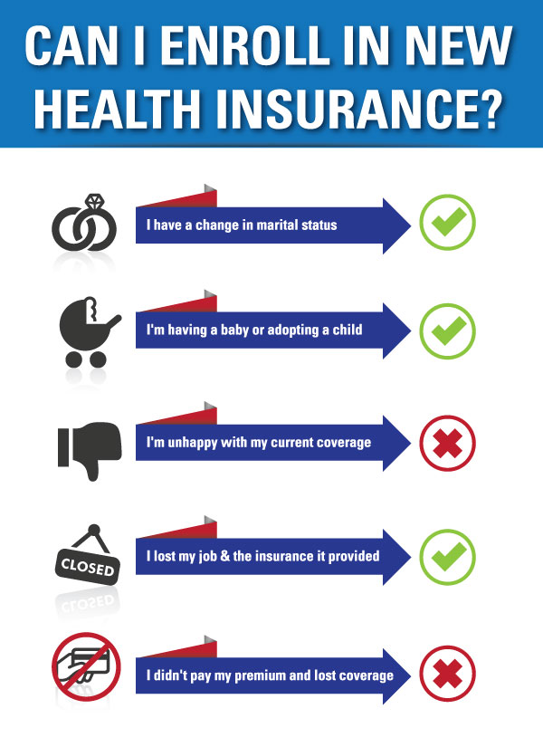

Slide 37
Online Enrollment
https://www.employeenavigator.com/

Slide 39
Questions about Insurance?

Slide 40
Archdiocese of Milwaukee Lay Employee Pension Information

Slide 41
Basic Lay Employee Pension Information
This is a Defined Benefit Plan
A defined benefit pension plan is a type of pension plan in which an employer/sponsor promises a specified pension payment, lump-sum on retirement that is predetermined by a formula based on the employee's earnings history, tenure of service and age, rather than depending directly on individual investment returns.
It is 100% employer funded and employees cannot contribute to it
It takes 6 full-time years to be vested (1-year wait plus 5 more years)
If an employee leaves before becoming vested, there is no benefit and the money paid in for them stays in the pension fund
If an employee breaks service before becoming vested, they have 18 months to return to full-time or their credited service is lost. The exception is if they work continuously part-time in between the full-time employment

Slide 42
Who Qualifies
Only full-time employees qualify for pension
All new employees have a one-year wait before going into the plan
Full-time is 30 or more hours per week / minimum 8 consecutive months per year
If a part-time employee works at more than one site and the hours total 30 or more, they are considered full-time and all employers must pay in toward their pension
If an employee moves from part-time to full-time, they have a one-year wait from their full-time start date

Slide 43
Quarterly Pension Reports
Pension bills are mailed out after the end of each quarter and due back within 30 days
All pages of the report must be completed and returned
The pension contribution is 7% of each employee’s gross, base wages
Overtime & bonuses are not qualified for pension
List all new full-time employees in the ‘New Employee’ section, along will their complete information
If an employee has transferred from another unit, their salary would count upon their start date
If an employee’s eligibility date falls in the middle of the quarter, only count the wages from their 1-year anniversary date, through the end of that quarter
Please call or email the pension office if you are unsure of an employee’s eligibility

Slide 44
Annual Pension Statements
Annual pension statements are normally produced every year in the spring and get mailed in a large packet to business administrators
Statements come in confidential envelopes for each employee
Employees cannot look up their pension information online
No one has a balance in any account.
If they are vested, the statement will show their age 65 monthly benefit
If employees continue to work full-time beyond age 65, their benefit will continue to increase until they terminate employment or retire

Slide 45
A Great Resource for Pension information
There is a pension calculator on the archmil.org website where non-vested employees can estimate a future benefit
The pension booklets are also available on our website
https://www.archmil.org/offices/lay-pension.htm

Slide 46
Retirement Process
The normal retirement age is 65
Pension can be taken as early as age 60, at a reduced benefit
Employees must contact the pension office for their pension information 8–10 weeks in advance of the month they’d like to start
Business administrators will be contacted prior to the starting month of an employee’s pension for final wage information
Applications are processed by mail
We offer a normal pension or a joint and survivor pension
The survivor for pension can only be the spouse
If a vested person is over age 65 and no longer working full-time, their benefit amount does not increase
Pension payments come via direct deposit at the end of each month
We offer a lump sum benefit, only if a retiree’s monthly benefit is $100.00 or less

Slide 47
Contact Information
Lay Pension Coordinator
Bridget Fischer fischerb@archmil.org
414-769-3317

Slide 48
Lunch

Slide 49
Parish Financial Management Manual
Katie Esterle
Parish & School Financial Consulting

Slide 50
Overview of the manual
Section 1 – Foundations for Financial Management
Section 2 – Accounting Principles & Procedures
Section 3 – Chart of Accounts
Section 4 – Parish Budgeting
Section 5 – Financial Management Guidelines
Section 6 – Financial Reporting
Section 7 – Financial Reviews

Slide 51
Section 1 Foundations for Parish Financial Management
What is in this section?
Purpose of the Manual – provide guidance to parish & school administrators who are charged with financial management
Ideas on Stewardship & Ministry of Administration
Civil & Canon Law
All parishes in the Archdiocese are separate corporations. The Board of Directors of each parish includes the Archbishop (as President), the Vicar General, Pastor/Administrator, and two Trustees.

Slide 52
Section 2 Accounting Principles & Procedures
What is in this section?
Development of Accounting Standards
Fiscal Year – Parishes & Schools report on a fiscal year beginning on July 1st and ending on June 30th
Cash vs. Accrual Accounting
It is recommended that parish use cash-basis with some accruals built in at year-end
Parishes & Schools that participate in the Choice program will need to report on a accrual basis
Other Accounting Practices: Financial Statements, Expense Allocations, Deprecation

Slide 53
Just for fun….
Did you know that the fundamental accounting method of “double-entry bookkeeping” was developed in 1494 by Luca Pacioli – a Catholic friar.
More valuable information like this can be found in the Parish & School Financial Management Manual!

Slide 54
Section 3 Uniform Chart of Accounts
Provides a simple & understandable method of reporting operations of the parish
Account format
Program & Account Definitions
Example: Accounting for Investments

Slide 55
Section 4 Parish Budgeting Guidelines
Budgeting Process
Balanced & Deficit Approval Process
Budget comparison to actuals
Budgeting Timeline
*We will discuss budgets in detail later today

Slide 56
Section 5 Fund & Financial Management Guidelines
Financial Control – good recordkeeping and preservation of key records
Affiliated Organizations – all affiliated organizations are accountable to the parish
Ex: Home & School, Christian Women. This does not include Knights of Columbus and other organizations that are affiliated with another organization.
Financial Accounts – maintenance of parish checking and saving accounts.
Procedures for Collection, Fundraising, Tuition and General Receipts
Procedures for Disbursements, including Petty Cash
Payroll
Investments & Fixed Assets
Cemeteries & Restricted Funds

Slide 57
Section 6 Financial Reporting
Financial Reporting to Parishioners
Finance Council & Management Reporting
Confidential Financial Statement (CFS)

Slide 58
Section 7 Financial Review Procedures
Periodic Financial and Internal Financial Reviews
Parish Audits
CFS Review
Archdiocesan Financial Review
Based on your parish’s size, this is performed annually or biennially
$500 for parish’s with $750,000 or less in operating revenue; $1,000 for parish’s with more than $750,000 in operating revenue
Facilitated by Parish Finance Office, by our staff or outside contractor

Slide 59
Questions?

Slide 60
Budgets
Katie Esterle, Parish & School Financial Consulting Office
Barb Gawlik, Business Manager, St. Patrick Parish in Whitewater
Celia Meyers, DAS, St. Gabriel Parish in Hubertus

Slide 61
Budget Timeline
December 15 – Budget forms and instructions are to be distributed to all persons responsible for any program or function in the parish. They should be given pervious fiscal year, current fiscal year and budgeted current fiscal year financial data.
January 31 – All completed budget forms should be returned to the Budget Committee (or Business Administrator) and assembled to create a consolidated budget.
February 28 – The Budget Committee should complete the initial review of the proposed budget and make suggestions for adjustments.
March 1-15 – The Budget Committee discusses the proposed adjustments with the persons responsible for the program. They then consult with the Finance Council and pastor/administrator.
April 1 – Budget Committee finalizes the proposed budget and a summary of it goes to the Finance Council in advance of the April Council meeting.
April/May – The proposed budget is presented to the Finance Council for discussion. Approval by the pastor/administrator.
Submit to the Archdiocese.

Slide 62
Submitting a balanced (surplus) budget
Your budget and a signed coversheet must be submitted to the Parish & School Financial Consulting Office by June 15th. New this year: Parishes are required to send a year-to-date actual P&L compared to the budget through February 28 with their budget submission.
It should be submitted in whatever format the budget was given to your Finance Council.
You can email or mail your budget the coversheet.
If there are any questions, the Business Administrator will be contacted.

Slide 63
Submitting a deficit budget
It is recognized that a deficit budget may be required from time to time. It is the routine and repeated use of a deficit budget that requires a change in direction.
Your budget and a signed coversheet must be submitted to the Parish & School Financial Consulting Office by May 15^{th.}
Also required:
Current year financial report through February 28 with a projection of revenue and expenses for the fourth quarter ending June 30.
Narrative explaining: Why the parish has a deficit, how the deficit will be funded and a plan indicating how the parish will resolve the budget in the future and identify the steps needed to maintain positive cash flow.
Then what? The Parish & School Financial Consulting Office will review the material and discuss the situation with the parish. The proposed deficit will be presented to the Archbishop. The Archbishop will approve the deficit, as proposed, approve it with modifications or return it to the parish for further work. You will be notified of his decision.

Slide 64
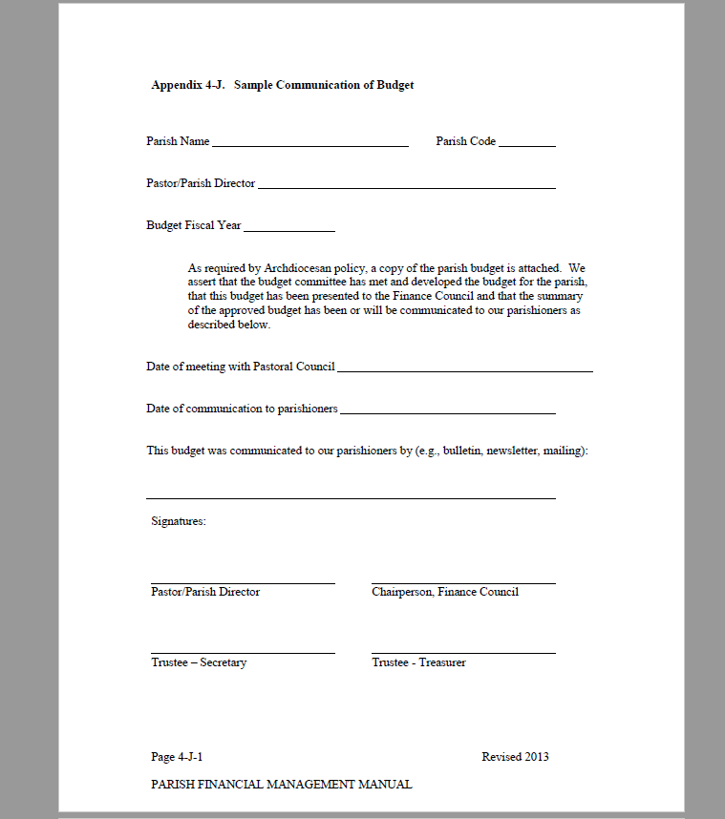
Sample Coversheet

Slide 65
How can we help? At any point during your budgeting process, we are happy to review a draft budget and make recommendations. We can also meet with you to discuss any concern you have. We are here to help.

Slide 66
Barb Gawlik & Celia Meyers St. Patrick, Whitewater St. Gabriel, Hubertus
How does it actually work in parishes?
What are their processes?
Any recommendations?

Slide 67
Small Group Break Out
Discuss your parish’s budget and the process for completing it.
What is your role?
Who do you work with?
What are some areas of concern you have?
What does the Archdiocese look for in their review process?

Slide 68
Questions and feedback from breakouts.

Slide 69
Break Let’s regroup in 15 minutes

Slide 70
Serving with a Missionary Heart
Business Administration According to the Plan of Christ

Slide 71
The Great Temptation
Seeing ourselves as small
and insignificant
Like a grain of sand
But that’s not how Jesus
sees us!

Slide 72
We are part of something bigger

Slide 73
Jesus Has Big Plans for Us – We Are Here…for a Purpose

Slide 74
Baptism – The Great Perspective Changer!
“Do you not know that all of us who have been baptized into Christ Jesus were baptized into his death? We were buried therefore with him by baptism into death, so that as Christ was raised from the dead by the glory of the Father, we too might walk in newness of life.” (Romans 6: 3-4)

Slide 75
Baptism – The Great Perspective Changer!
The baptized have “put on Christ.” (Galatians 3:27)
Baptism not only purifies from all sins, but also makes the neophyte “a new creature,” an adopted son/daughter of God, who has become a “partaker of the divine nature,” member of Christ and co-heir with him, and a temple of the Holy Spirit. (Catechism, 1265)

Slide 76
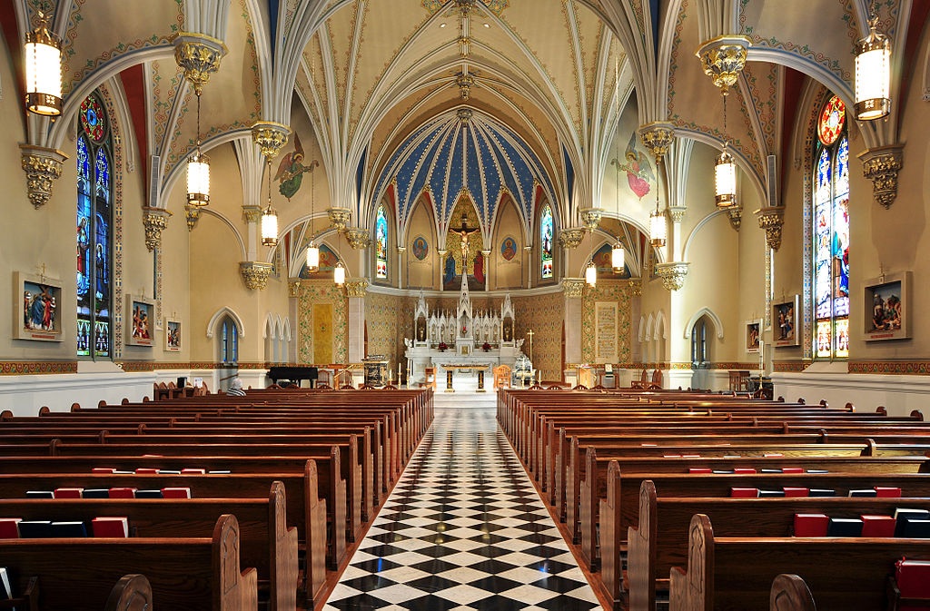
The Ultimate Orientation for Our Work – Jesus and His Missionary Church

Slide 77
The Ultimate Orientation for Our Work
If Jesus and His Missionary
Church are the fundamental
orientation for our daily work…
How do we see ourselves?
What is our identity?
What is our motivation?
What is our purpose?

Slide 78
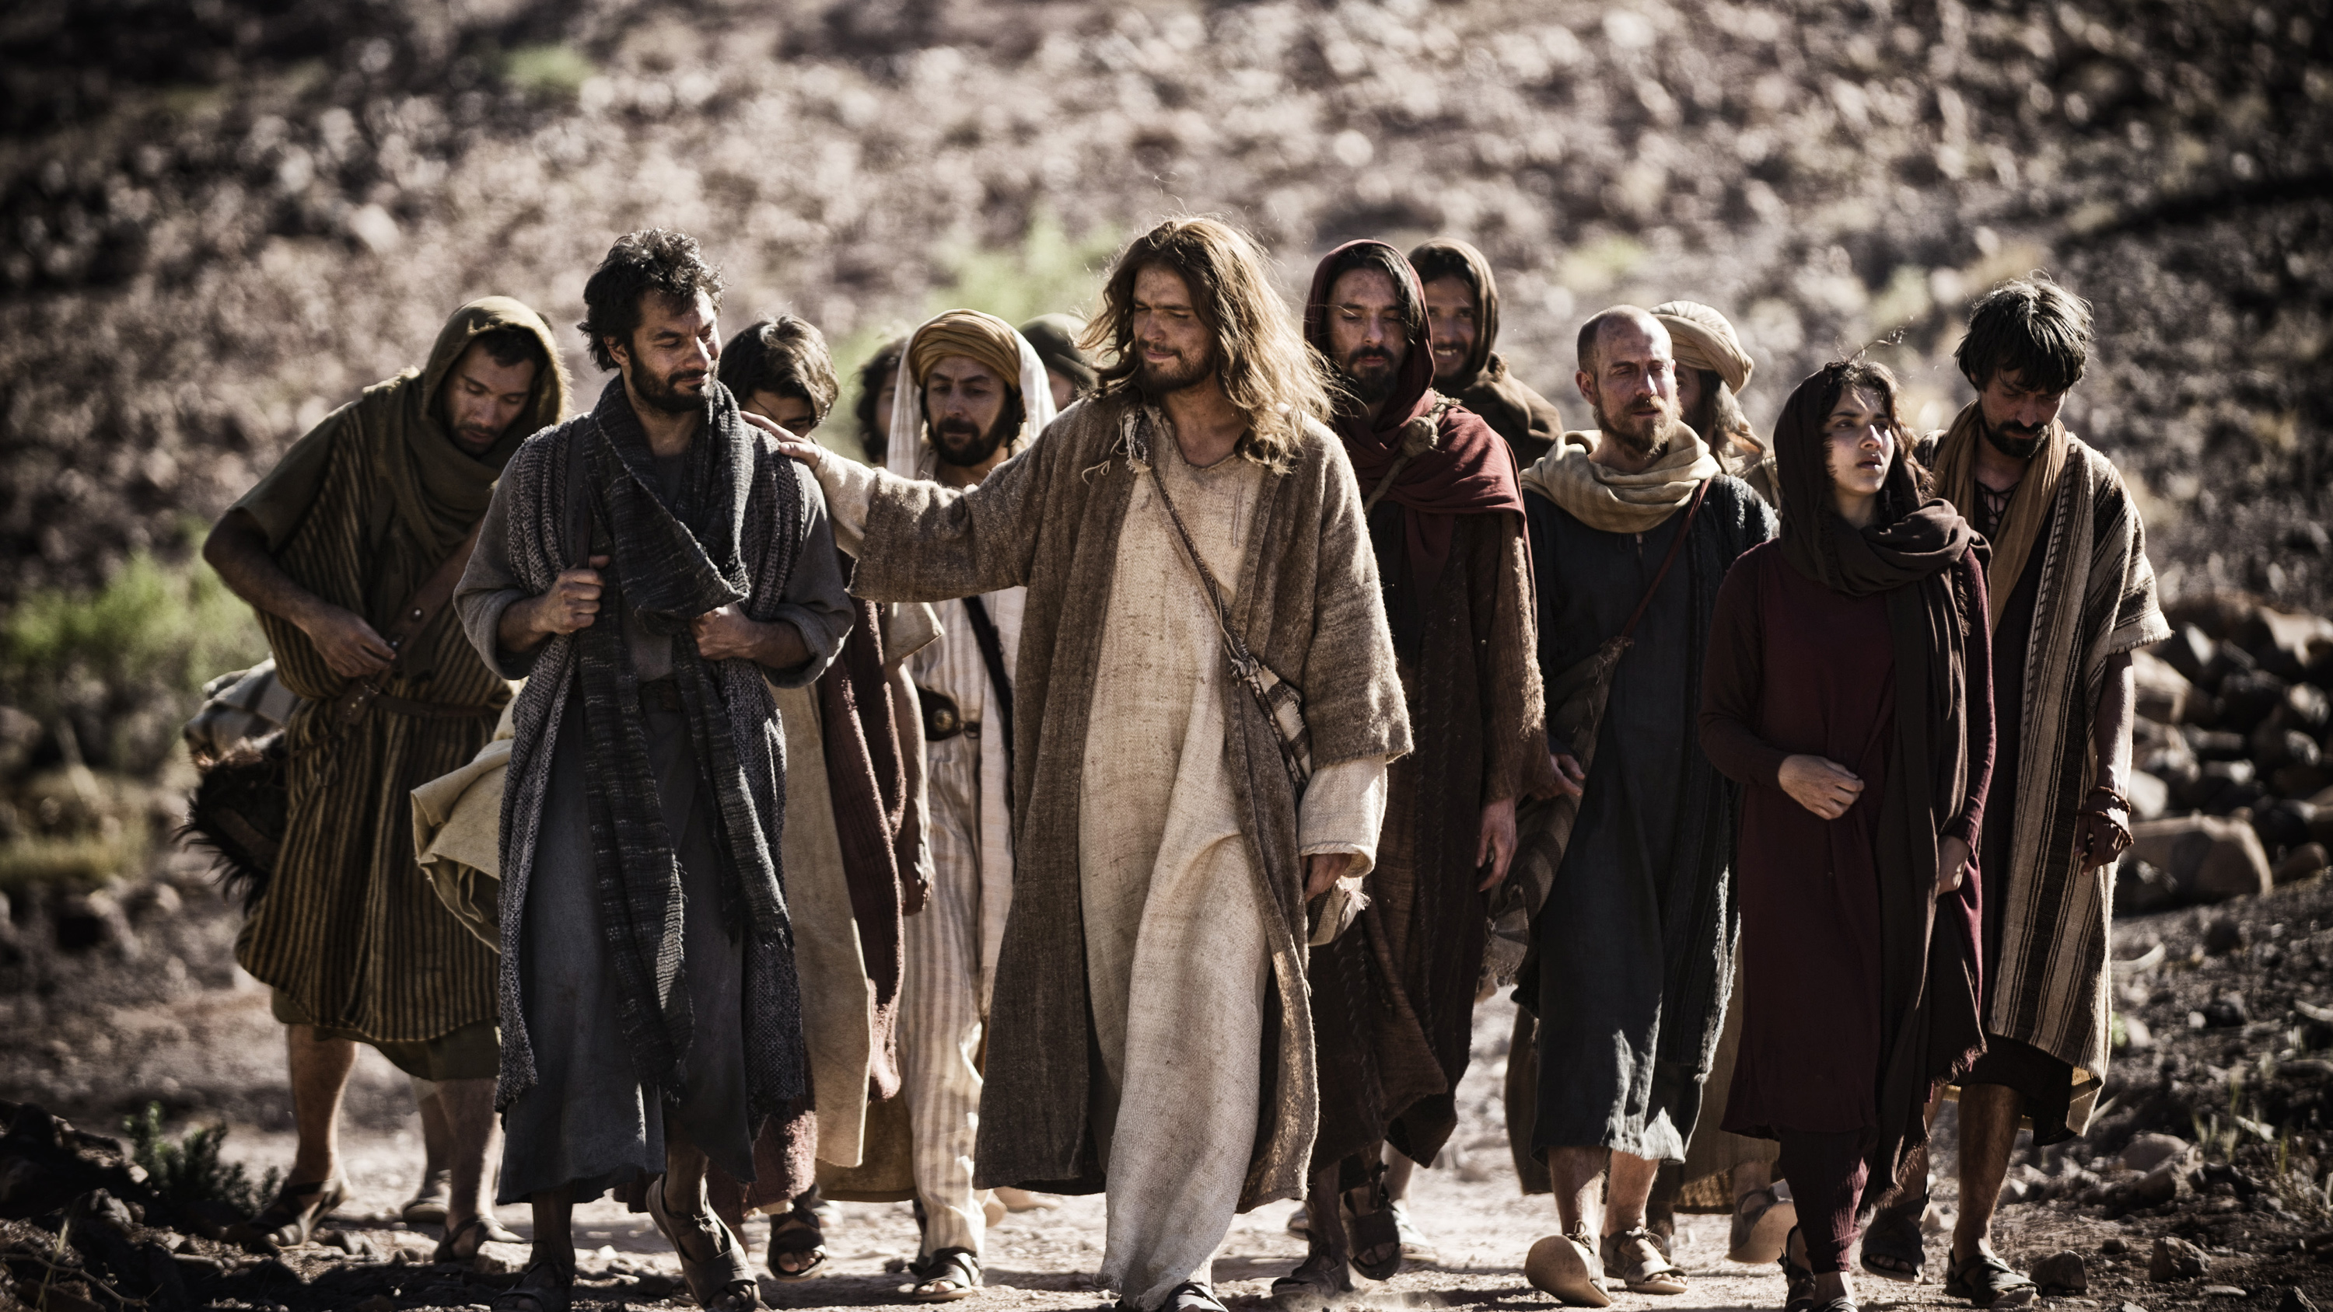
The Best Answer to These Questions
The Mission of Jesus in His Missionary Church
is Our Mission!

Slide 79
Put Another Way…
Baptized into Christ and
His Missionary Church
And seeing everything through
our new identity in Christ
Our daily work is not ours…
But swept up into the Saving
Plan of Christ!

Slide 80
Let’s back up for some context – The Mission and Plan of Jesus
In the beginning, God went “on mission”
As a “community of love – reaching out in love,”
the Trinity created us and our world
We were created in perfect union with
God and each other – the “original union”

Slide 81
Then came sin
Sin came into the world and this
“original sin” broke the “original union”
We were separated from God and
each other
We were lost and could not find our
way back into union

Slide 82
So God went on mission again
God sent His only Son into the world
Jesus went on mission “to seek and
save the lost” Luke 19:10)
Dying for our sins, Jesus rose to open
the door back into “union through Him”

Slide 83
Jesus was mission personified
He was the saving mission of God
He practiced mission by reaching
all people, calling them to follow Him,
and forming them as disciples
He imbedded His mission in His
Church by sending His apostles to “Go
and make disciples” (Mt. 28:16-20)

Slide 84
The Church is Missionary
Through the power of the Holy Spirit,
Jesus continues His mission in the Church
The mission of the Church is to “Go
and make disciples” (Matthew 28:16-20)
The Church is the Body of Christ that
reaches, calls, and forms disciples so
we can send them to make new disciples

Slide 85
Our Daily Work is Jesus’ Daily Work
To be on mission for the Father
To heal what is broken
To proclaim the Good News
To lead people to Jesus and His
promise of new life

Slide 86
Our Daily Work according to the Universal Plan of Christ
The plan of Christ is to heal what is broken,
call people into relationship, and find new
life in Him
How do we see ourselves?
What is our purpose?
What is our motivation?
To whom are we responsible?

Slide 87
Our Universal Job Description: Our Why
Compassionate healers of brokenness
Leading others to see their dignity/identity as children of the Father
Being an encounter with Jesus through our words and actions
Inviting others to follow Jesus as disciples in the Church
Sending disciples to make new disciples

Slide 88
Living with a Missionary Heart
Our Daily Work according
to the Plan of Christ…
-Disciples of Jesus Christ
-on His Mission to…
-Seek and Save the Lost
-and Make Disciples
-so they can Die and Rise
with Him

Slide 89
In virtue of their baptism, all the members of the people of God have become missionary disciples
Pope Francis, Evangelii Gaudium, #120

Slide 90
I Am a Mission
“My mission of being in the heart of the people is not just a part of my life or a badge I can take off; it is not an ‘extra’ or just another moment in my life. Instead, it is something I cannot uproot from my being without destroying my very self. I am a mission on this earth; that is the reason why I am here in this world. We have to regard ourselves as sealed, even branded, by this mission of bringing light, blessing, enlivening, raising up, healing, and freeing.”
Pope Francis, Evangelii Gaudium, 273

Slide 91
Mission Statement of the Archdiocese of Milwaukee
To proclaim the Gospel of Jesus Christ through his saving death and resurrection by calling, forming and sending disciples to go and make new disciples.
As a people, we are called to encounter Jesus and grow as disciples through the sacramental life of the Church.

Slide 92
Living with a Missionary Heart
Our Daily Work According to the Great Plan of Christ

Slide 93
Closing Comments & Prayer

