Slide 1

Welcome to the New Business Administrator Institute
Session IV

Slide 2
Opening Prayer
Led by Celia Meyers

Slide 3

Today’s Chat Topic:
A Look at Human Resources in Terms of Laws
Coffee with Catherine
Notes:
Retaliation:
Employers also are prohibited from punishing employees for exercising other rights assured to them. For example, employers can’t retaliate against an employee who asks for a reasonable accommodation of her disability under the Americans with Disabilities Act (ADA) or who applies for medical leave under the Family and Medical Leave Act (FMLA). Employers also must be careful not to retaliate against employees who file Title VII of the Civil Rights Act of 1964 (Title VII) complaints of harassment or discrimination.

Slide 4

Federal Laws that Affect Employment
Americans with Disabilities Act
Genetic Information Nondiscrimination Act
Pregnancy Discrimination
Title VII of Civil Rights Act
Age Discrimination in Employment Act
Family & Medical Leave Act
Worker Adjustment & Retraining Notification Act
Consumer Credit Protection Act
Employee Polygraph Protection Act
Notes:
ADA – prohibits er from discriminating against applicants & ee w/ disabilities or perceived disabilities & may require er to provide reasonable accommodation to disabled worker.
Genetic Information - designed to prohibit the use of genetic information in health insurance and employment.
Pregnancy Discrimination - amended Title VII of the Civil Rights Act of 1964 to "prohibit sex discrimination on the basis of pregnancy." The Act covers discrimination "on the basis of pregnancy, childbirth, or related medical conditions.“
Title VII discriminating against employees on the basis of sex, race, color, national origin, and religion.
ADEA - prohibits discrimination against workers because of their age.
FMLA - requiring covered employers to provide employees job-protected and unpaid leave for qualified medical and family reasons. Qualified medical and family reasons include: personal or family illness, family military leave, pregnancy, adoption, or the foster care placement of a child.
Worker Adjustment & Retraining Notification Act - employees to provide 60 calendar-day advance notification of plant closings and mass layoffs of employees.
Consumer Credit Protection Act - The restrictions on wage garnishment guard employees from discharge by their employers because their wages have been garnished for any one indebtedness.
Employee Polygraph Protection Act - prevents employers from using polygraph (lie detector) tests, either for pre-employment screening or during the course of employment, with certain exemptions.
Fair Credit Reporting Act - regulates the collection of credit information and access to your credit report. It was passed in 1970 to ensure fairness, accuracy and privacy of the personal information contained in the files of the credit reporting agencies.
Fair Labor Standards Act - minimum wages, requirements for overtime pay and limitations on child labor.
Federal Insurance Contributions Act - a United States federal payroll (or employment) tax^{[1]}imposed on both employees and employers to fund Social Security and Medicare^{[2]}—federal programs that provide benefits for retirees, disabled people, and children of deceased workers.
Health Insurance Portability & Accountability Act - allows persons to qualify immediately for comparable health insurance coverage when they change their employment or relationships.
Immigration Reform & Control Act - enforces that employers can only hire persons who can legally work in the U.S. (citizens and nationals of the U.S. and aliens authorized to work in the U.S). Employers must verify the identity and employment eligibility of anyone to be hired, which includes completing the Employment Eligibility Verification Form (I-9).
Occupational Safety & Health Act - employers are responsible for providing a safe and healthful workplace. OSHA's mission is to assure safe and healthful workplaces by setting and enforcing standards, and by providing training, outreach, education and assistance.
Sarbanes-Oxley Act - enacted as a reaction to a number of major corporate and accounting scandals, including Enron and WorldCom.
Uniformed Services Employment & Reemployment - protect the civilian employment of non-full-time military personnel in the United States called to active duty.

Slide 5
Federal Laws that Affect Employment
Fair Credit Reporting Act
Equal Pay Act
Fair Labor Standards Act
Federal Insurance Contributions Act
Health Insurance Portability & Accountability Act
Immigration Reform & Control Act
Occupational Safety & Health Act
Sarbanes-Oxley Act
Uniformed Services Employment & Reemployment
Notes:
ADA – prohibits er from discriminating against applicants & ee w/ disabilities or perceived disabilities & may require er to provide reasonable accommodation to disabled worker.
Genetic Information - designed to prohibit the use of genetic information in health insurance and employment.
Pregnancy Discrimination - amended Title VII of the Civil Rights Act of 1964 to "prohibit sex discrimination on the basis of pregnancy." The Act covers discrimination "on the basis of pregnancy, childbirth, or related medical conditions.“
Title VII discriminating against employees on the basis of sex, race, color, national origin, and religion.
ADEA - prohibits discrimination against workers because of their age.
FMLA - requiring covered employers to provide employees job-protected and unpaid leave for qualified medical and family reasons. Qualified medical and family reasons include: personal or family illness, family military leave, pregnancy, adoption, or the foster care placement of a child.
Worker Adjustment & Retraining Notification Act - employees to provide 60 calendar-day advance notification of plant closings and mass layoffs of employees.
Consumer Credit Protection Act - The restrictions on wage garnishment guard employees from discharge by their employers because their wages have been garnished for any one indebtedness.
Employee Polygraph Protection Act - prevents employers from using polygraph (lie detector) tests, either for pre-employment screening or during the course of employment, with certain exemptions.
Fair Credit Reporting Act - regulates the collection of credit information and access to your credit report. It was passed in 1970 to ensure fairness, accuracy and privacy of the personal information contained in the files of the credit reporting agencies.
Fair Labor Standards Act - minimum wages, requirements for overtime pay and limitations on child labor.
Federal Insurance Contributions Act - a United States federal payroll (or employment) tax^{[1]}imposed on both employees and employers to fund Social Security and Medicare^{[2]}—federal programs that provide benefits for retirees, disabled people, and children of deceased workers.
Health Insurance Portability & Accountability Act - allows persons to qualify immediately for comparable health insurance coverage when they change their employment or relationships.
Immigration Reform & Control Act - enforces that employers can only hire persons who can legally work in the U.S. (citizens and nationals of the U.S. and aliens authorized to work in the U.S). Employers must verify the identity and employment eligibility of anyone to be hired, which includes completing the Employment Eligibility Verification Form (I-9).
Occupational Safety & Health Act - employers are responsible for providing a safe and healthful workplace. OSHA's mission is to assure safe and healthful workplaces by setting and enforcing standards, and by providing training, outreach, education and assistance.
Sarbanes-Oxley Act - enacted as a reaction to a number of major corporate and accounting scandals, including Enron and WorldCom.
Uniformed Services Employment & Reemployment - protect the civilian employment of non-full-time military personnel in the United States called to active duty.

Slide 6

Wisconsin Laws that Affect Employment
Clean Indoor Air Act
Concealed Weapons
Direct Deposit
Employee Access to Personnel Files
Fair Employment Law
Genetic Information Bias
Hours of Work and Overtime Law
Jury Duty and Court Testimony
Meal and Rest Breaks
Notes:
Clean Indoor Air Act - Prohibits smoking in enclosed public places and places of employment.
Concealed Weapons - Employers may prohibit an employee from carrying a concealed weapon or a particular type of concealed weapon.
Direct Deposit - Employers can make participation in a direct deposit pay program a condition of employment if 1) employee is able to collect wages at a bank or facility in Wisconsin, and 2) no charges are required of the employee. If employee must establish an account solely to receive wages, fees for account must be covered by the employer.
Employee Access to Personnel Files - Requires employers to provide current employees (twice a year) with the opportunity to review, copy and dispute contents of their personnel file.
Fair Employment Law - unlawful for employers to discriminate against employees and applicants because of age, race, creed, color, disability, marital status, sex, national origin, ancestry, arrest record, conviction record, military service, use or nonuse of lawful products off the employer's premises during nonworking hours, or declining to attend a meeting or to participate in any communication about religious matters or political matters.
Genetic Information Bias - No employer may directly or indirectly solicit, require or administer a genetic test to any person as a condition of employment.
Hours of Work and Overtime Law - Requires employers to provide minimum wage and overtime to employees and child labor protection.
Jury Duty and Court Testimony - Prohibits employers from discharging, taking disciplinary action, or discriminating with regard to seniority or pay advancement against an employee because the employee takes a leave of absence due to jury duty. Employers may not discharge an employee if subpoenaed to testify in court in a criminal or juvenile justice case.
Meal and Rest Breaks - Requires employers to provide minimum 30 minute meal period for employees under age 18 who are working at least a six hour shift. Employers are not required to provide rest periods, coffee breaks or meal periods for workers age 18 or older, but the employer must pay for meal periods of less than 30 minutes or when work is required.
Minor Work Hours - Requires employers hiring minors to adhere to hours of work restrictions established under the federal Fair Labor Standards Act.
New Hire Reporting - Requires employers to report new hires to the State Directory of New Hires within 20 days after the employee starts work for the purpose of collecting child support payments. Employers must also report employees who are rehired after an unpaid interval of more than 90 days.
Payment of Terminated Employee Wages - Requires employers to pay terminated employees in full by the employee's next regular pay date. If termination is due to an employer’s merging, liquidating or disposing of the business, or relocating the business, employees’ final pay is due within 24 hours of termination.
Right-to-Know - Requires employers to let employee know what toxic substances might be encountered on the job.
Voting Leave - Employers must provide employees with up to three consecutive hours off between the opening and closing of the polls in which to vote.
Wage Deductions - Prohibits employers from making pay deductions for loss, theft, damage, or faulty workmanship without the written authorization of the employee unless employer has a legal judgment against the employee or the employer and employee representative agree the loss was due to employee negligence.
Workers Compensation - Provides benefits (i.e. care, treatment and wage continuation) to workers resulting from workplace illnesses or injuries.
Bone Marrow and Organ Donation Leave - Requires employers to allow employees up to six weeks of job protected, unpaid leave in a 12-month period to donate bone marrow and organs.
Family Medical Leave (WFMLA) - Requires employers to allow employees up to two weeks of unpaid leave for an employee's own health problems or to care for a family member with a serious health condition. Requires employers to provide unpaid leave up to six weeks for birth or adoption of a child. Some provisions also extend to domestic partners. Employees must have worked at least 1000 hours for 52 consecutive weeks. Requires "Wisconsin Family and Medical Leave Act" poster.

Slide 7
State of Wisconsin Laws that Affect Employment
Minor Work Hours
New Hire Reporting
Payment of Terminated Employee Wages
Right-to-Know
Voting Leave
Wage Deductions
Workers Compensation
Bone Marrow and Organ Donation Leave
Family Medical Leave (WFMLA)
Notes:
Clean Indoor Air Act - Prohibits smoking in enclosed public places and places of employment.
Concealed Weapons - Employers may prohibit an employee from carrying a concealed weapon or a particular type of concealed weapon.
Direct Deposit - Employers can make participation in a direct deposit pay program a condition of employment if 1) employee is able to collect wages at a bank or facility in Wisconsin, and 2) no charges are required of the employee. If employee must establish an account solely to receive wages, fees for account must be covered by the employer.
Employee Access to Personnel Files - Requires employers to provide current employees (twice a year) with the opportunity to review, copy and dispute contents of their personnel file.
Fair Employment Law - unlawful for employers to discriminate against employees and applicants because of age, race, creed, color, disability, marital status, sex, national origin, ancestry, arrest record, conviction record, military service, use or nonuse of lawful products off the employer's premises during nonworking hours, or declining to attend a meeting or to participate in any communication about religious matters or political matters.
Genetic Information Bias - No employer may directly or indirectly solicit, require or administer a genetic test to any person as a condition of employment.
Hours of Work and Overtime Law - Requires employers to provide minimum wage and overtime to employees and child labor protection.
Jury Duty and Court Testimony - Prohibits employers from discharging, taking disciplinary action, or discriminating with regard to seniority or pay advancement against an employee because the employee takes a leave of absence due to jury duty. Employers may not discharge an employee if subpoenaed to testify in court in a criminal or juvenile justice case.
Meal and Rest Breaks - Requires employers to provide minimum 30 minute meal period for employees under age 18 who are working at least a six hour shift. Employers are not required to provide rest periods, coffee breaks or meal periods for workers age 18 or older, but the employer must pay for meal periods of less than 30 minutes or when work is required.
Minor Work Hours - Requires employers hiring minors to adhere to hours of work restrictions established under the federal Fair Labor Standards Act.
New Hire Reporting - Requires employers to report new hires to the State Directory of New Hires within 20 days after the employee starts work for the purpose of collecting child support payments. Employers must also report employees who are rehired after an unpaid interval of more than 90 days.
Payment of Terminated Employee Wages - Requires employers to pay terminated employees in full by the employee's next regular pay date. If termination is due to an employer’s merging, liquidating or disposing of the business, or relocating the business, employees’ final pay is due within 24 hours of termination.
Right-to-Know - Requires employers to let employee know what toxic substances might be encountered on the job.
Voting Leave - Employers must provide employees with up to three consecutive hours off between the opening and closing of the polls in which to vote.
Wage Deductions - Prohibits employers from making pay deductions for loss, theft, damage, or faulty workmanship without the written authorization of the employee unless employer has a legal judgment against the employee or the employer and employee representative agree the loss was due to employee negligence.
Workers Compensation - Provides benefits (i.e. care, treatment and wage continuation) to workers resulting from workplace illnesses or injuries.
Bone Marrow and Organ Donation Leave - Requires employers to allow employees up to six weeks of job protected, unpaid leave in a 12-month period to donate bone marrow and organs.
Family Medical Leave (WFMLA) - Requires employers to allow employees up to two weeks of unpaid leave for an employee's own health problems or to care for a family member with a serious health condition. Requires employers to provide unpaid leave up to six weeks for birth or adoption of a child. Some provisions also extend to domestic partners. Employees must have worked at least 1000 hours for 52 consecutive weeks. Requires "Wisconsin Family and Medical Leave Act" poster.

Slide 8

Agencies that govern the workplace
Equal Employment Opportunity Commission (EEOC)
Department of Labor (DOL)
Occupational Safety & Health Administration (OSHA)
Wisconsin Equal Rights Division (WERD)
Wisconsin Department of Workforce Development (DWD)
Notes:
Equal Employment Opportunity Commission (EEOC):
Title VII
Pregnancy Discrimination Act
Equal Pay Act
Age Discrimination
American Disabilities
Retaliation
Department of Labor (DOL)
OSHA
Wage and Hour (WHD)
Employee Benefits
Wisconsin Equal Rights Division (WERD)
Discrimination /Harassment
Occupational Safety & Health Administration (OSHA)
Health & Safety
Wisconsin Department of Workforce Development (DWD)
Unemployment Division
Wage & Hour/Labor Standards Violation
Worker related injuries & illness

Slide 9

What does this have to do with my School/Parish?
Negligent Hiring – Employers who hire workers they knew, or with reasonable diligence should have known, were unsuitable.
Adverse Employment Action – Actions taken by the employer that have a negative impact on terms or conditions of an individual’s employment.
Disparate Treatment – Different & unfavorable treatment built on membership in a protected class.
Notes:
Employers also are prohibited from punishing employees for exercising other rights assured to them. For example, employers can’t retaliate against an employee who asks for a reasonable accommodation of her disability under the Americans with Disabilities Act (ADA) or who applies for medical leave under the Family and Medical Leave Act (FMLA). Employers also must be careful not to retaliate against employees who file Title VII of the Civil Rights Act of 1964 (Title VII) complaints of harassment or discrimination.
Hostile Work Environment – Offensive, intimidating, or oppressive atmosphere.

Slide 10
What does this have to do with my School/Parish?
Retaliation – Employer taking adverse employment action against an individual for filing a complaint against the law(s).
Harassment vs Hostile Work Environment vs Job Expectation
Notes:
Employers also are prohibited from punishing employees for exercising other rights assured to them. For example, employers can’t retaliate against an employee who asks for a reasonable accommodation of her disability under the Americans with Disabilities Act (ADA) or who applies for medical leave under the Family and Medical Leave Act (FMLA). Employers also must be careful not to retaliate against employees who file Title VII of the Civil Rights Act of 1964 (Title VII) complaints of harassment or discrimination.
Hostile Work Environment – Offensive, intimidating, or oppressive atmosphere.

Slide 11
Sexual harassment: A Commonsense Approach

Slide 12

Harassment High Points
Hostile work environment is ongoing, pervasive, or severe behavior.
Sexual harassment is unwelcomed conduct of a sexual nature and it is looked at from the view point of the victim.
Can cross the line when it is unwelcomed & not reciprocated.
Victim can be intended person or third party
observer.

Slide 13
Harassment High Points
Victimizer can be: supervisor, manager, co-worker, outsider
Employer must act:
  Educate & share policy.
  If complaint respond promptly, thoroughly, objectively, & completely.
  Take effective & appropriate action.
Notes:
Employer must act reasonably to protect their employee from harassment regardless of the source:
Educate prevention & share policy.
If complaint respond promptly – prompt, thorough, objective, & complete.
If illegal harassment did occur, take effective & appropriate action to make it stop.

Slide 14
Leave in Wisconsin

Slide 15


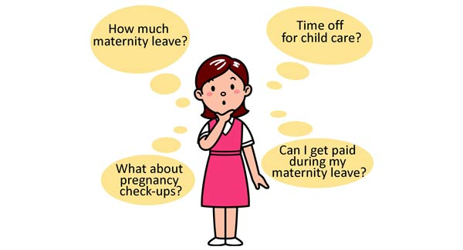






Life Happens

Slide 16

Types of Leave:
Vacation
Holiday
Snow/Severe Weather
Jury Duty
Bereavement
Sick
Maternity (Medically Necessary & Maternity/Paternity Leave)
Personal Leave (Paid and Unpaid)
Military Leave
Family Medical Leave (Wisconsin & Federal)

Slide 17


#1
What does our handbook say?

Slide 18

Is the Employer (er) Covered?
Federal = 50 or > employees in at least 20 weeks or private elementary or secondary school
WI = 50 or > permanent employees at least 6 of the preceding 12 calendar months
FMLA – WI and Federal
Notes:
If employer is not required to comply with FML; don’t list in handbook unless you want to give the benefit.
If you list in handbook, the employer MUST follow the regulation to a T.

Slide 19
FMLA – WI and Federal
Is the Employee (ee) Eligible?
Federal = EE employed for 12 months AND worked for 1250 hours in preceding 12 months
AND
50 or > employees within 75 miles.
WI = worked at least 1000 hours in preceding 52 weeks AND for at least 52 consecutive weeks.

Slide 20
FMLA - Types & Amount of Leave:
Federal Leave | Wisconsin Leave
12 for birth or placement of a child for adoption or foster care | 6 weeks for the birth or placement of adoption of a child
12 for care for a spouse, child or parent with a serious health condition, or for an employee’s own serious health condition | 2 weeks for seriously ill child, spouse, parent, parent-in-law, and for employee’s own serious health condition.
26 weeks in 12 month period for care of service member | No military caregiver provision.
Notes:
Federal Leave
Wisconsin Leave
12 weeks in a 12 month period for birth or placement of a child for adoption or foster care
Within a calendar year, 6 weeks of leave for the birth or placement of adoption of a child (which must begin within 16 weeks before or after the event.
12 weeks in a 12 month period for care for a spouse, child or parent (no parent-in-law) with a serious health condition, or for an employee’s own serious health condition
2 weeks to care for seriously ill child, spouse, parent, parent-in-law, and for employee’s own serious health condition.
26 weeks in 12 month period for care of service member
No military caregiver provision.

Slide 21
Communicate, Communicate, Communicate…..
Communication | Federal Leave | Wisconsin Leave
Awareness | Formal Employee Request (in Addendum) or Employer Aware | Formal Employee Request (in Addendum) or Employer Aware
Employer Initial Response to Ineligible Employee | Send EE specific FMLA Denial Letter in Addendum | Send EE specific FMLA Denial Letter in Addendum
Employer Initial Response to Eligible Employee: Cover letter Notice of Eligibility Rights & Responsibilities Medical Certification with Job Description | Cover letter specific to EE WH-381 rev. 2013 Part A WH-381 rev. 2013 Part B WH-380 E or F (appropriately) (must do w/i 5 business days of awareness) | Cover letter citing Notice & Rights No specific form for WI No specific form for WI Form ERD-10111 (R. 01/2013) (must do w/i 5 business days of awareness)
Medical Certification * | Completed by Provider WH-380 E or F appropriately (must turn in w/i 15 calendar days) | Completed by Provider Form ERD-10111 (R. 01/2013) (must turn in w/i 15 calendar days)
Designation Notice | Form WH-382 January 2009 (must do w/i 5 business days of receiving Medical Certification) | No specific form for WI therefore designation include in letter (must do w/i 5 business days of receiving Medical Certification)
Letter to EE at end of Leave | Send letter specific to EE at end of Leave in Addendum | Send letter specific to EE at end of Leave in Addendum
Fitness for Duty | Treating doctor provides | Treating doctor provides

Slide 22
FMLA - Policy Decisions:
  Decide the relationship of paid leave with Federal & State
  of Wisconsin leave Because:
    an employee MAY substitute paid or unpaid leave under Wisconsin law.
    an employer may require or an employee may elect to substitute paid leave for the otherwise unpaid leave under Federal law.
  Decide the 12 month period:
    For Federal Medical Leave define the 12 month period, i.e., calendar, rolling forward, rolling backward, etc.
    Wisconsin Medical Leave is defined by the calendar year.

Slide 23

Explain Health Insurance:
An employee on St. Raphael Health Plan will maintain coverage of health insurance for the 12 weeks while out on leave, paying their portion of the premiums.
If the employee has not returned to work after the 12 weeks of leave, continuation of coverage must be offered to the employee via Insurance Continuation.
NOTE: If a location is not subject to FMLA, then continuation would begin the first of the month once all sick and vacation time is exhausted.

Slide 24

Americans with Disabilities Act
Disability – mental or physical impairment that substantially limits a major life activity.
Unlike FMLA (which is ee entitlement), the ADA provides RIGHTS to employees.
  Protection from discrimination, e.g, hiring, employment.
  Reasonable accommodation
Notes:
Disability is defined as a mental or physical impairment that substantially limits a major life activity.
What is a reasonable accommodation?
Generally, any change in the work environment or in the way things are customarily done that enables an individual with a disability to enjoy equal employment opportunities
Including:
Modifications to existing leave policies
Leave of absence, even if:
The er does not offer leave as an employee benefit
The ee is not eligible for leave under the employer’s policy; or
The ee has exhausted the leave the er provides as a benefit (including leave exhausted under a wc program, or the FML

Slide 25

ADA Reasonable Accommodation is….
“Any change in the work environment or in the way things are customarily done that enables an individual with a disability to enjoy equal employment opportunities.“
May include:
  Modifications to existing leave policies.
  Leave of absence, even if:
    The er does not offer leave as an ee benefit;
    The ee is not eligible for leave under the employer's policy; or
    The ee has exhausted the leave the er provides.

Slide 26

What must an employer do after receiving a request for reasonable accommodation?
Interactive Process
Obtain relevant information to determine the feasibility of providing the leave as a reasonable accommodation.
  Specific reason – info from health care provide may assist the employer
  Block of time or intermittent
  When the need for leave will end.

Slide 27
Is an employer required to provide the reasonable accommodation that the individual wants?
Undue hardship - an "action requiring significant difficulty or expense" when considered in light of a number of factors, e.g., unduly extensive, substantial, or disruptive.
ER may offer alternative suggestions and discuss their effectiveness in removing the workplace barrier that is impeding the individual with a disability.
If there are two possible reasonable accommodations, and one costs more or is more burdensome than the other, the employer may choose the less expensive or burdensome accommodation as long as it is effective.
An employer must assess on a case-by-case basis

Slide 28

FMLA/ADA in re: Light Duty
FMLA – ER cannot require an ee to work a light-duty job rather than take FML leave
ADA:
  Light-duty may be a reasonable accommodation.
  The employer is not required to create a job.

Slide 29

FMLA/ADA in re: Return to Work:
FMLA – EE is entitled to reinstatement in same or equivalent position.
ADA:
  EE may be entitled to reinstatement if qualified to perform essential functions.
  ER must consider reassignments to vacant positions.

Slide 30

FMLA/ADA in re: Return to Work:
FMLA – 12 weeks; assuming continuing eligibility it refreshes each year.
ADA:
  Absent undue hardship, leave may be a reasonable accommodation.
  But, how much is reasonable?

Slide 31
Did you know….
Employer policies that require employees on extended leave to be 100% healed or able to work without restrictions……
may deny some employees reasonable accommodations that would enable them to return to work.

Slide 32
Challenge #1: Is this lawful or unlawful?
An employer provides four days of paid sick leave each year.
An employee who has not used any sick leave this year requests to use three days of paid sick due to major depression.
The employee's supervisor says that she must provide a note from a psychiatrist if she wants the leave.
The employer's sick leave policy does not require any documentation, and requests for sick leave are routinely granted based on an employee's statement that he or she needs leave.
Lawful or Unlawful?????
Notes:
An employer provides four days of paid sick leave each year to all employees and does not set any conditions for its use. An employee who has not used any sick leave this year requests to use three days of paid sick leave because of symptoms she is experiencing due to major depression which, she says, has flared up due to several particularly stressful months at work. The employee's supervisor says that she must provide a note from a psychiatrist if she wants the leave because "otherwise everybody who's having a little stress at work is going to tell me they are depressed and want time off." The employer's sick leave policy does not require any documentation, and requests for sick leave are routinely granted based on an employee's statement that he or she needs leave.
Bottom line - The supervisor's action violates the ADA because the employee is being subjected to different conditions for use of sick leave than employees without her disability.

Slide 33

Challenge #2:
Policy: All employees must provide a doctor's note or other documentation to substantiate the need for leave for over 3 days.
Situation: An employee with a disability asks to take six days of paid sick leave.
The employee must provide the requested documentation.
Yes or No?
Notes:
Policy: Employers are entitled to have policies that require all employees to provide a doctor's note or other documentation to substantiate the need for leave.
An employee with a disability asks to take six days of paid sick leave. The employer has a policy requiring a doctor's note for any sick leave over three days that explains why leave is needed. The employee must provide the requested documentation.
Yes or No?
Bottomline - Yes

Slide 34
Did you know?
An employer's leave policy does not cover employees until they have worked for 6 months.
Situation: An employee who has worked for only three months requires four weeks of leave for treatment for a disability.
Although the employee is ineligible for leave under the employer's leave policy, the employer must provide unpaid leave as a reasonable accommodation unless it can show that providing the unpaid leave would cause undue hardship.

Slide 35

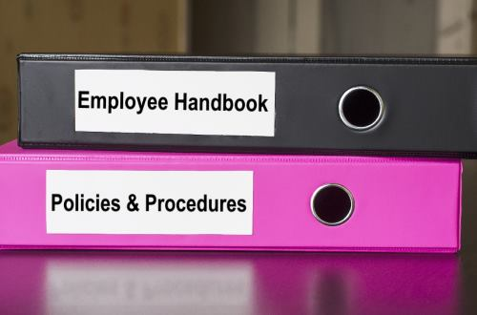
Know where to look

Slide 36


Parish and School
Policy Manual 2017-2018
#4151.1: Teacher Attendance Days
&
#4152.3: Pregnancy, Childbirth, Maternity
Notes:
4151.1: Teacher Attendance Days Absences, Leaves, and Vacations Each parish/school shall allow the full-time employee at least five (5) days of leave with pay each year provided that such leave is used for personal illness or for any critical illness, death, or funeral of a member of the employee's immediate family or any relative living in the same house. The minimum number of teacher contracted days shall be 190 based upon: • 180 teacher-student contact instructional days • A minimum of 10 professional days in the school calendar. Professional days include educational conventions, orientation, curriculum planning, accreditation work, and staff development. Deductions from a teacher's salary will be based on the total number of scheduled teacher attendance days, as defined by the contract. A standard form shall be used for parishes to keep attendance records. A copy of the individual's attendance record will be given to the person at the end of the fiscal year.
Download Form 4151.1: Attendance Record ADOPTED: 2/11/1975;
REVISED: 7/30/2015
4151.5: Legal Commitment: Jury Duty Employers shall release employees from their regular responsibilities to serve as a jury member. An employee required to serve as a jury member who presents a court pay voucher to his/her supervisor will be compensated for the period of jury duty based on the difference between jury fees (excluding food and mileage allowance) and the amount of the employee's normal straight- time earnings for that period. 66 ©2017– Archdiocese of Milwaukee To be eligible for jury duty pay, an employee must be at work during regular working hours while not on jury duty. ADOPTED: 5/16/1991;
REVISED: 7/28/2015
4152.3: Pregnancy, Childbirth, Maternity Leaves Both federal and state laws prohibit discrimination on the basis of pregnancy or a pregnancy-related condition. The federal Pregnancy Discrimination Act (PDA) prohibits discrimination because of or on the basis of pregnancy, childbirth, or related medical conditions. It mandates that employers treat women who are pregnant or affected by other childbirth or related medical conditions the same for employment-related purposes, including the receipt of benefits under benefit programs, as other persons not so affected but similar in their ability or inability to work. The Wisconsin Fair Employment Act also makes it unlawful to discriminate against any woman on the basis of pregnancy, childbirth, maternity leave, or other related medical conditions. Employers cannot discriminate against pregnant women in providing benefits. Fringe benefits for long-term or permanent disabilities resulting from pregnancy-related conditions must be provided to the employees to the same extent as provided for other disabling conditions. Employers are also prohibited from maintaining any policies which have an adverse impact upon or which disparately treat pregnant employees, unless appropriate affirmative defenses can be established. Pregnancy-related leaves should be consistent with disability leave policies. The Federal Family and Medical Leave Act of 1993, and the State of Wisconsin Family and Medical Leave Act of 1988 apply to employers of 50 or more employees. Leaves of up to 12 weeks may be allowed under these acts. Schools and Parishes are required to post written notice of the FMLA regulations in a conspicuous place for employees. The employee handbook should provide staff with policy information on the handling of leaves of absence. Leaves of absence should be documented and have supporting medical evidence where appropriate. Contact the Office for Parish and School Personnel for further clarification and policy guidelines on leaves of absence. Family and Medical Leave Act
ADOPTED: 4/2/1990; REVISED: 5/4/1999
4216.34: Clerical Staff Sufficient clerical assistance should be provided for the administrators through the employment of secretarial staff. A business-like yet personable relationship with all clientele shall be maintained through the office. The parish/school secretary shall be employed by the administrator and will work under his/her supervision: • The parish/school secretary, under the supervision of the administrator, shall be responsible for maintaining and managing the parish/school office. • A job description for the parish/school secretary shall be developed by the administrator in consultation with the secretary. • The parish/school secretary's work will be evaluated by the administrator annually

Slide 37


Human Resources Review Tool……

Slide 38


Handbook
Hiring
Personnel Files
Employee Status
Posters
Record Retention

Slide 39
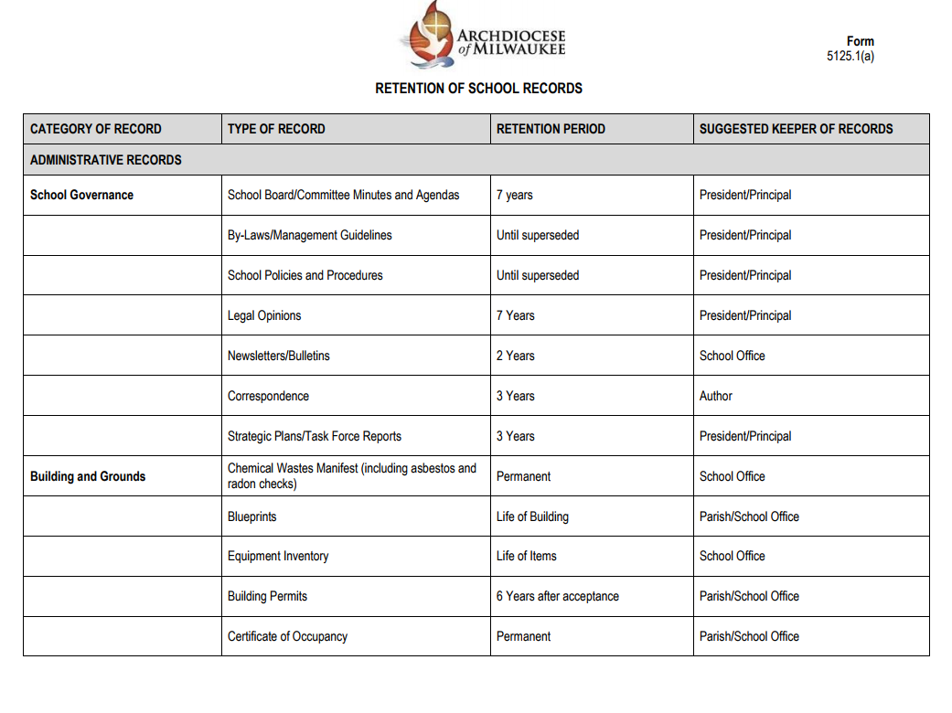
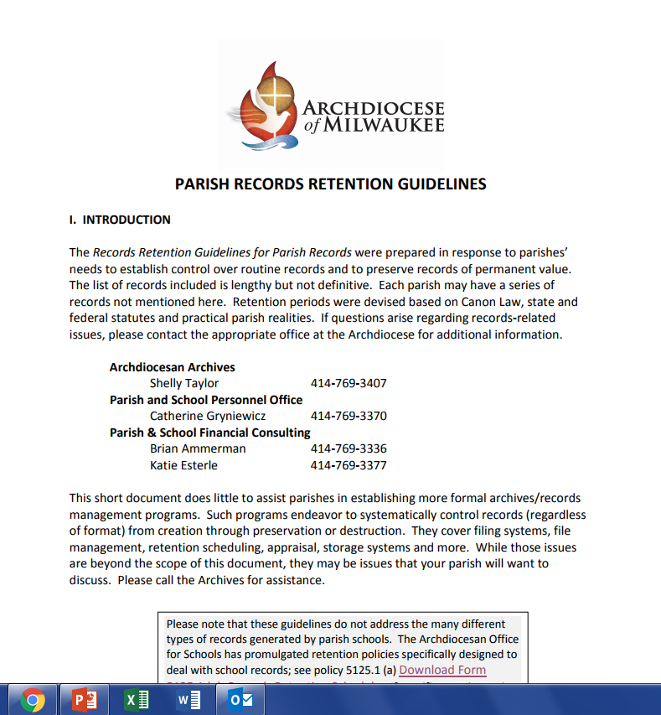

Record Retention

Slide 40

Questions?

Slide 41
Break
Up Next: Stewardship with Barb Vite

Slide 42

Stewardship: It’s Not About the Money
The Business Administrator’s Relationship to the Parish Stewardship Commission

Slide 43
This Morning’s Agenda
Stewardship defines a parish culture
Parish culture affects the “bottom line”
“Why me?” – The role of the Business Manager
Clarifying commonly used and often confused terms
Catholic giving: some facts and figures
Increasing offertory: some basics and exciting news #1!
Planned Giving – some basics and exciting news #2!
Questions

Slide 44
A Culture of Stewardship…
… is about making connections.
… is grounded in spirituality and best practices.
… is more than time/talent/treasure.
… is about vision and mission.
… is an engine for moving a parish forward.
Notes:
The culture of a parish has a significant impact for better or for worse. Stewardship commissions developing and implementing effective stewardship initiatives based first in prayer, engagement, invitation and service have an incredibly positive impact everything in a parish – including the budget.
(click)

Slide 45

Notes:
A culture of stewardship provides the financial resources needed to grow ministry offerings, increase parish staffs and enable our Pastors and Parish Directors to be pastoral.

Slide 46



Historically…
Notes:
Historically, if a stewardship committee did exist – it had one clear area of responsibility raising money. These committees were often a sub-committee of the Finance Council, and were given the sole responsibility for increasing parishioner giving. Some committees devoted a small amount of time to recruiting volunteers and hospitality. Lots of good work was done, but nothing really changed. (CLICK)

Slide 47
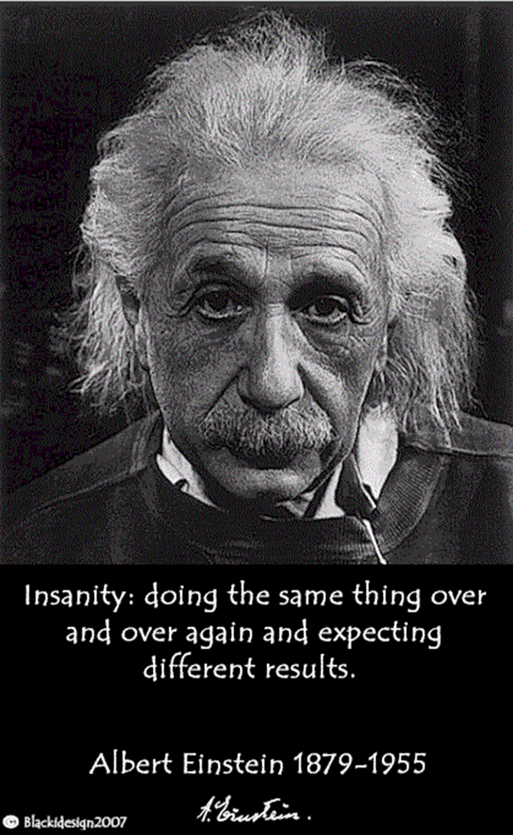
A Definition
“This (Stewardship) commission educates and promotes the giftedness of all parishioners and the responsibility of disciples to steward all resources. The members collaborate with pastor and staff to develop strategies and practices which will invite all parishioners and the parish organization itself to share time, talent and treasure.”
Definition of the Stewardship Commission
Archdiocese of Milwaukee Parish Pastoral Council Norms
Approved May 10, 2012 by Archbishop Jerome Listecki
Notes:
We’ve all heard this definition of insanity – and if what we have done traditionally to increase offertory or to raise money by adding more and more fund raisers, every parish would have more money that it could spend. We need to do things differently, and following the lead of US Bishop’s 25+ years ago the AB established a stew comm as a standing…….. (CLICK)

Slide 48

Here’s Where You Come In!
Link between the Stewardship Commission and parish resources
Create and maintain systems detailing participation and financial giving
Control or navigate systems of communication
Act as a liaison to other parish staff members as appropriate
Offer expertise, knowledge and guidance as appropriate
Is NOT solely responsible for executing elements of the stewardship plan
Notes:
A couple of the parishes represented here have a staff position of Director of Stewardship and Communications – and that is the ideal since as with any other area, we can do so much more when we have the people and resources dedicated to a ministry. In most parishes, however, the Business Manager becomes the “stewardship person”. In parishes where there there is a stewardship commission, but no staff position dedicated to stewardship, it is the Business Manager who acts as liaison to the commission. Where there is no commission – CALL ME – . In any case, the Business Manager plays an important role in the success of any stewardship initiative.
The Business Manager is the link between the stewardship commission and the resources of the parish, including full knowledge of the parish calendar, events schedules and parishioner information databases. He or she creates and maintains the systems for assessing parishioner participation and financial giving. The Business manager often controls, or can help navigate, the avenues of communication needed to invite and increase parishioner participation and giving. He or she is the link to other parish staff members. Give Examples
Offers expertise Give Examples. Not solely….

Slide 49

Defining our Terms
Stewardship
Development
Fundraising
Notes:
As Business Managers, you will hear several terms used in the parish when groups or individuals are talking about stewardship in the financial realm. While these terms that are often used interchangeably - and are related, each has it’s own distinctive meaning, function, an effect on parish life. These terms are (CLICK) Stewardship, Development and Fundraising.

Slide 50

Stewardship…
… is a way of life in which we live as God intended, recognizing that all we have is a gift meant to be shared with others and returned with increase to the Lord.
Notes:
Parishes that are seeing positive momentum and long term change, start by developing a culture of living stewardship in their parish communities. Good stewardship is the foundation upon which all other activities and ministries are built if a parish is to thrive.
Stewardship is the philosophy, the theology, the spiritual foundation from which we, as people of God, live out our baptismal call to serve others and to serve God.
Stewardship is the means through which we build the Kingdom here on earth – which requires faith, intentional planning and committed execution of best practices and other elements that speak to the personality and heart of the parish.

Slide 51
Development…
… provides structures, organization, processes and avenues through which parishioners can practice good stewardship.
Notes:
Development puts a face on stewardship.
Development, as a ministry, provides structures, processes and avenues by which the people of God can practice good stewardship.
Development brings the good news – of the parish and it’s ministries – to parishioners in a structured, organized, systematic way, providing the means to encourage involvement and engagement, enabling and empowering the greatest number of parishioners to be active in the life of the parish.
Development in the fullest sense goes beyond offertory into strategies such as planned giving, donor cultivation, grant writing.
(CLICK)

Slide 52

Fundraising…
… encourages transactions, not relationships.
... gets results that are not in proportion to the time and effort expended.
… can create “camps” and “silos”.
Notes:
Successful stewardship and development are based on building and strengthening relationships.
(CLICK) Fundraising, for the most part is based on simple transactions. With sales and raffles, parishioners might buy what we’re selling, but the interaction ends there.
Some fundraisers have a community building benefit, but even this seeming “plus” can be outweighed by the amount of time, hands and effort needed to make them successful. And large fundraisers can be dangerous territory when the group of leaders who run a large event step down – and no one new steps forward. Many a parish budget has had to recover from lost revenue when events ended years later after the initial excitement and enthusiasm wore away.
Fundraisers can also detract from the spirit of one faith community working for the good of all parish ministries when priorities are not clarified and disagreements arise about how profits should be spent.
(CLICK)

Slide 53


Stewardship + Development =
Maintenance to Mission
The ability to stop treading water and begin to plan from our abundance!
Notes:
This is how you will get to budgets..

Slide 54

Catholic Giving…it’s always a hot topic!
“We believe the main problem with Catholic giving is a cultural one. Culture is the potent brew of knowledge, belief and behavior which everyone in an organization shares. And it can be the most powerful force of all.
(Culture) affects everything: enthusiasm and morale, productivity and creativity, effectiveness and success.
And money.”
Fr. Michael White & Tom Corcoran
Notes:
Catholic Giving has always been quite the “hot topic”. Authors and researchers have been examining the facts, figures, trends and reasoning behind Catholic giving (or more accurately, the lack thereof) for decades. In 2000 – now almost 20 years ago Dr. Charles Zech wrote the book “Why Catholics don’t Give and what can be done about it”. Books, webinars and more…. Just a few months ago…. CHURCH MONEY from the authors of Rebuilt. While the book does discuss best practices surrounding increasing giving, the first half of the book reinforces what parishes focused on the big picture of stewardship are learning (CLICK and read)……. (CLICK)

Slide 55

18% of Catholic respondents donated money to religious causes, including their parish, compared with 26% of respondents from other denominations.
Three-quarters of one percent vs two-three percent of gross annual income.
Average annual $175 compared with $588 for non-Catholics.
Gaps in weekly giving between Catholics and other denominations increase among weekly church attenders.
Notes:
Unleashing Catholic Generosity: Explaining the Catholic Giving Gap in the United States is a study that was done some years ago thru Notre Dame that contains some very insightful information. Here a just a very few of the findings in that study. GO THRU SLIDE… explain last (CLICK)

Slide 56
Compassion and empathy
Materialistic values
Wealth and income differences
Spiritual engagement with money
Notes:
In addition to church attendance, the study examined other factors to gauge their influence on giving behaviors and to test whether these other factors might help explain the Catholic giving gap. By equalizing for factors including respondents’ compassion and empathy, their materialistic values, and wealth and income differences, the study determined that none of these factors could explain the lack of Catholic financial generosity.
The one factor that was determined to be the single most significant difference between Catholics and all of the other groups studied was spiritual engagement with money – in other words, the culture of Catholic giving. (CLICK)

Slide 57
Most Catholics separate money from matters of faith and think that money has little to do with spiritual issues.
Viewing money as having a spiritual purpose dramatically increases giving, while separating money from religion has the opposite effect.
Notes:
In short, we Catholics tend, more than any other religious denomination, to detach our money and finances from our spiritual lives. 2 of the study’s conclusions were, that most Catholics, rather than seeing their use of money and possessions as part of their spiritual life, tend to compartmentalize; separating money from matters of faith and thinking that money has little to do with spiritual issues. Second that viewing money as having a spiritual purpose dramatically increases giving, while separating money from religion has the opposite effect. (CLICK)

Slide 58


Parish Culture
Paying the Bills vs. Living the Vision
Notes:
…which again takes us back to a stewardship culture. Explain from study … (CLICK)

Slide 59

Stewardship: Pieces of the Puzzle
Education
Talent
Process
Formation
Prayer
Communication
Hospitality
Planning
Evangelization
Finances
Notes:
Parishes that are growing a culture of stewardship and making real headway in securing the ability of the parish to continue and expand it’s ministry goals – realize that focusing only on one part of an equation - money, while ignoring the others, will not achieve the hoped-for results. Hopefully, your parishes have stewardship commissions that have worked in collaboration with the PC to identify priorities, built solid action plans to address those priorities and are beginning the slow, but critical process, of building a stewardship culture. If that’s not the case in your parishes – call me!
(CLICK)

Slide 60

In the meantime…..
Notes:
In the meantime – every parish has bills to pay and income is always on your minds. Culture change, while critical takes time. What can a parish do right now to increase offertory in the short term? (CLICK)

Slide 61

Our most generous givers…
make a conscious decision to give.
use systems and routines to guide their giving.
Notes:
Remembering that how we think about money matters and how we talk about money matters, there is one last finding I would like to share that is important to frame any discussion about an enhanced offertory process. The Notre Dame study determined that two factors helped to explain the higher giving of some. The first is making a conscious decision to give. The second was the use of systems or routines to guide their giving rather than relying on spontaneous or situational giving – hence the importance of a sound process that provides the tools that help people live out their desire, indeed their need, to give. As Business managers you will play an important role in that process. (CLICK)

Slide 62
The Business Manager’s Role in the Enhanced Offertory Process – The Basics
Working with your parish data; accuracy, consistency, analysis
Generating personalized letters “Dear John and Mary” vs “Dear Parishioner”
When applicable, manage E and print communications regarding the process and progress
Additional roles based on parish resources and structure:
Coordinate stuffing/mailing schedule
Manage component printing
Connect stewardship commission with other staff (liturgy director, etc.)
Notes:
My intent this morning is not to define a process, but rather to touch on just a couple of basics to give to an idea of your role and some of the things that maximize the results of an increased offertory process. In a moment, I’ll introduce you to an amazing new member of our team who will become your resource for “all things offertory”. So – here are some of those basics to give you a feel for your role in an offertory process. GO THRU SLIDE THEN (CLICK)

Slide 63

“Back Room” Procedures are Important
Record gifts in a timely manner
Send “Thank you” letters
Include a personal note from the pastor as appropriate
Send follow up letters to non-respondents
Update the congregation on participation
Notes:
Go Thru slide… (CLICK)

Slide 64

Exciting News #1! Introducing…
Cindy Lukowitz
Offertory Specialist
Notes:
Now the first bit of exciting news I promised you…. (CLICK)

Slide 65
A Few Words About Planned Giving
Notes:
Now some thoughts about another aspect of parish financial planning – Planned Giving. Over time a planned giving program can begin to set a parish on a strong financial foundation. Some parishes have planned giving committees or endowment committees, and do a fairly good job of promoting estate and planned gifts - but many more do not. (CLICK)

Slide 66

Some of the Facts…
Notes:
Here a just a couple of interesting facts from philanthropy research. GO THRU POINTS (CLICK)

Slide 67
Notes:
GO THRU SLIDE… (CLICK)

Slide 68

You don’t have to be an expert!
Notes:
RESOURCES WEBSITE… (CLICK)

Slide 69
Exciting News #2! Introducing…
Bob Pfundstein
Planned Giving Director
Notes:
Now the SECOND bit of exciting news I promised you…. (CLICK)

Slide 70


and
Notes:
In closing, thank you for all you do – your work is a critical ministry. As you encounter your stewardship commissions or have development, offertory or other related questions, please don’t hesitate to call us. QUESTIONS

Slide 71
Up Next:
Parishioner Statements: The “Dos” and the “Don’ts” with Celia Meyers

Slide 72

PARISHIONER
STATEMENTS
Annual Contribution Statements

Slide 73
Annual Parishioner Statements
More than a year end report ……

Slide 74
Annual Parishioner Statements
Every communication is an OPPORTUNITY

Slide 75
Annual Parishioner Statements
What do they WANT to know?
What do they NEED to know?
What do WE WANT them to know?

Slide 76
Annual Parishioner Statements
What do they WANT to know?
What did I give this year?

Slide 77
Annual Parishioner Statements
What do they NEED to know?
IRS Publication 1711: Charitable contributions overview – Substantiation and Disclosure Requirements for any single contribution over $250.00
  Name of the Parish (Parish Letter head)
  Amount of cash contribution or description (but not value) of non-cash contribution
  “No goods or services were provided by the parish” (if that is the case)
  Description and good faith estimate of the value of goods or services, if any, that the parish provided in return for the contribution
    Ex: Dinner Auction Ticket
  *Important Note: These are the minimum IRS requirements and not the recommendation of best practices in the Archdiocese

Slide 78
Annual Parishioner Statements
What do WE WANT them to know?
This is an opportunity!!!! No communication to our parishioners should be wasted …..

Slide 79
Annual Parishioner Statements
What do WE WANT them to know?
All contributions are important
All contributions are accounted for
All contributions are used as they were intended
All contributions are APPRECIATED

Slide 80
Annual Parishioner Statements
What do WE WANT them to know?
ALL PARISHIONERS ARE IMPORTANT AND APPRECIATED

Slide 81
Annual Parishioner Statements
What do WE WANT them to know?
How do we do that????

Slide 82
Annual Parishioner Statements
What do WE WANT them to know?
Timely Reports … by January 31 … preferably mailed
Accurate Reports … Reconcile your parishioner data system to your accounting system
  Reconcile by deposit & monthly year to date
Complete Reports … Include all contributions
  Contributions, Non-Cash items, Mass Stipends, Parish-Related Collections, Other …
  What about? Collections for others, Third Party Matching, Memorials, Special Collections, Other …

Slide 83
Annual Parishioner Statements
What do WE WANT them to know?
Sounds like Over-Kill???
(. . . or does it?)

Slide 84
Annual Parishioner Statements
What do WE WANT them to know?
Our communities have a RIGHT to EXPECT that we have ACCURATELY accounted for EVERY donation
Donations are given of free will ….

Slide 85
Annual Parishioner Statements
What do WE WANT them to know?
ACCURACY
BUILDS
CREDIBILITY

Slide 86
Annual Parishioner Statements
What do WE WANT them to know?
CREDIBILITY
TRANSFORMS
INTO TRUST

Slide 87
Annual Parishioner Statements
What do WE WANT them to know?
TRUST
BUILDS
COMMUMITY

Slide 88
Annual Parishioner Statements
What do WE WANT them to know?
MOST IMPORTANT ….
SAY THANK YOU!

Slide 89
Annual Parishioner Statements
What do WE WANT them to know?
Gratitude Promotes Community
Community Proclaims Christ
We are all part of the Mission

Slide 90
Annual Parishioner Statements
Questions?

Slide 91

Lunch

Slide 92
Building & Grounds Committees – Art Scheuber

Slide 93
Up Next:
Catholic Mutual as a Partner in your Parish Work – Molly Hatfield

Slide 94
Catholic Mutual Group
Archdiocese of Milwaukee Participant’s Indemnity Plan Irrevocable Trust (PIPIT)
New Business Administrator Institute
November 13, 2019

Slide 95
Question #1
Who is Catholic Mutual Group and how is it different from a standard insurance company?
Catholic Mutual is a Catholic not-for-profit that administers a property and liability self-insurance program of the Catholic Church in North America. We have been the administrator of the Archdiocese of Milwaukee’s Protected Self-Insurance Program since 1987. We are not an insurance company. Funding for the program comes directly from the premiums paid by the members. The Participant’s Indemnity Plan Irrevocable Trust, or PIPIT, holds the funds that are paid by the parishes and organizations in the Archdiocese of Milwaukee, which are used to pay the administrative costs of the program and claims.

Slide 96
Question #2
Who are your local Catholic Mutual representatives?
Molly Hatfield, Claims Risk Manager II and Office Manager
Claims, risk management, on-site inspections, policy, employment and sensitive issues
Jennifer Brokmeier, Claims Risk Manager I
Claims (auto specialist), risk management, on-site inspections
Patrick Peyton, Service Office Assistant II
Certificates of insurance, special events coverage, special projects, front office and technical support
In addition to the local Catholic Mutual Office, we have a full staff of risk management, coverage, and claims specialists in Omaha, Nebraska

Slide 97
Question #3
What does Catholic Mutual do for the Archdiocese of Milwaukee?
We investigate and pay property, liability and auto claims and perform safety and risk management duties to mitigate the adverse financial and legal effects of risk for the archdiocese and its parishes, schools and agencies. This is accomplished by:
  Investigate and adjust property, liability, and automobile claims for members.
  Coordinate the legal defense of our members against 3rd party claims and lawsuits.
  Perform on-site safety and risk management inspections of all locations on a yearly basis.
  Work with our members to provide answers to questions relating to operational and situational safety and risk.
  Review contracts to correct improper or unfair insurance, hold harmless, and indemnification language.

Slide 98
Question #3, continued
What does Catholic Mutual do for the Archdiocese of Milwaukee?
Prepare certificates of insurance that are required or requested by outside entities for use of their facilities, to obtain special permits for events, or as required by equipment leases (ex. Photocopiers, retreat centers).
Collaborate with archdiocese departments, including the Office of Finance and the School’s Office, in the development and support of best practices and policies.
Disseminate information – using both written materials and on-line training programs for our members on major risk management initiatives on topics including specific accident reduction, human resources, financial management, premises safety, and transportation safety.
Work closely with archdiocese human resources on employment issues.

Slide 99
Question #4
What are some common interactions between Catholic Mutual and Business Administrators?
Communication about accidents or injuries or problem situations at the parish or school that you feel might develop into a claim. Accident reports can be submitted online at the Catholic Mutual Group website, faxed, or e-mailed to our office.
Questions about outside groups using parish facilities – what form should be used? Facility Usage Indemnity Agreement, Adult Hold Harmless Agreement, purchase Special Events Coverage?
Questions about coverage issues, such as “our boiler went out, or our roof is leaking, is this covered?”
Discussion on safety and risk about proposed activities at the parish/school.

Slide 100
Question #5
Is the parish responsible for the actions of volunteers? Is there coverage?
The parish is responsible for the actions of volunteers when they are acting under the direction and control of the parish. The liability coverage for volunteer acts mirrors the coverage available to the parish. PIPIT would provide a legal defense for a volunteer implicated in a civil lawsuit against the parish.
It is important that volunteer activities be directed by the parish, and that volunteers are not allowed to “run the show” or perform high risk activities without careful consideration and consultation with Catholic Mutual.
PIPIT does not contain a health or accident policy for volunteer injuries. Workers Compensation Insurance does not apply to volunteers.
Utilize an Adult Volunteer Hold Harmless Agreement for volunteers in high risk situations.
PIPIT does not contain coverage for either staff or volunteer professionals such as lawyers, engineers, or doctors. These individuals need to have their own liability coverage that will protect the parish from claims.

Slide 101
Question #6
What are some of the coverages in the Catholic Mutual Program?
Property – all risk replacement cost coverage for buildings, contents, computers, phone systems, electronics, loss of income. Perils include wind, lightning, fire, vandalism, theft, water damage. There is a $1,000 deductible per loss.
Builders Risk – coverage for construction projects up to $10,000,000 at no extra cost to the parish, if our addendum to contract is signed.
Boiler and machinery – covers accidental damage to boilers, air conditioners, furnaces, compressors with a $2,500 deductible.
Comprehensive crime coverage – employee dishonesty (embezzlement) with a $250,000 limit, and theft with a $100,000 limit and $1,000 deductible.
Cyber liability – covers hardware, software and operations from the effects of hacking, malware, etc.
General liability – coverage triggers off a third-party claim for bodily injury, property damage or personal injury.

Slide 102
Question #6, continued
What are some of the coverages in the Catholic Mutual Program?
Educator’s legal liability
Employment practices liability – costs shared between the location and PIPIT on an 80%/20% basis for legal costs and settlements.
Limited sexual misconduct (for entity – not perpetrator).
Incidental medical malpractice for school nurses and parish nurse programs.
Liquor liability – parish must follow all municipal and state ordinances.
Auto liability for parish owned, hired, and non-owned (excess only) vehicles. Priest’s personal vehicles are not covered in the program. Transportation Policy must be followed.
Directors and officers liability – coverage for schools boards and parish committees, trustees.
Priests, religious – personal liability and property coverage. $300,000 liability and $25,000 property with a $250 deductible.

Slide 103
Question #7
Is Worker’s Compensation Coverage through Catholic Mutual?
No, worker’s compensation coverage for injured workers is a package policy written through Church Mutual Insurance Company in Merrill, Wisconsin. Worker injuries are reported directly to Church Mutual who investigates and adjusts the claims. Catholic Mutual Group plays a support role for the archdiocese’s worker’s compensation program, but is not responsible for adjusting claims.
The premium for worker’s compensation coverage is based on your payroll and is included on your yearly PIPIT billing statement.

Slide 104
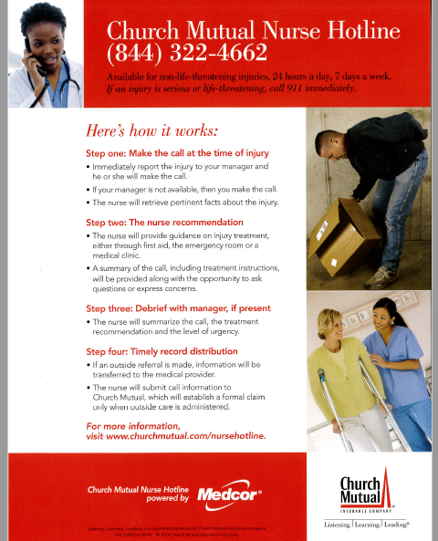

Slide 105
A few important reminders business managers….
-Do not allow the pastor, principal or administrator to terminate an employee without prior consultation with Catherine Gryniewicz, Archdiocese Director of Human Resources for Parishes and Schools, Rick Tank, or a qualified employment law attorney. If a consultation is not completed and followed before termination, coverage for a subsequent claim will be excluded. In emergency situations, an employee an be immediately suspended pending an investigation.
-Assume that all civil laws and regulations apply to parishes until you are sure that they don’t apply.
-It is important that the parish adheres to its written policies and procedures. Review your handbooks and keep them current with practices that are being followed and that are legal. It’s better to not have a written policy than to have a policy that is not followed, because policies create potential liabilities.
-Establish a Safety and Security Committee to review security vulnerabilities and develop basic emergency responses. Practice your emergency responses and involve local law enforcement if possible.
-Contact Catholic Mutual at any time to discuss a situation or problem that you believe could result in liability for the parish.

Slide 106
Catholic Mutual Group
P.O. Box 178
Menomonee Falls, WI 53052-0178
Ph. 262-255-6906
Fx. 262-255- 7276
Molly Hatfield, Claims/Risk Manager
mhatfield@catholicmutual.org
cell phone: 414-405-2603

Slide 107
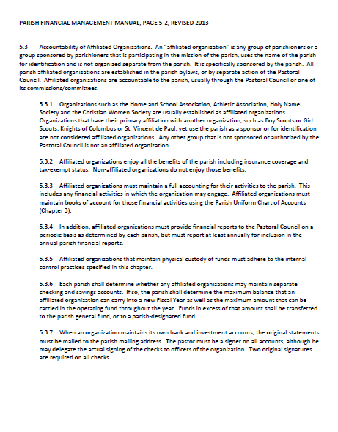

Slide 108
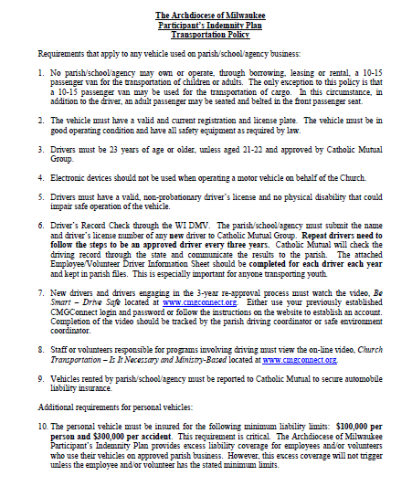

Slide 109
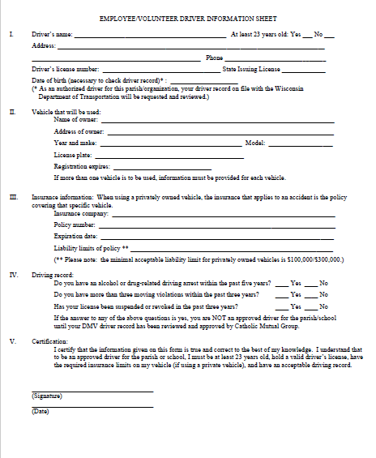

Slide 110
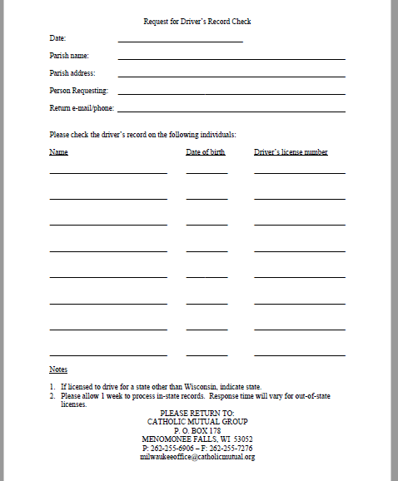

Slide 111
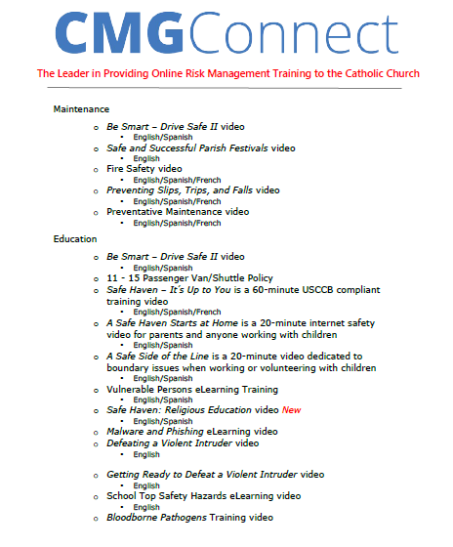

Slide 112
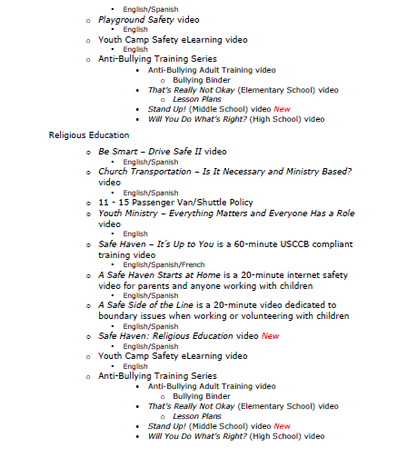

Slide 113
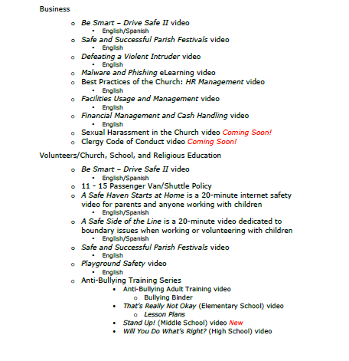

Slide 114
Questions for Molly?
Up Next: Year-End Financial Reminders, Katie Esterle

Slide 115
Year-End Financial Reminders
*1099’s and W-2s

Slide 116
Year-End Financial Reminders
1099’s
First…. A Quiz!

Slide 117
Year-End Financial Reminders-
1099’s
Form 1099 should be issued for all non-employees who the parish paid $600 or more in a calendar year for services they performed
Not all vendors receive a 1099.
  You should have a W-9 on file for any vendor that you pay (this includes individuals) for services. No new vendors should be paid without this document filled out by the vendor.
  A W-9 tells you (the parish) the federal tax classification of the vendor.
    The vendor should fill it out, including their tax classification and EIN or Social Security Number
  You should use the data provided on the W-9 to determine if they are eligible for a 1099 and that information should be entered in your accounting software.

Slide 118
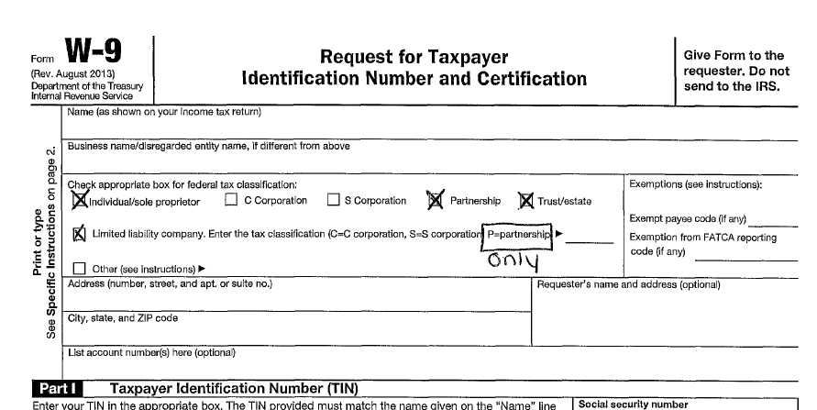
Year-End Financial Reminders-
1099’s

Slide 119
Year-End Financial Reminders-
1099’s
So, vendors who are:
  Individuals/sole proprietors
  Partnerships
  Trusts/estates
  LLC’s (Partnerships Only)
  Are all 1099 eligible
  So let’s review your Quiz

Slide 120
Year-End Financial Reminders-
W-2’s
Should be prepared for all employees
  Generally speaking, a single person should be receive a 1099 and a W-2 from your parish
    UNLESS – their designation or position changed during the calendar year
    Let’s review a couple of examples.

Slide 121
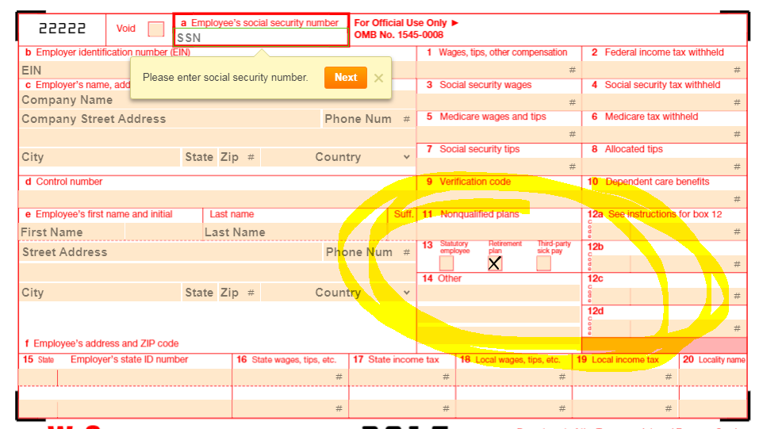
Year-End Financial Reminders
W-2s
  If an employee is part of the lay pension program and/or contributes to a 403b (or 401k), box 13 on their W-2 should be checked

Slide 122
Year-End Financial Reminders
W-2s
  In most cases, your priest’s W-2 will look significantly different than that of all other employees. This is due to their dual tax status: employees for income tax purposes but self-employed for Social Security and Medicare purposes.
    Typically, only Box 1 and 2 are filled out. Boxes 3-12 are blank.
    Box 13 “Retirement Box” should be checked, as they patriciate in the Priest Pension Plan.
    Housing should be included in Box 14.

Slide 123
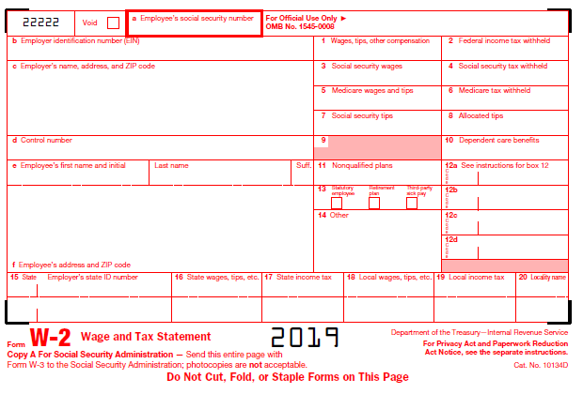
Year-End Financial Reminders
W-2s for Priests
This is after the housing deduction
987-65-4321
12-3456789
26698.00
3000.00
St. Mary Parish
123 Easy Street
Anywhere WI 55555 United States
Andrew J Smith
8675309 Main Street
Nowhere WI 56565 United States
X
Here is housing
7440.00 Housing
WI 112233445566
26698.00
600.00

Slide 124
Year-End Financial Reminders
W-2s
Other Items to Note:
  The face value of gift cards given to employees are considered taxable income and need to be included on a W-2
  Gifts (that are not de minimis) or gift cards that are given to employees by Home & School, Christian Women, etc. are considered taxable income and need to be included on a W-2

Slide 125
Year-End Financial Reminders
W-2s
Questions?

Slide 126
You Can’t Make this Up – Denise Montpas

Slide 127
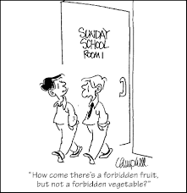
Intro…

Slide 128
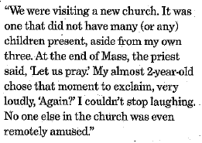
Catholic Herald
“Unruly Kids? Mamas, You’re Not Alone”
October 24, 2019

Slide 129
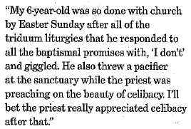
Parish Finance: Here to Help
First, any other examples to share?
Remember…
We have seen it all before
Call us; we are glad to help you
You are not alone

Slide 130
Closing remarks – Katie Esterle & Chris Brown
2020 NBAI Updates
BAAM Meetings
Distribution of Certificates
Please remember to fill out an evaluation form. We appreciate your feedback.
Thank you for coming.

Slide 131
Closing prayer – Chris Brown
Notes:
Michelle. We began in prayer and we will end in prayer.. This prayer asks God to be with us in our leadership groups and in our individual lives as we work to embrace intentional discipleship. Let us pray CLICK

