Slide 1
Rooting Catholic Social Teaching
Formation for Lay Ministers
Notes:
Introduction
Hello everyone, and welcome! Again, my name is Catherine Orr, and I am thrilled to be here with you today representing the Roundtable Association of Catholic Diocesan Social Action Directors. I have served as the Program Coordinator for 5 years now, and my role is to support those working in social ministry around the country. The Roundtable is the national, professional membership organization for those working in social ministry. Members are primarily from diocesan offices like Rob’s, but also from parishes, religious orders and other national collaborating organizations.
Before diving into today’s topic, I first and foremost, want to thank Rob and Susan for the invitation to speak, and for the Archdiocese in hosting all of us today. I am thrilled to be here today to talk to you about one of my favorite aspects of the faith: Catholic Social Teaching. I first got started working in ministry a little over 10 years ago, and that was when I first started connecting how I lived my faith to the language of CST. I grew up in a very Catholic home with parents who lived their faith as followers of Christ by practicing the works of mercy and regularly participating in the sacramental life of the Church. But interestingly enough, they never used the language of CST, but rather, they lived and modeled it.
It was when I started working in ministry and took a certificate course in CST at Catholic University where my eyes were open to the language, history, and depth of CST.

Slide 2
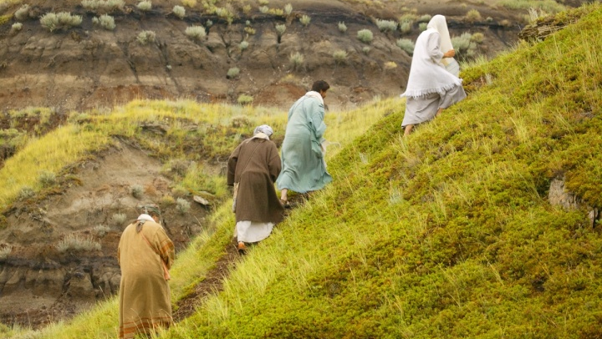
Outline
Contextual overview
Rooting Catholic social teaching (CST) to the Gospels
Gospel of Luke examples
  The Sermon on the Plain
  Martha and Mary
Small group discussions
Q/A
Notes:
So for my presentation today, I am not going to try to go into the depths of every aspect of CST, but rather, I’d like to provide an overview of how and why we need to root CST to the Gospel, which should always be our starting point.
We will then take the Gospel of Luke as an example, specifically looking at two familiar stories - the Sermon on the Plain and Martha and Mary.
We will have time for small group discussion where you can dialogue and share your thoughts on these stories coming from a particular lens, and then we’ll have some time for large group recap and questions.
Sound alright? Ok, let’s jump right in.

Slide 3
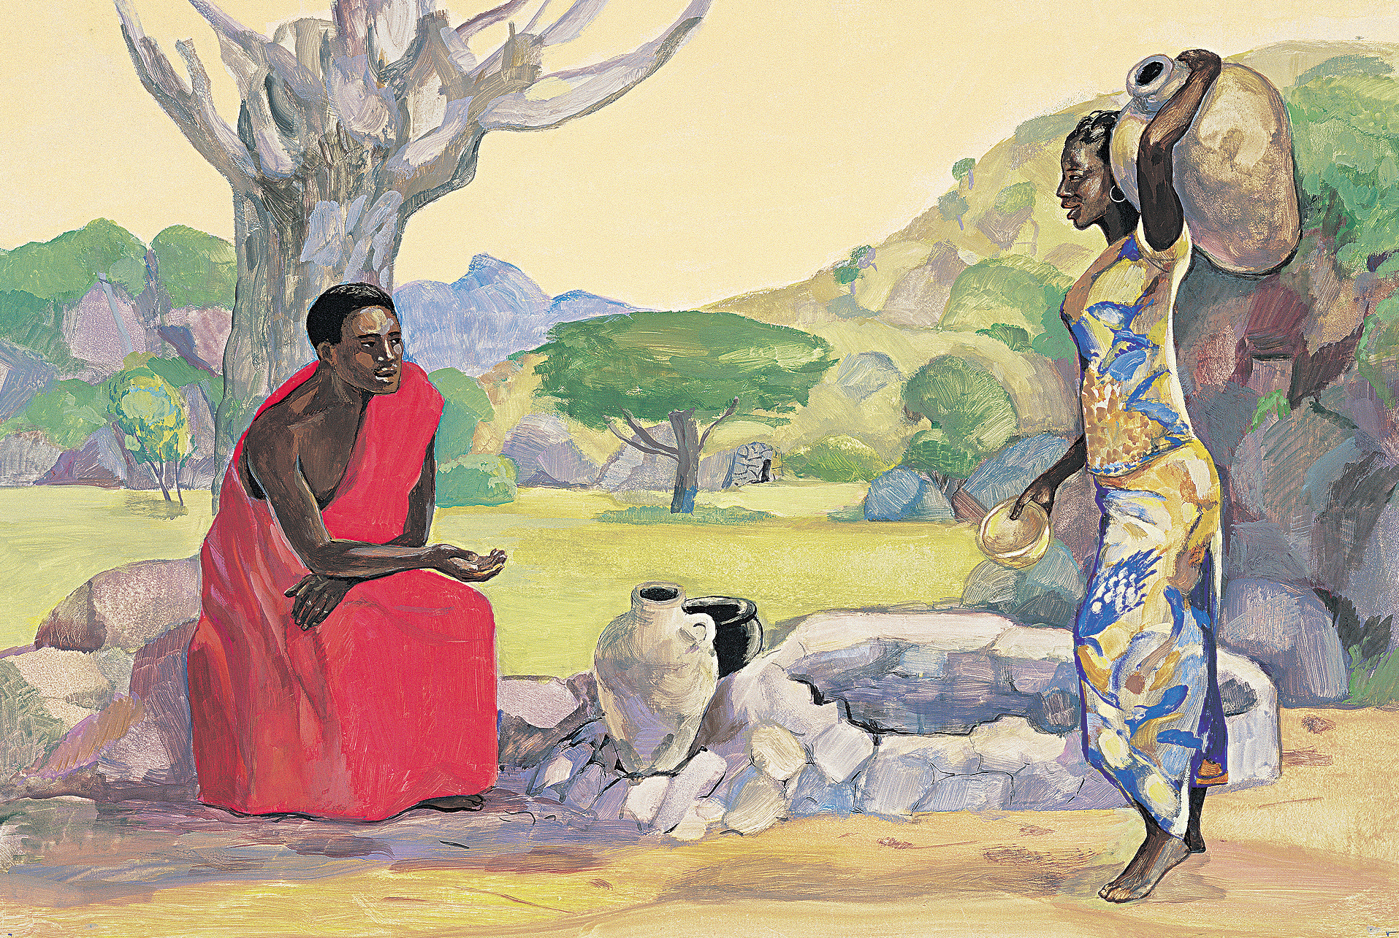
Rooting CST to the Gospels
It is of critical importance to always start from the lens of faith when engaging with CST.
Resource: Catholic Social Teaching Scripture Guide (USCCB)
Source Image: Son of God movie
Notes:
So, before taking a look at the Gospel of Luke, we need to all start from the same jumping off point. It is of critical importance to always start from the lens of faith when engaging with CST. I know this might seem like an obvious point, but because of the very divisive climate in which we live, it is even more important now-a-days to root CST to the Gospel. CST and the area of Human Concerns touches on all the politically hot button issues and because of that, critics will claim that the Church is engaging in politics, which
1.) is not an accurate statement because the Church (us) is called to engage in politics, but we are not called to engage in partisan politics and there is a distinction; but
2.) the overall concerns is a valid concern and one of the reasons why starting from the lens of faith is of critical importance.
The reason why each of us is called to engage with politics is because Jesus invites us to participate in building up His kingdom of justice, love and peace. CST is one way in which we can actively put our faith into action and one way in which we can live as a disciple of Jesus, which is not easy. To be an intentional disciple of Jesus means to be in tension, so that we can grow in our faith and help others grow too. Think of a rubber band and how you pull it, that tension causes it to stretch. We need to be stretched.
And to do that, we need to be firmly grounded in our own understanding, and we will need to engage with people who do not necessarily think and believe the same as we do. Jesus said in this past Sunday’s Gospel reading which came from Luke 6: 27-38: “Do to others as you would have them do to you. For if you love those who love you, what credit is that to you? Even sinners love those who love them. And if you do good to those who do good to you, what credit is that to you? Even sinners do the same.”
I chose this picture of Jesus talking to the Samaritan woman at the well because at the time, that was culturally scandalous. While this particular story is unique to the Gospel of John, it does serve as a good starting point to think about who Jesus engaged with during His public ministry. And we know the answer to that question: He came to call the sinners, and not the righteous. He dined with tax collectors, those who were considered to be unclean, and sinners.
CST offers us a framework to better understand how we engage with others who do not always agree with our values and beliefs. A very helpful resource that I use regularly is this document from the United States Conference of Catholic Bishops (USCCB) titled, Catholic Social Teaching Scripture Guide. It highlights the 7 themes of Catholic Social Teaching and includes both Old Testament and New Testament references.
Life and Dignity of the Human Person
Luke 10:25-37 The good Samaritan recognized the dignity in the other and cared for his life.
John 4:1-42 Jesus broke with societal and religious customs to honor the dignity of the Samaritan woman that day at the well. He challenged her about her marital situation saying she has had 5 husbands and the man she is with now is not her husband. And instead of an angry rebuke to this, she says, “I can see you are a prophet.” And because they both willingly dialogued with one another, not only does John tell us that she believed, but she went into town and brought others to Christ, who then also believed.
Scripture is full of examples that highlight tension or challenging moments, but from those moments, there are opportunities for growth. So they should inspire us to embrace the tension so that we can grow in our faith, rather than shy away from potentially difficult conversations.
Call to Family, Community and Participation
John 15:12-17 This is my commandment: love one another as I have loved you.
Rights and Responsibilities
Matthew 25: 31-46 Just as you did it to the least of these, you did it to me.
Luke 16:19-31 The rich man has a responsibility to care for Lazarus.
Option for the Poor and Vulnerable
Luke 4:16-21 Jesus proclaims his mission: to bring good news to the poor and oppressed.
Luke 6:20-23 Blessed are the poor, theirs is the kingdom of God.
Dignity of Word and the Rights of Workers
Matthew 20:1-16 All workers should be paid a just and living wage.
Mark 2:27 The Sabbath was made for people, not people for the Sabbath.
Luke 3:10-14 Practice integrity in your work.
Luke 12:13-21 One’s worth is not determined by an abundance of possessions.
Solidarity
Matthew 5:9 Blessed are the peacemakers, they will be called children of God.
Matthew 5:21-24 Be reconciled to one another before coming to the altar.
Caring for God’s Creation
Matthew 6:25-34 God loves and cares for all of creation.
Whatever the issue might be, you can find it in scripture.

Slide 4
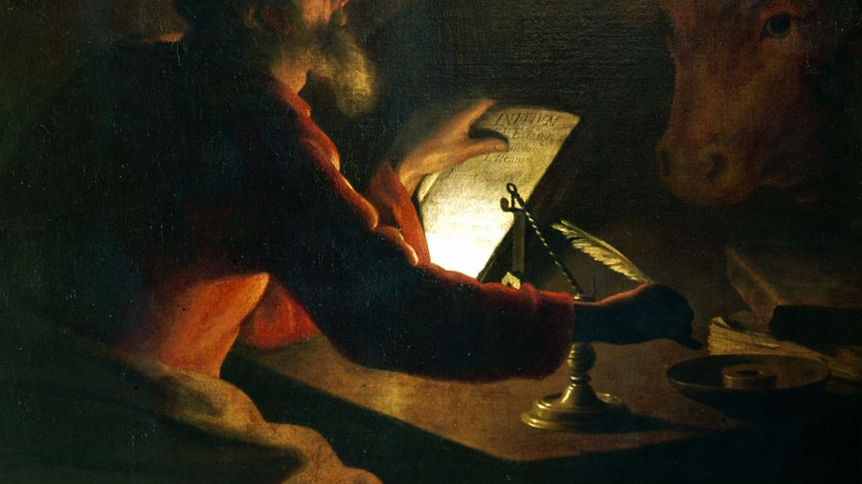
Gospel of Luke
Notes:
Why Luke?
Luke's Gospel, the last of the Synoptic Gospels, is in many ways the most "familiar" of the Synoptic Gospels. From Luke we get most of the traditional Christmas Nativity scene (everything except the star and the wise men). And Luke contains many of the most well-known parables of Jesus, including the Good Samaritan and the Prodigal Son, and I chose to utilize this Gospel as an example because of its familiarity. I must confess that when reading Scripture, sometimes when I come to a familiar story, I sometimes gloss over it because “I’ve heard this story before.” When I do that, I fail to remember that scripture is ever ancient and ever new and that each time I break it open, I will hear something new if I stay attentive.
I also selected Luke because it is the Gospel that is most concerned with the economic and social conditions of the people at the time and is concerned with those who are living on the margins of society and those who are oppressed. Jesus uses strong language in this Gospel that does not sugar coat the level of sacrifice and suffering that is required to follow Him. He states in Luke 14:27, “Whoever does not carry his own cross and come after me cannot be my disciple.”
But even though there will be sacrifice and suffering, there is also great hope, which we see in Luke 4: 18-20, when He quotes the prophet Isaiah:
¹⁸ “The Spirit of the Lord is upon me,
because he has anointed me
to bring good news to the poor.
He has sent me to proclaim release to the captives
and recovery of sight to the blind,
to let the oppressed go free,
¹⁹ to proclaim the year of the Lord’s favor.”
²⁰ And he rolled up the scroll, gave it back to the attendant, and sat down. The eyes of all in the synagogue were fixed on him. ²¹ Then he began to say to them, “Today this scripture has been fulfilled in your hearing.” - Jesus is the good news, and to follow Him, we will need to embrace the tension that exists in order to follow Him.
So with the remaining time that we have together, we are going to take a look at two familiar stories: the Sermon on the Plain and Martha and Mary.
Key characteristics of this Gospel as compared to the others
the Gospel according to Luke. Like Mark and Matthew, Luke was written by an anonymous author, but this author has been traditionally identified as a travel companion of Paul (in Colossians 4:14 reference is made to "Luke, the beloved physician" or, more literally, "Luke the beloved healer").
The usual difficulties apply when we ask the question of Luke's date of composition. Powell gives a date that is roughly contemporary with Matthew because of how he understands the Synoptic Problem (who is copying from whom). Scholars who propose an alternate solution to this problem (one without the Q Source) will assign Luke a much later date toward the end of the first century or even at the start of the second century.
Luke's Gospel is also the only one that begins with a short note from the author to its intended audience. In the first four verses, the author speaks directly to the text's patron, a person called "Theophilus," and tells him that he has written this account so that he might know "the truth concerning the things of which you have been informed." At the start of the gospel this author always betrays an awareness of and dependence on other gospels ("many have undertaken to compile a narrative of the things which have been accomplished among us").
Luke's Gospel is also designed as part one of a two-part work, part two being the Acts of the Apostles. Note the way in which Acts 1:1 is also addressed to "Theophilus," and that Luke, uniquely, ends with the risen Jesus telling the apostles to remain in Jerusalem as opposed to being sent to Galilee (24:49), while Acts begins with the apostles situated in Jerusalem.
Also, about one half of the material found in Luke’s Gospel is unique to him, and it is the longest book in the New Testament. Remember that when scholars get into conversations about identifying the sources of the gospels, there is considerable conversation around the two – source theory (Mark being written first and then the Matthew and Luke utilizing both Mark and the Q source while also having material unique to them).

Slide 5
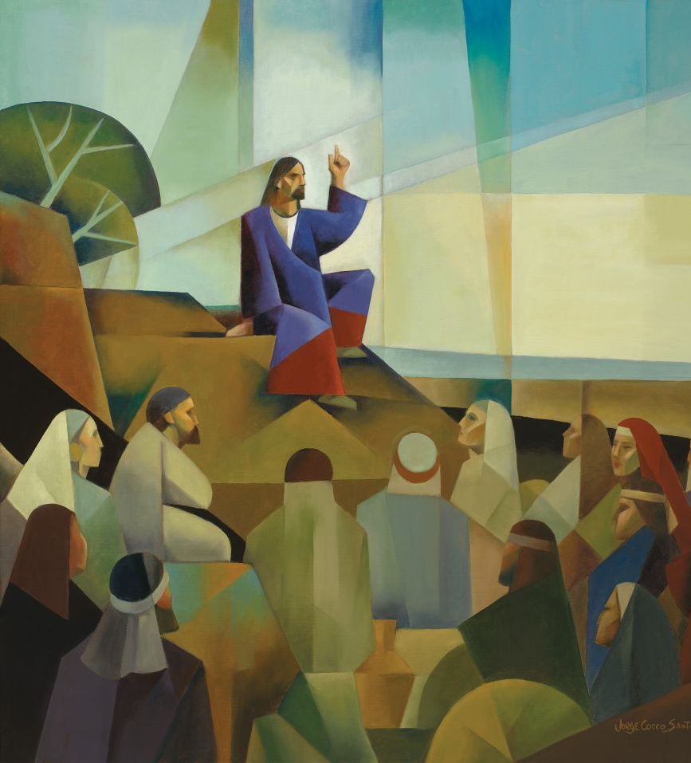
Sermon on the Plain
Luke 6:17-49
Notes:
Difference between Luke’s Sermon on the Plain vs. Matthew’s Sermon on the Mount
Matthew’s Sermon on the Mount is longer and parallels the first, second, fourth and ninth beatitudes of Luke.
Matthew wrote to a more traditionally Jewish audience whereas Luke wrote for a more culturally diverse audience, one that would be likely to interpret Jesus’ story against the background of Roman history. We have been listening to the Sermon on the Plain over the course of the last two Sunday Gospel readings from the 6th and 7th Sundays of Ordinary Time (February 13th and 21st)
New Revised Standard Version (NRSV) has the following subcategories: (ASSIGN SMALL GROUPS ONE OF THE FOLLOWING SUBCATEGORIES)
Blessings and Woes
Love for Enemies
Judging Others
A Tree and Its Fruit
The Two Foundations
SMALL GROUP DISCUSSION – TAKE 7 MINUTES - Where do you see tension in these passages? What do you find to be most shocking and/or challenging, and why?
Jesus was not afraid to speak hard truths, and for this reason, we need to embrace the tension and speak the truth of our faith found in CST, which is not always easy, especially when we need to speak that truth to people, who are closest to us whether at home, in our parish, or when advocating to our legislators. This information then provides the foundation for us to engage in difficult conversations. By saying “I am a Catholic Christian, and I care about the dignity of all human people, especially those who are vulnerable like the recently arrived Afghan refugees, that is why I am here today in your office” or “this is the reason why we decided to host this educational forum at the parish.” It legitimizes why we engage in this work.

Slide 6
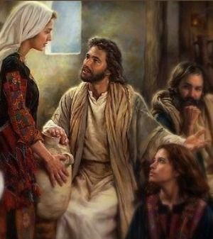
Martha and Mary
Luke 10:38-42
Source Image: “At Jesus’ Feet”, Nathan Greene Studio
Notes:
Another familiar story, and one that is unique to Luke, and it’s a short one, so I’ll read it, but again, I’d like for you all to think about, where is the tension? What is shocking or challenging here? TAKE 5 MINUTES FOR LARGE GROUP DISCUSSION
Jesus Visits Martha and Mary
³⁸ Now as they went on their way, he entered a certain village, where a woman named Martha welcomed him into her home. ³⁹ She had a sister named Mary, who sat at the Lord’s feet and listened to what he was saying. ⁴⁰ But Martha was distracted by her many tasks; so she came to him and asked, “Lord, do you not care that my sister has left me to do all the work by myself? Tell her then to help me.” ⁴¹ But the Lord answered her, “Martha, Martha, you are worried and distracted by many things; ⁴² there is need of only one thing.^{[a]} Mary has chosen the better part, which will not be taken away from her.”
Jesus befriended several individuals, including Martha, Mary, and Lazarus of Bethany where one can see “…that Jesus is at home here,” (224), and each sibling is described differently. Martha, who is kind and welcomes Jesus into the house, also occupies herself with the task of hosting and serving her guest. She has a quick tongue and does not hesitate to tell Jesus what is on her mind. Comparatively, Mary is quiet, more introverted, sits at the Master’s feet and is considered “…the ideal of Christian contemplation,” (227). Lazarus, on the other hand, is completely silent and is described as “one who He loves” (John 11:3). Jesus loves each of the siblings, and they serve as examples on how to balance a life of reflection and action.
The ease at which Martha calls out Jesus, and the way in which He lovingly responds to her demonstrates a certain level of comfort and familiarity. This same level of familiarity is what is needed with our colleagues, parishioners, and legislators, and that starts by building intentional relationships with them, and this takes time and dedication.
SMALL GROUP DISCUSSION – TAKE 7 MINUTES - Describe how you handle tension/conflict between family members, colleagues or parishioners. If it’s helpful, think of a particular example.
“Christianity…has always valued silence more highly than words,” (227) because all action must be rooted in the interior life. As a person who takes seriously the practice of putting one’s faith into action, I sympathize with Martha’s complaint that her sister was not helping because too often, individuals use reflection and prayer as an excuse to justify their inaction. I appreciate and do see how Martha’s work is balanced by Mary’s reverence, and how action must be deeply connected to Christ. All action is meant for God’s glory and to do His will. Lazarus, in his complete silence, is entirely open to God’s will and obediently listens to His command to come out of the tomb. These three siblings continue to serve as a great witness to how much they all loved Christ in their own way, and how Christ loved each of them.

Slide 7
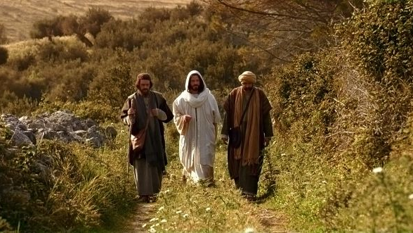
Questions?
Notes:
At this time, I’d like to thank all of you for your attention this morning, and I’d love to open it up for questions.

Slide 8
References
The Catholic Study Bible. Third edition. 2013. Edited by: Donald Senior, John J. Collins, Mary Ann Getty. The New American Bible (NAB) Revised Edition. New York: Oxford University Press.
Guardini, Romano. The Lord. 2021. Washington, DC: Gateway Editions.
Lee, Brian. 2022. Jesus in the New Testament. Lecture notes, Sacred Heart Seminary and School of Theology, Hales Corners, WI. February 21.
Powell, Mark Allan. 2018. Introducing the New Testament: A Historical, Literary, and Theological Survey. Second edition. Grand Rapids: Baker Academic.

