Slide 1


Managing and Resolving Conflict
Human Resources: Judy Shownkeen, John Barker, Rachel Uchytil

Slide 2
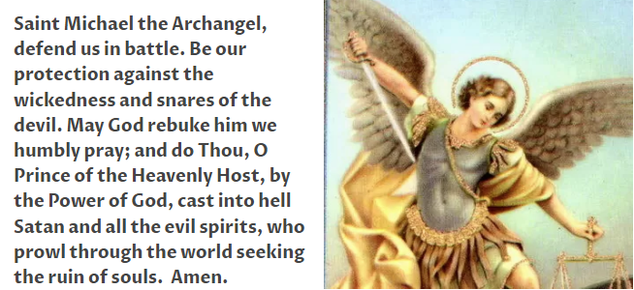
Prayer to St Michael the Archangel
Notes:
The reason we say this prayer - know that when there is unhealthy conflict – situations that feel more like ‘combat’ - we can feel lost, hurt, and alone in our struggle.
The only one who profits from unhealthy conflict is Satan – so try to focus on positive conflict – healthy debate.
Archbishop and Father Nathan have both recently mentioned ‘Trust God’ and ‘You aren’t alone’. What does this mean?
God’s promises to us, Mary, the saints. Trust them and share the work - pray. You aren’t alone.

Slide 3



Objectives of the Training
Understand types of conflict. (Discussion)
Tips to prevent unproductive conflict.
Tips for Win-Win conflict resolution. (Practice)

Slide 4
Types of Conflict
Relational: Style, values, motivation.
Task: Goals, priorities, competing for resources, what/when/how to do something, making decisions.
Both!
Notes:
Give examples of each:
Style – personality – what we see: direct vs passive, quiet vs expressive, Type A, Type B, competitive,
Values – relationship vs task, Loyalty, privacy, personal space, quiet, flexibility/personal time off, perfection, order, structure, simplicity, competition, tradition
Some people value stability and tradition.
Conflict is even more challenging when both Relational and Task conflict are in play. We need to understand ‘why’ there is conflict, so that we can address it accordingly

Slide 5
Discussion
Which of the types of conflict do you see in your parish?
Notes:
Table discussion or around the room, or if a team, this could be done on post-its, placed on a board, and then organized into groups for discussion.

Slide 6
Tips to Prevent Conflict
  Personal and “team” relationship building.
  Clear roles and responsibilities.
  Clear decision space.
  Open and effective communication.
  ‘Respect in the Workplace’ Training.
PRAYER
Notes:
Relationship and Team Building – in the beginning, when the relationship is new. Invest time in building relationships outside of doing the work. Create norms, common objectives.
Ice breakers before meetings. Styles training, joint expectations. Do exercises with your boss or coworkers: give/gets – what you provide/give, and what you ‘get’/need for support in your role;
Team development can address roles and responsibilities (including the leader), collaboration needs, overlaps, how to address tasks that don’t fall into any specific role, decision making.
Leader establishes decision space – by role, for key decisions especially decisions that impact other individuals/groups. Understand decision boundaries and decision processes, and how each role fits in.
Communication – clear, consistent, respectful, share communication preferences - phone/email/meetings, give/gets (what I give/you get and what you give/I get.). Be transparent in communication so that people don’t guess what you need or value. Silence may be interpreted as ‘OK’, so if you’re not ‘OK’, find a way to share.

Slide 7
Principles for Conflict Resolution
Everyone wants to feel valued and heard.
Everyone is unique. Different personalities and styles are not ‘bad’ – we just need to learn how to navigate them.
People usually have good intentions – you just need to find out what they are.
EMPATHY
Notes:
The ability to resolve conflict successfully is one of the most important social skills an individual can possess.
You can improve resiliency by practicing negotiation and debate.
Segue – ask the participants – when is conflict unproductive?

Slide 8
When Is ‘Conflict’ Effective?
As an agent of change.
Healthy debate enables us to make better decisions with more ideas, innovation, and creativity.
To uncover and address issues instead of avoiding them.
Notes:
Examples in parishes include parish restructures –different parishes with different traditions together need to work through change together, navigating different opinions, values/traditions, to build a future that looks different than the past. Also, if a new member to a parish staff arrives, they may bring new ideas that could lead to better results. Not engaging in healthy debate stifles creativity.

Slide 9
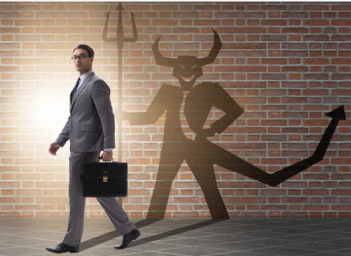
When is Conflict Unproductive?
When the underlying issues aren’t resolved.
When done without respect.
When one person wins and the other loses.
Notes:
Focusing on styles and personality vs the issues causes hurt feelings and sometimes grudges.
Using language, labels, sarcasm, and tone that harm.
Any scenario with one loser is lose-lose. Losers needs not met, anger, frustration, loser may lack of commitment to r sabotage this or other decisions, damage to relationship
What are the impacts of unproductive conflict? To the individual, to the organization
Segue – seeking win-win
Win-Win doesn’t mean that everyone gets what they want. That is unrealistic expectation.
Sometimes the solutions does not result in agreement.
An example of how people might feel is: “Well I didn’t like the outcome; however, I understand the discussion and at least I was treated with respect”
Win-Win: Minimizes differences, amplifies common objectives, considers everyone’s needs/wants

Slide 10
Tips for Win-Win
Set the stage:
    Who should be involved?
    Who has the information/data needed?
    Where is the best neutral location to have the discussion?
    Defer the discussion/conflict until you’re prepared.
    Seek a facilitator or ally.
Notes:
Avoid places that have distractions – noise, people…
Who should be involved? If the right people aren’t present, what can you do?
When are you ready? When your emotions are in check, when you have information that you need.
Seeking a facilitator or ally does not mean asking someone to fight the battle for you. Best when dealing with peers, issues with a leader.
Could help you to think out loud and prepare for engaging or being present in the meeting.

Slide 11
"If your brother or sister sins, go and point out their fault, just between the two of you.
If they listen to you, you have won them over.
But if they will not listen, take one or two others along, so that 'every matter may be established by the testimony of two or three witnesses.’
If they still refuse to listen, tell it to the church;
and if they refuse to listen even to the church, treat them as you would a pagan or a tax collector."
Objectives of Matthew 18: 15-17
Notes:
This should be understood within context and that Christians should never give up hope of reconciling with or converting someone, even their enemies.
There may need to be a break. Maybe forgiveness is one sided when reconciliation is not possible.
Recognize that the person may be ignorant or a sinner but decide the impact of cutting them off completely.
Through prayer and time, the person may one day find the grace for conversion. Pray.

Slide 12
Tips for Win-Win
2. Active listening - with respect:
  What I hear you saying is…
  Don’t spend time formulating your response when you’re supposed to be listening.
  Can you say more about that?
  Avoid telling the other person how they do/should think or feel.
    What does each party need vs want?
    Why is it important to each person?
    Address one issue at a time.
    Share the impact of words/behaviors on you.
Notes:
As the listener, you should be able to repeat back in your own words what they have said to their satisfaction. This does not mean you agree with, but rather
understand, what they are saying.
Pay attention to body language

Slide 13
Case Study – Table Discussion
1. Select two people who will role play a situation within a parish.
Review the scenario (handout)
Marijo should begin the discussion, with the goal of each person meeting their respective needs.
2. Others at the table observe and take notes.
Notes:
Rachel

Slide 14
Case Study – Tables Debrief
What went well?
Which elements of active listening did you see? What could have been done differently?
(Did Marijo or Peg use any of the Tips for Active Listening?)
  What I hear you saying is…
  Don’t spend time formulating your response when you’re supposed to be listening.
  Can you say more about that?
  Avoid telling the other person how they do/should think or feel.
    What does each party need vs want?
    Why is it important to each person?
    Address one issue at a time.
    Share the impact of words/actions on you.

Slide 15
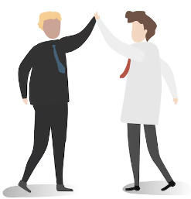
Tips for Win-Win
  3. Generate Solutions
  Seek common ground. What do you both agree to?
  Compromise. What are you willing to ‘give’?
  Discuss the impact of proposed solutions on others and the overall organization, using ‘what if’ questions.
  Don’t criticize ideas – understand merits and be objective.

Slide 16
Summary
  Prevent Conflict: Build healthy relationships, establish clear roles and responsibilities, and maintain respectful and effective communication.
  PRAY TOGETHER
  Empathy: Seek to understand the other person’s position.
  Meet in the middle.
Notes:
Rachel

Slide 17
Questions?

Slide 18
Thank You!

