Slide 1
Catechist Spirituality

Slide 2
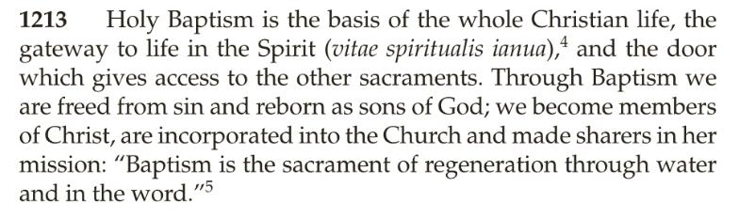

Slide 3
Catechesis “is related to the liturgy and to charity in making evident the essential unity of the new life which springs forth from Baptism.”
(Directory of Catechesis, 1)

Slide 4
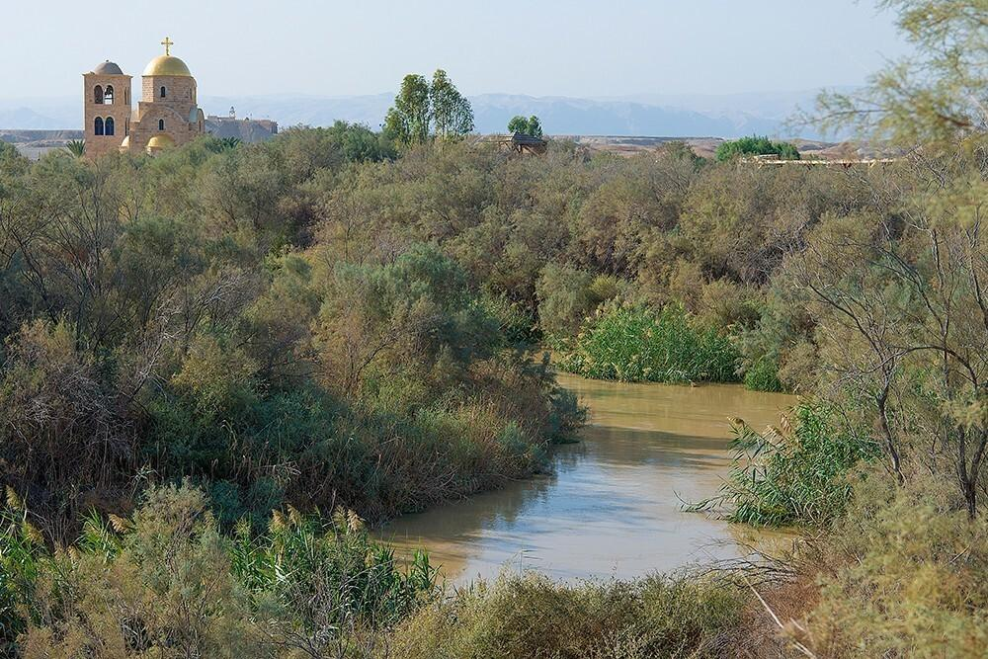

Slide 5
Review Your Prayer
What happened in your prayer?
What feelings did you experience?
During the prayer period, when did you feel encouraged?
When did you feel discouraged?
Did you receive the grace you asked for?
What did you receive?
Do you want to go back to the River Jordan and revisit this prayer?

Slide 6
Priest
St. Thérèse of Lisieux: “To pick up a pin, for love, can convert a soul”
Colossians 1:24: “Now I rejoice in my sufferings for your sake, and in my flesh I am filling up what is lacking in the afflictions of Christ on behalf of his body, which is the church.”
Morning Offering: For love of me, you came to earth
You gave your life for me.
So every day you give me now,
I give back happily.
Take all my laughter, all my tears,
Each thought, each word, each deed,
And let them be my all-day prayer
To help all those in need.

Slide 7
Prophet
SPEAK: A prophet speaks on behalf of another (God),
and points people to truth (eternal life)
LOVE: “The holy people of God shares also in Christ’s prophetic office; it spreads abroad a living witness to him” (Lumen Gentium 12)
BELIEVE: John 6:29: ““This is the work of God, that you believe in the one he sent.”

Slide 8
King
We are destined for royal GLORY! Don’t give into the “degradation of awe” (Pope Francis)
“By his obedience unto death, Christ communicated to his disciples the gift of royal freedom” so that they might rule over sin in themselves (Catechism of the Catholic Church 908)
We “exercise a kind of royal power” over ourselves (St. Ambrose)

Slide 9
Catechist Spirituality: Priest, Prophet, and King
How can you make an offering of yourself each day? (Morning Offering, Mass, etc.)
How can you share the Word of God and point people to heaven?
How can you reign over yourself (order your desires) and remind yourself of the GLORY Jesus promised?

