Slide 1
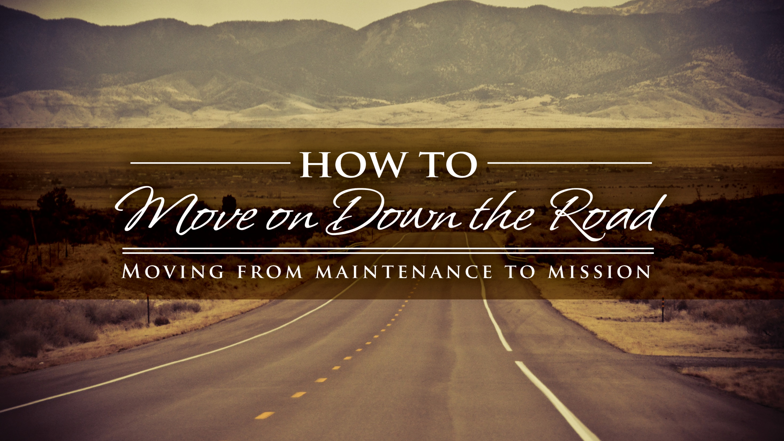
Notes:
Welcome, introductions, set the stage. CLICK

Slide 2

PRAYERFUL OF A FAITHFUL STEWARD
Most loving God, you have placed an important task before us.
There will be challenges, which we will meet bolstered by Your strength.
There will be decisions to make, which we will discern with Your guidance.
There will be work to do, which we will accomplish fed by Your grace.
We ask You to be with us as we work to enliven our parish communities.
Help us to see the great good that will be accomplished when we answer Your call to build the kingdom.
We ask this through Christ, our Lord.
Amen
Notes:
Let’s begin in prayer. This prayer asks God to be with us in our leadership groups and in our individual lives as we work to embrace intentional discipleship. Let us pray CLICK

Slide 3
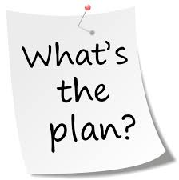
Recharge
Refresh
Refocus
Rethink
Notes:
Barb This morning is all about recharging and refreshing our spirits – and Father Maurice has certainly inspired us! In this session we hope to spark some refocusing and rethinking about some of the ways our leaders – pastors, parish staff members and lay leaders, can work collaboratively, using best practices in leadership development and organization management to benefit our parishes.
One goal for our time together this morning is to help synthesize many of the programs, learning and networking opportunities that you may have heard about, or be participating in. We know that sometimes it may seem that there are a hundred and one different programs, approaches and tools out there – and it can be confusing and overwhelming! Our hope is to look at this though the lens of some elemental building blocks.
But, before we talk about how to move on down the road, we need to take an honest look at what our parish’s rode looks like. CLICK

Slide 4


Notes:
Barb New directions call for new ways of thinking. One thing that we know for sure – we have to begin to break away from complacency and find “new ways” to be about our discipleship – spreading the gospel. A second thing that we can say with certainty is that new ways require change – and successful travelers must evaluate the road they will be following. CLICK

Slide 5

Notes:
(Michelle on roads)

Slide 6

Five minute
What does your road look like?
Notes:
Michelle 5 minute exercise

Slide 7


A Passion for Evangelization
and Discipleship
A Commitment to
a Healthy Organization
A Reliance on Prayer & Sacraments
Notes:
Barb In the roadmap that we shared at the leadership conference last year, and in the parish stewardship assessment that I do in parishes, the first area of focus is the Spiritual and Physical environment of the parish. The leaders in a given parish set the tone of that environment. Helping leaders focus on the mission of their parishes, and find ways to be intentional in their leadership and by extension their discipleship, we’d like to share three building blocks from The Amazing Parish organization.
Michelle The 3 building blocks of an amazing parish, and of the leaders in such a parish, are 1. a reliance on prayer and the sacraments, a commitment to a healthy organization and a passion for evangelization and discipleship. These 3 building blocks also apply to our leadership circles, our parish staffs, Councils and Commissions.
Barb When these three building blocks are firmly in place, a parish will be enveloped in the spirituality of stewardship. CLICK

Slide 8


Hail Mary, full of
ENERGY…
Notes:
Barb A reliance on prayer and the sacraments should be part of our makeup as individual Catholics. Individual prayer and participation in the sacraments brings us the grace we need to continue on our journey as intentional disciples. In a recent presentation to archdiocesan staff, Fr. Tim Kitzke told us about a professor in the Seminary who suggested that each time we speak or read the word “grace” we should substitute it with “energy”. Fr. Kitzke asked us to pray CLICK “Hail Mary, full of energy…”. The perspective of God’s energy shared with us really brings home the abstract concept of grace. CLICK

Slide 9
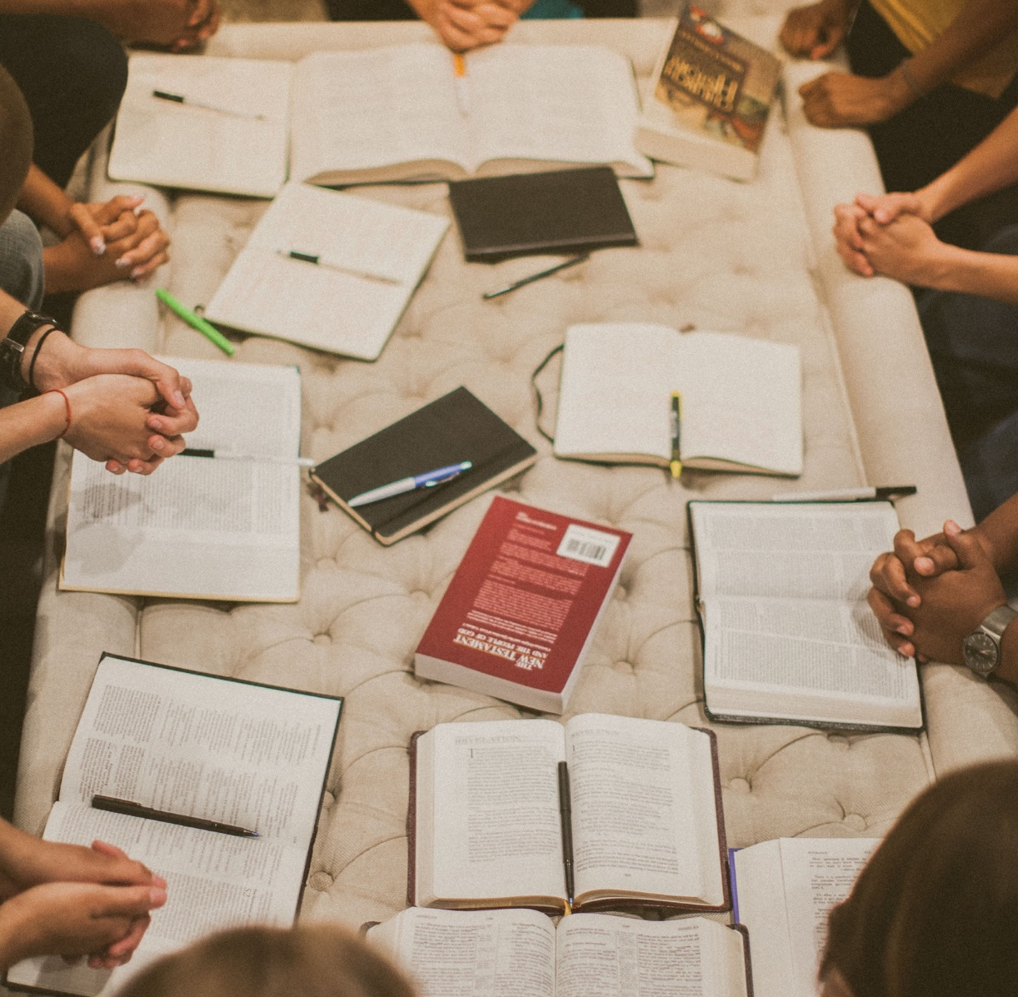
Pray together in a meaningful way
Attend Mass together
Attend adoration when offered
Plan a Council/Commission liturgy
Notes:
Barb Communal prayer and participation the sacraments are equally critical for our leadership groups – pastoral staffs, Councils, Commissions and Committees. How often has the person “assigned” to prayer forgotten his/her task, and a quick “Hail Mary” is said, in effect knocking off an agenda item so the meeting can really get moving. Parish leaders, with the decisions they make and the actions they take, set the course of the parish mission. How important is it, then, for these groups to call on God to share his “energy” with them in their deliberations, decision making, and visioning?
Pray together – in a meaningful way- as a staff, as Councils and Committees. Go to Mass together – it would not be too hard for a parish staff to attend a weekday morning Mass, or for Council members to agree to occasionally attend a weekend Mass as a group. In some parishes, the Pastoral Council attend 30 minutes of adoration prior to their meetings. Other parishes have a communal weeknight liturgy once a year for all Council and Commission members.
All of the models for a successful parish, where leadership groups work cooperatively as a unit, include participating in prayer and the sacraments together to build the spirituality of the group. To borrowing from and old, old, saying – the group that prays together leads together. CLICK

Slide 10


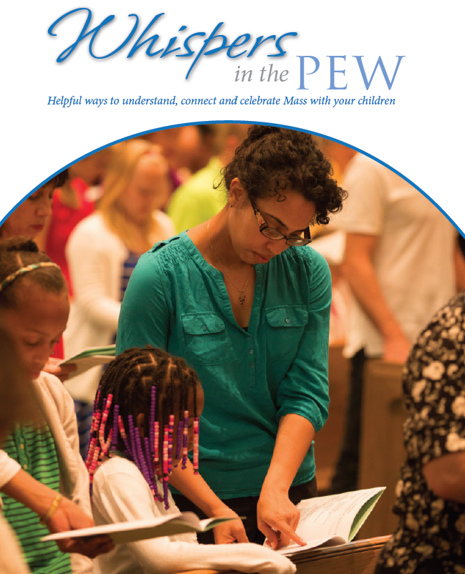

Notes:
Michelle Communal participation in prayer and the sacraments is equally critical for our leadership groups and the parish as a whole. The first focus of Synod implementation focused on the Sunday Mass. Resources like the Evangelization and the Sunday Mass Guide and the newly released Whispers in the Pew speak to ways to make our liturgies welcoming and vibrant. CLICK

Slide 11

Notes:
Michelle As Catholics working or volunteering in parish leadership, we can see the obvious benefits of beginning our efforts from a place of prayer, seeking God’s guidance. From that essential spiritual foundation, Catholic leaders are recognizing that it is also critical for us to commit to using best practices that help all organizations function in a healthy, effective and impactful ways. As members of the Church of the 21st century, we need to look at concepts like stewardship, discipleship and evangelization in new ways.
Parish leaders, staff and parishioners alike, must examine innovations in individual leadership development, team building, visioning, goal setting, planning and assessment so that we will have the ability to meet ministry needs now and in the future. Let’s look at resources that are available and on the horizon for to our various leaders and leadership groups. CLICK

Slide 12
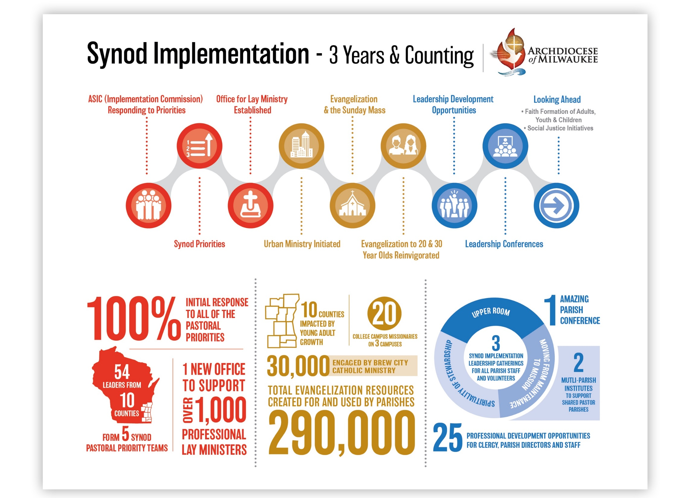
Notes:
Michelle

Slide 13







Parish Stewardship Tool Box
Office of Planning & Councils
Notes:
Michelle

Slide 14

Makes connections between ministry and activity groups.
Rooted in spirituality and best practices.
More than time/talent/treasure
Vision and mission centered
Engine and energy to move a parish forward.
Notes:
In a healthy parish, the organization includes strong, well focused commissions and committees. One resource for our lay leaders that can be overlooked is the Commissions and committees manual. This resource, first and foremost, explains the rational behind the Commission structure. The standing commissions were not established simply because we like bureaucracy. The Commissions play a very important role in making our parishes function as healthy organizations. The manual is available on the archdiocese website, and the descriptions, member makeup, subcommittees and more about the standing commissions can be found within.
Just a couple of questions for you to consider in regard to all of the Commissions within your parish. Does every commission have regularly scheduled meetings? This sound elemental, but you might be surprised at the number of groups that meet on an “as needed” basis – and when that is the case the “need” often becomes less and less. Do you have regular or period common meeting nights when all of the commissions are present to report, communicate and perhaps plan together? Does the Pastoral Council ask each Commission for their goals – not to direct, but to be aware of ways each commission is collaboratively moving the parish toward the greater vision? Do your commissions seek collaboration with each other and other ministry groups.
Every Commission plays a role in moving a parish from maintenance to mission– and often the most MISunderstood group, but the one that can have the most impact over time - is the Stewardship Commission.
I won’t go too deeply into the structure and workings of the stewardship commission today – but know that I’m happy to meet personally any time to talk about this in detail. For today, let’s just say that a strong stewardship commission with a good plan formed around the mission of the parish, can be the difference between making progress and spinning our wheels. The Stewardship Commission, working in a healthy collaboration with the Councils and the other Commissions, can be one of the significant drivers in building a healthy organization. If you currently have an active Stewardship Commission – you know what I mean. If you have the beginnings of a commission, or have yet to move in that direction, please give me a call. I’d be happy to talk to you about where to begin – including doing a parish stewardship assessment. CLICK

Slide 15

A Parish Stewardship Assessment
Spiritual & Physical Environment | Parish Worship |Stewardship Formation & Education Communications Tools | Gratitude | Time & Talent | Financial Stewardship
Notes:
The assessment provides a strong foundation for planning, which is critical for a healthy organization.
The roadmap which we shared last year is based on the stewardship assessment. There are copies of the roadmap on your table which will give you a feel for some of the specifics that the assessment addresses.
We’ve spoken this morning about moving down the road – making progress toward increasing our capacity for mission and ministry. Doing a baseline assessment tells us where we are and helps us establish measurable goals that will have the desired impact and outcome we seek. Successful parishes assess, plan, implement and reassess - increasing their capacity for ministry. Some of you are from parishes that have done the stewardship assessment and know the value of the data gathered. If you have any questions on the assessment, I’d be happy to speak with you when we conclude.

Slide 16

Notes:
Michelle
As a parish council or staff
Is there a vision for the parish
Do you know what the mission of your parish is?
Hold regularly scheduled staff meetings?
Discuss current and coming events across ministry “borders”?
Think about collaboration opportunities when planning programs

Slide 17

Notes:
Michelle Our final question for you this morning is this: Let’s say that 50 new people join your parish in the next couple of months. Among them are families, a millennial or two, some senior folks and perhaps a person or two returning to their faith. Other than “signing them up”, giving them the standard welcome packet and, of course, their envelopes, what will you do to engage these newcomers? What are your plans now and for the future – and how can you move one step closer to becoming the amazing center of faith and action that you want your parish to be? How will you move on down the road?

Slide 18
What would you do?
Where are you on the road map?
Notes:
Michelle 10 minute exercise.

Slide 19
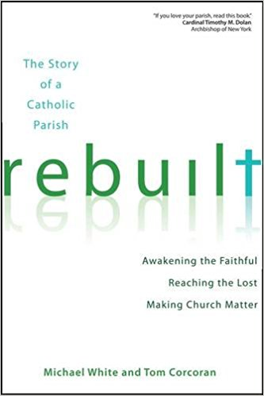
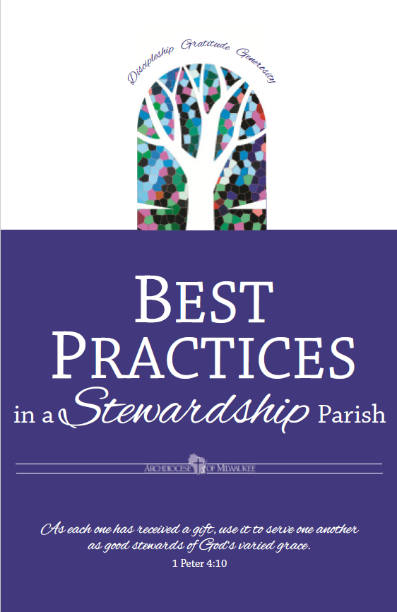
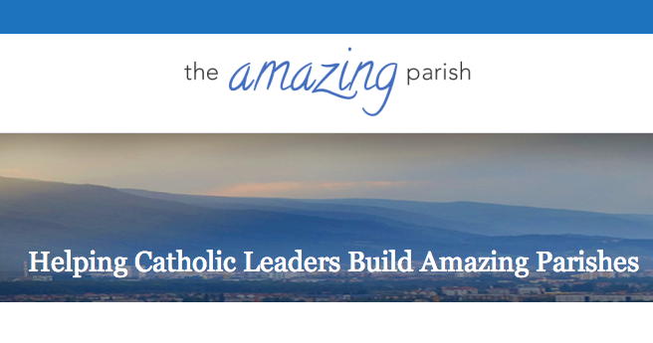


Notes:
Michelle There are many resources on best practices in building a stewardship culture. However, the success of any list of action steps, any stewardship plan, any course you set will depend significantly on parish leadership – pastor, staff and lay leaders. A cohesive team, with members grounded in the vision for ministry of the parish, is the most significant factor in moving a parish from maintenance to mission. Without dedicated, cooperative, collaborative leadership, it is very difficult for a parish to advance it’s mission and move on down the road to becoming an amazing, vibrant parish. CLICK

Slide 20
A Passion for Evangelization
and Discipleship
A Commitment to
a Healthy Organization
A Reliance on Prayer & Sacraments
Notes:
Michelle The final building block is a passion for evangelization and discipleship. And – we’ll add a passion for living as a faithful steward to that mix. This passion is a natural outcome in a parish where the leaders are steeped in prayer and spirituality, and a healthy, collaborative working atmosphere exists.
Barb Our message for you today is to resist the urge to be content with maintenance. Make the conscious decision to build a healthy organization that will have all it needs – and more – to fulfill its mission. Know that Michelle and I, and others here in the central offices are here to help.
QUESTION IF TIME

Slide 21
Closing prayer
Most loving God, you have placed an important task before us.
There will be challenges, which we will meet bolstered by Your strength.
There will be decisions to make, which we will discern with Your guidance.
There will be work to do, which we will accomplish fed by Your grace.
We ask You to be with us as we continue this adventure in faith.
Help us to see the great good that will be accomplished when we answer Your call to build the kingdom.
We ask this through the intercession of Jesus, our Lord.
Amen
Notes:
Michelle. We began in prayer and we will end in prayer.. This prayer asks God to be with us in our leadership groups and in our individual lives as we work to embrace intentional discipleship. Let us pray CLICK

