Slide 1
Business Manager Update
August 19, 2021

Slide 2
Agenda
“Parish Connector”
Welcome and Opening Prayer
Introduction of Jenny Moyer
Updates from Chris Brown
LOA, Property Tax, Software updates
COVID-19 Reminders
CFS Changes & Updates

Slide 3
Prayer
“Parish Connector”
August 19, 2021: Together in Faith
Jesus, my Savior, I come to You today, To ask for Your blessing in prayer. Through the love You give to me, Please make me more loving and aware. For people around me, May I be a sign You are near. Should I meet with sorrow, Let me be Your hand to dry a tear. You are always with me, My hope when others might despair. May the faith you give to me Be a gift that I gratefully share. Amen.

Slide 4
Love One Another Capital Campaign

Slide 5
Love One Another Campaign Plan: 2021
$150 Million Capital Campaign
Campaign split 60% to Parish / 40% to Archdiocese
Campaign fees paid for by the Archdiocese
Funds will be received in a trust fund separate from the Archdiocese
Parish Case Statements will need to be developed as part of the process
Area of Activity | 2021
 | A | M | J | J | A | S | O | N | D
IV. Pilot Parishes Confirm continued parish interest in pilot participation through individual meetings Launch and conduct pilot parish Wave |  | Preparation |  | Active Fundraising
V. Wave 1 Parishes Prepare first Wave of parishes for January launch |  |  |  |  |  |  |  | Preparation
Notes:
Case & material development; leadership; lead gifts; pilots

Slide 6
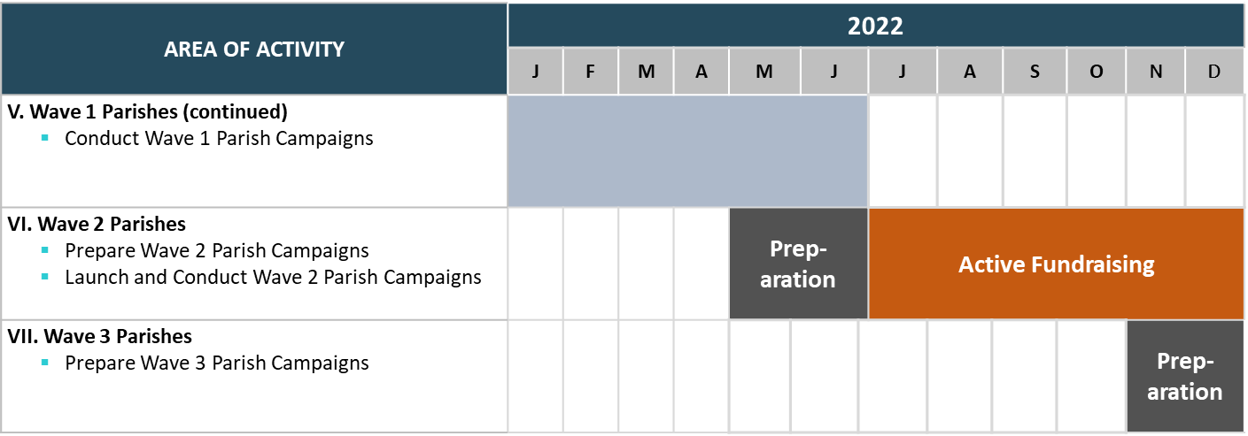
Notes:
Case & material development; leadership; lead gifts; pilots

Slide 7
Parish Finance Updates
Real Estate Taxes
City of Milwaukee / Other Municipalities Fair Share Program Communication
Taxing jurisdictions to “encourage” tax-exempt taxpayers to make some sort of payment for municipal services, such as for police & fire protection, snow plowing, etc.
Payments have been referenced as “Payments in Lieu of Taxes”, or PILOTS
Municipalities are now referencing these payments as “Fair Share” payments
In some instances, have gone so far as to recommend the amount of such payments
These programs are voluntary – You don’t have to pay them
If a parish were to participate in a Fair Share/PILOT program, you can pay less than the suggested amount
Software
Common Financial Systems for Parishes

Slide 8
COVID-19 reminders
“Parish Connector”
Katie Esterle

Slide 9
PPP Reminders
“Parish Connector”
PPP-1
Most parishes have received PPP-1 forgiveness
There are only 5 that we don’t have record of receiving forgiveness
PPP-2
Parishes must submit a proxy request to accept a PPP-2 loan. A separate proxy request must be submitted when PPP-2 loan forgiveness is received.
We have record of 52 parishes or schools receiving PPP-2 loans.
Record Retention of PPP Records
Retain all records relating to the PPP loan and forgiveness application for 6 years

Slide 10
Employee Retention Tax Credit
“Parish Connector”
All parishes are eligible for the ERTC because of the Wisconsin Safer at Home Order that went into effect on March 17, 2020
Parishes in the Archdiocese have received over $2.7 million in credits.
Over 20 parishes are working with Wegner CPAs
If you haven’t yet applied, please call the Parish Finance Office so we can discuss the potential credit amount and next steps.

Slide 11
Emergency paid sick leave
“Parish Connector”
Under the Families First Coronavirus Response Act (FFCRA), covered employers were required to provide eligible employees with paid sick leave for qualifying reasons. The mandated program ended on 12/31/2020. Employers would voluntarily provide these benefits through 3/31/2020.
The American Rescue Plan Act (ARPA) extended the optional benefits (EPSL and EMFLA) to be effective from 4/1/2021 through 9/30/2021.
The Archdiocese of Milwaukee recommends parishes and schools to extend both leave programs to their employees. The extension of the programs should be communicated to your employees.

Slide 12
School specific COVID-19 relief programs
“Parish Connector”
EANS
The purpose of the EANS program is to provide services or assistance to eligible non-public schools to address education disruptions caused by COVID-19.
Administration of the program is through the local Cooperative Educational Service Agency (CESA 6)
64 schools in the Archdiocese have received EANS funds, totaling almost $20 million
Upcoming deadline for past reimbursement requests: September 30, 2021
E-Rate Expansion
Provides additional funding for laptops, tablets and other technology expenses
All E-Rate eligible entities are eligible
Free Hot Lunch
Expanded free hot lunch program for the 2021-2022 school year
See BAAM website for additional information

Slide 13
CFS Changes & updates
“Parish Connector”
Denise Montpas

Slide 14
CFS: Template Changes & Updates for 2020-21
“Parish Connector”
No significant changes in 2020-21
Updated deanery codes to break out Kenosha and Racine
Expanded Account 2130:
First Row: PPP-1 Loan Payable
Second Row: PPP-2 Loan Payable
Moved Account 3455.3 Other Pandemic Assistance on the Data Entry worksheet:
From “Restricted Funds”, Column L
To “COVID-19 Relief”, Column N

Slide 15
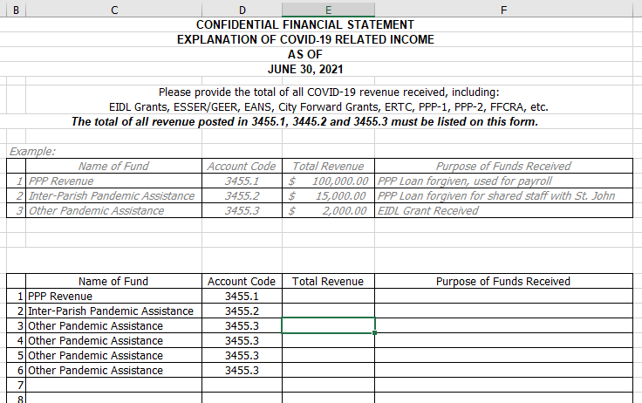
CFS: Reminder, Template Update from 2019-20
“Parish Connector”
COVID-19 worksheet added in 2019-20:
Worksheet is intended to provide additional information around COVID-19 income
An error message will appear if the amounts entered on this worksheet do not equal the sum of the amounts entered on the Data Entry worksheet, for accounts 3455.1, 3455.2 & 3455.3
Use one row for each unique COVID-19 revenue item
Optional commentary section at the bottom

Slide 16
CFS: Top 5 Tips
“Parish Connector”
The more closely aligned your chart of accounts is with the Archdiocesan COA, the easier this process will be.
Communicate! If a deadline extension is needed, email Katie or Denise. Otherwise you are at risk of a 15% assessment penalty.
Reference the Instructions worksheet in the template – it is quite helpful ☺
Do not “cut and paste” or “drag and drop” between cells. This changes formulas, creates errors.
The CFS should reconcile to your parish financials.
Utilize the Balance Sheet worksheet and the P&L worksheet from the CFS template to compare

Slide 17
CFS: 5 Common Mistakes
“Parish Connector”
Missing data from top of the Data Entry worksheet
Deanery codes are on the Archmil website
Student counts should agree to the count provided to the Archdiocesan Schools Office for the third Friday of September (in 2020)
Other “easy to miss” items:
Unrealized gains and losses (market change) should be entered on the Data Entry worksheet in rows 224-225
Contribution to another school (subsidy) should be entered on the Data Entry worksheet in row 218
Be prepared to provide additional information on unusual items:
Negative revenue or expense
Restricted revenue and expense
Special Collections for Others, if Revenue (account 3070) does not equal Expense (account 4690)
Significant variance to budget (net surplus or deficit)
Make sure there is not an error message on the following worksheets: COVID-19, Restricted & Debt Recon, Explanations
Alternatively, provide commentary as to why the difference is appropriate
Restricted funds should be listed separately on the Explanations tab, and the purpose fully explained
If your parish has so many restricted funds, Katie or Denise can update your template for additional rows

Slide 18
CFS: Submission Tips
“Parish Connector”
Please send electronically (workbook, coversheet and Choice audit, if applicable)
Coversheet should be sent along with your submission
If there will be a delay due to availability of signors, communicate anticipated timing of coversheet to Katie and Denise (but okay to send workbook in the meantime)
In the case of subsequent changes to your CFS, a new coversheet should be prepared and submitted
Acknowledgements by Parish Finance Office:
Upon receipt of CFS
Final acceptance of CFS submission

