Slide 1
CFS Training
8/20/2020

Slide 2
Prayer
In his First Letter to the Corinthians Paul cites "administrators" as one of God's gifts to the Christian community. But many who serve in administrative service today have difficulty seeing how their everyday work is an expression of discipleship. Loving father, please help us to see our work as an expression of discipleship. Let others see the work we do as necessary functions of administration that are deeply rooted in the Scriptures and are a genuine expression of our call to discipleship. We thank you for this gift and pray that we continue to use it to help build your kingdom.
We pray this in your name, Amen.

Slide 3
Confidential Financial Statement (CFS)
What is the CFS?
The CFS Process.
Each worksheet, with comments on certain data points
Helpful hints along the way

Slide 4
What is the CFS?
The annual Confidential Financial Statement (CFS) is a group of financial documents prepared at the end of the fiscal year by all parishes of the Archdiocese of Milwaukee. Since there is no common accounting software among parishes, the workbook is in Excel.
The data contained in these reports is used to calculate the archdiocesan assessment as provided for in Canon 1263 of the 1983 Code of Canon Law, for strategic planning purposes, for reporting to the NCCB, for proxy determinations, and for other analytical purposes. It is confidential in that it is not public record.
Besides the assessment, the CFS produces a Balance Sheet, P&L, information on restricted funds, and school financial data.

Slide 5
The CFS Process (Steps 1-6)
Parish prints final financial statements. If affiliated organizations are not part of your internal financials (they should be), make sure you have their data available to enter in the CFS.
Download CFS template from Archdiocesan website.
Enter data into “Data Entry” worksheet on CFS. This should reconcile to your parish financials.
The more closely aligned your chart of accounts is with the Archdiocesan COA, the easier this process will be.
Review the CFS with your Pastor (Parish Director), Trustees and FC Chair. Have them sign a coversheet.
Submit the excel workbook and the signed coversheet to Parish Finance.
-Email the CFS workbook in excel and the coversheet in PDF.
You will receive an email confirming receipt.

Slide 6
The CFS Process (Steps 7-12)
Parish Finance Office reviews the CFS
If there are questions or revisions need to be made, Parish Finance will follow up with the person who submitted the report and copy the Pastor/Administrator.
Once a final CFS is received and approved by the Parish Finance Office, you will receive a confirmation email.
Your financial data is summarized into reports used by the Archdiocese.
The assessment is calculated based on the data in the CFS.
Assessment billing typically happens in October. Expect to receive a statement soon after that. If a final (accepted) workbook is not received by that date, your parish will be charged a 15% penalty.

Slide 7
The CFS Workbook Sheet 1 - Instructions
The first worksheet provides detailed instructions on filling out and submitting the CFS. Please read the instructions, they are quite helpful.

Slide 8
The CFS Workbook Sheet 2 – Data Entry
This is where you will spend most of your time on the CFS. This is the first of four worksheets that require you to input data.
Please fill out all of the data points at the top of the worksheet.
Do not cut and paste or drag and drop within any cells.
The Data Entry worksheet includes a full chart of accounts, by department, that need to be filled out according to your parish internal financial statements.
Fundraising income is the only income account that should be reported as net. Fundraisers that lose money should not be reported as negative income, but as expenses. All other income should be reported as gross.
Review all of your figures for reasonableness and compare to last year’s CFS to ensure correct data entry on the CFS and accounting in your internal books through the year.
If your parish has investments, make sure unrealized gains and losses (market change) are entered on the Data Entry worksheet in rows 223 and 224. Do not include market change as investment income.
Notes:
Does every department need to be filled out?
What if your internal financials don’t reconcile to the CFS?
This typically happens if you do accounting “different” than the Parish Financial Management Manual.

Slide 9
The CFS Workbook Sheet 2 – Data Entry Cont’d
The bottom line on the Data Entry worksheet should reconcile to your P&L and Balance Sheet on your parish’s internal financial statements.
Take a look at your parish’s bottom line P&L. Is this close to your parish budget? If not, provide an explanation to the Parish Finance Office when you submit your CFS.
Special Collections for Others (Revenue Account 3070) received should be the same as the disbursements that are recorded (Expense Account 4690). If they do not equal each other, please provide an explanation to the Parish Finance Office when you submit your CFS.
Notes:
Does every department need to be filled out?
What if your internal financials don’t reconcile to the CFS?
This typically happens if you do accounting “different” than the Parish Financial Management Manual.

Slide 10
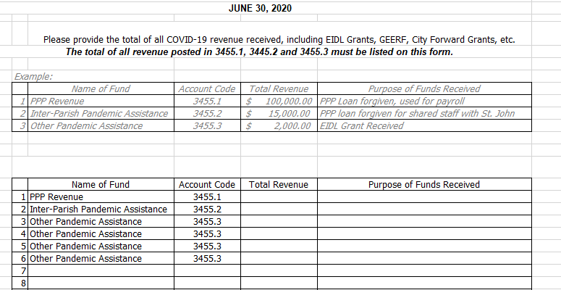
The CFS Workbook Sheet 3 – COVID-19
This is the second of four worksheets that require you to input data.
Denise will go over this in detail later in this presentation.
Notes:
Why do we do this?

Slide 11
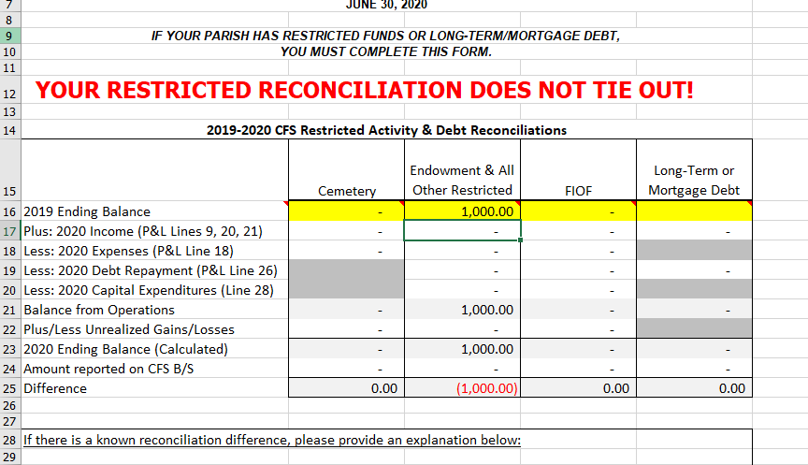
The CFS Workbook Sheet 4 – Restricted & Debt Recon
This is the third of four worksheets that require you to input data.
This worksheet is used to track and reconcile restricted funds and mortgage debt.
Enter your 6/30/2019 ending balances in the yellow boxes
Verify these numbers against your 2019 CFS. (They should be the same)
Make sure you have no reconciliation differences before submitting your CFS.
Notes:
Why do we do this?

Slide 12
The CFS Workbook Sheet 5 – Explanations
This is the fourth of four worksheets that require you to input data.
Parishes are required to fill out information on restricted funds, not including cemeteries.
Dollar Amount
Purpose of the Funds
Only include truly restricted funds in your restricted fund balances
The CFS is set up to verify that the values on the Explanations worksheet reconcile to the Balance Sheet.
Notes:
Why do we do this?

Slide 13
The CFS Workbook Sheet 6 - Balance Sheet
Based on the figures provided on the Data Entry worksheet, a Balance Sheet is populated.
The accounts are consolidated for easy review, with restricted funds being recorded separately.

Slide 14
The CFS Workbook Sheet 7 – P&L
Based on the figures provided on the Data Entry worksheet, a P&L is populated.
The accounts are consolidated for easy review.
For more accurate financial reporting, the P&L is separated into four categories
1. Operating
2. Restricted
3. Faith in Our Future
4. COVID-19 PPP

Slide 15
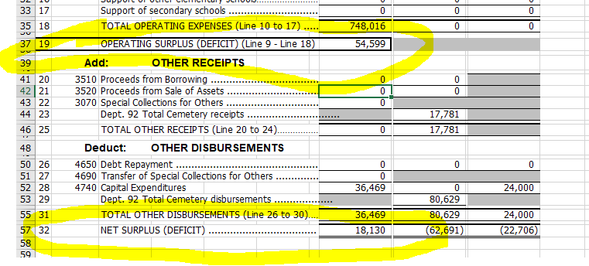
The CFS Workbook Sheet 7 – P&L cont’d

Slide 16
The CFS Workbook Sheet 8 – School
Based on the figures provided on the Data Entry worksheet, school financial information is populated.
A P&L specific to the school is populated with other key financial data points:
1. Cost per student
2. Parish subsidy (investment)
Schools that participate in any of the Choice programs must report their financials on the Archdiocesan modified cash method of accounting. (Note: This may differ from your audited financials)

Slide 17
The CFS Workbook Sheet 9 – Assessment
The Archdiocesan assessment is calculated based on the figures provided in the CFS.
For 2020-2021 (based on 2019-2020 income), parishes will be assessed at 5% of their unrestricted income.
There are two deductions that parishes can receive.
1. A parish may subtract 10% of their long-term debt from their assessable income.
2. A parish receives a credit based on their enrollment. The credit is calculated using the average cost per student in the Archdiocese.
This credit is only for parish schools, not consolidated or collaborative schools.

Slide 18
Hmmmm – No one ever told me that before
Cash vs. Accrual
The Archdiocese requires a modified method of cash account. (AKA – hybrid cash). It is modified because most entries are required to be on a cash basis, but there are a few exceptions.
The unpaid portion of teacher contracts and the related benefit expenses should be accrued at year end.
Outstanding accounts receivables (tuition), prepaids, accounts payable and deferred revenue should all be recorded at year-end.
Proxies
Proxy approval is required for all FIOF disbursements
Parishes must request proxy approval upon receipt of PPP loan forgiveness
Parishes must request proxy approval for all rent, lease and facility usage agreements
Revenue Recognition
Memorials are typically not restricted
Rent from a priest living in a rectory is considered rental income

Slide 19
CFS Changes and Updates

Slide 20
CFS Changes and Updates
New accounts listed in the COVID-19 Manual
A new account (#4770) for reporting shared expenses between parishes and system schools
An additional worksheet for tracking COVID-19 income

Slide 21
New accounts listed in the COVID-19 Manual
New
Column
Data Entry Worksheet
Liabilities: Acct XX-2130 PPP Loan Payable (excel row 76)
Revenue:
Acct XX-3455.1 PPP Revenue (excel row 141) PPP loan amount from Lending Institution
Acct XX-3455.2 Inter-parish Pandemic Assistance (excel row 142) Revenue or contra-revenue between parishes and/or schools
Acct XX-3455.3 Other Pandemic Assistance (excel row 143)

Slide 22
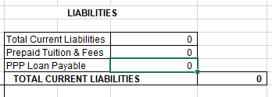
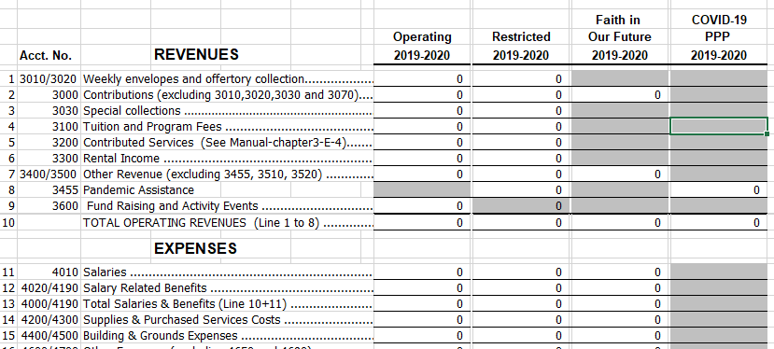
New accounts listed in the COVID-19 Manual (cont’d)
Balance Sheet Worksheet
(populated automatically)
PPP Loan Payable
P&L Worksheet
(populated automatically)
Row 8: 3455 Pandemic Assistance
Column: COVID-19 PPP

Slide 23
New account: XX-4770, Shared Expense Reimbursement
Rolls up under account 4600 Other Expenses
May be positive or negative, depending on whether the parish or school passes expense (negative) or receives expense from another parish or school
Reminder: Reimbursement for expenses is reported as a reduction in the appropriate expense category, not as income.
Example: Parish A has a Facility Usage Agreement with School B to pay for the school’s portion of utilities, maintenance, and shared staff. For the year, this totaled $75,000. Parish A would show ($75,000) in account 4770; School B would show $75,000.
Alternatively, Parish A and School B could adjust each of the utility, maintenance, salaries, benefits, etc. accounts individually.

Slide 24
New worksheet: COVID-19
Worksheet is intended to provide additional information around COVID-19 income
An error message will appear if the amounts entered on this worksheet do not equal the sum of the amounts entered on the Data Entry worksheet, for accounts 3455.1, 3455.2 & 3455.3
For most parishes/schools, this will be blank for the 2019-20 CFS
Exceptions: Receipt of Other Pandemic Assistance (other COVID related grant revenue); Choice audit adjustment to record PPP revenue in 2019-20
Use one row for each unique COVID-19 revenue item
Optional commentary section at the bottom

Slide 25
Questions?
Powerpoint presentation and Zoom meeting recording will be made available

